Slide 1
WOMEN ORDAINED IN
THE CHURCH OF ENGLAND
AN ACCOUNT OF THE JOURNEY
Notes:
In 2004, 20 years after our ordination as priests, women came to St Paul’s Cathedral in London to celebrate with the Archbishop of Canterbury. But the campaign for women to be ordained priest in the Church of England began long before, in 1920, when the subject was debated for the first time – and the vote to proceed was lost.
My account begins in 1987.

Slide 2
The first women deacons in the Church of England were ordained in 1987
Christine was ordained deacon in 1989
Notes:
It was in 1987 that the first women deacons were ordained in the Church of England. Some of them had been ministering in the church as deaconesses for many years.
I had started training for ordination in 1986, and was ordained deacon in 1989.
The path had not been easy. I had given up my job in order to train and I expected to be paid and housed after ordination in the same way as the men with whom I had trained. The (female) Dean of Women’s Ministry thought I was asking for too much. I moved with my husband and three children to another Diocese where I was paid and given modest housing.
I was a pioneer, aware that how I behaved would be seen as “this is what women deacons are like”. Initially a few members of the congregation were uncertain, but soon accepted me. One woman thanked me for helping her to face her prejudice.

Slide 3
Notes:
But this was the reality -

Slide 4
Notes:
graphically illustrated. After a year as deacons the men were ordained priest, the women were not. I was always having to explain to people in the parish why I was not allowed to be a priest, why I couldn’t preside at the Eucharist.
When we debated locally with those opposed they would say: “don’t take it personally” but it was very personal, because they were saying that I was mistaken in my call from God to be a priest. That was very painful.

Slide 5
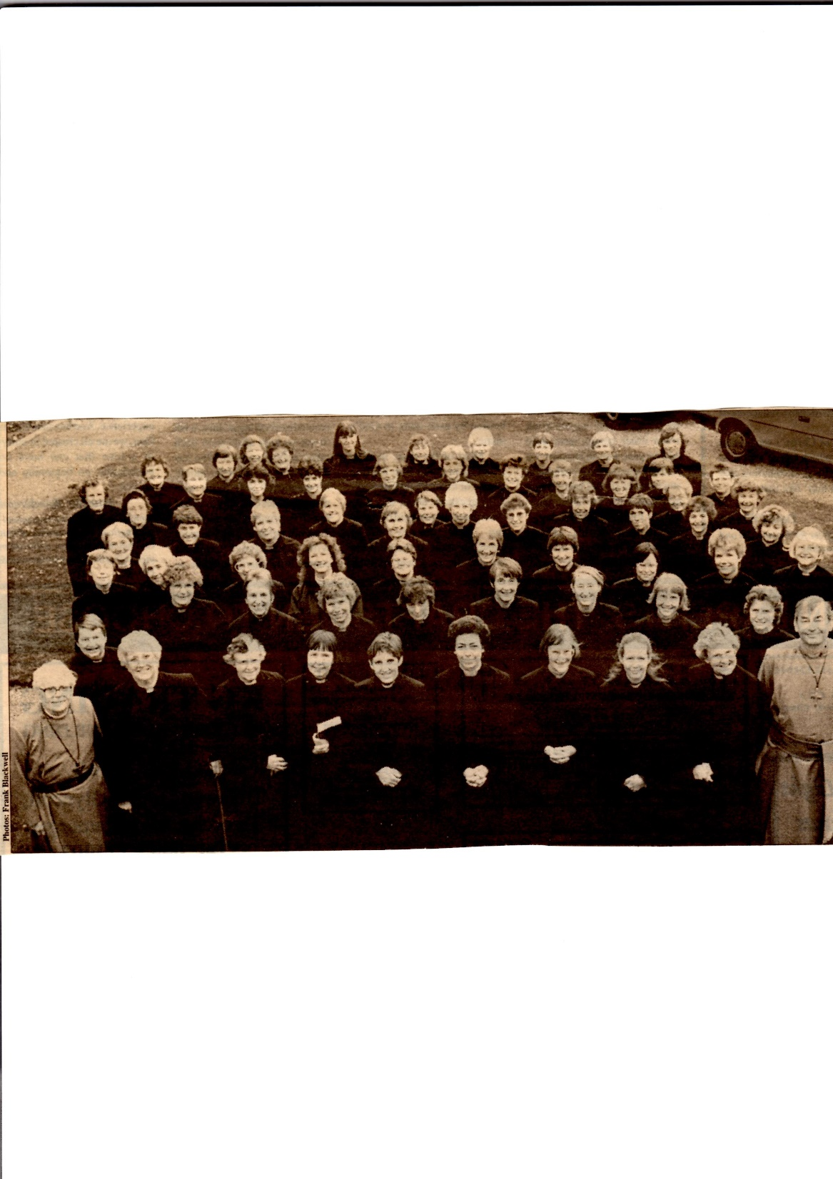
Notes:
There was great joy when our General Synod voted in favour of women’s ordination to the priesthood on 11th November 1992. I was booked to be interviewed by BBC Radio immediately after the vote was announced. So I had to prepare two statements: one for if the answer was “yes” and one for if the answer was “no”.
The vote had needed a two thirds majority in each of three houses – laity, clergy and bishops. As the established church there also had to be legislation in our state parliament. It was 1994 before we could be ordained. 1300 of us across the country, 66 of us pictured here in the Diocese of Oxford….

Slide 6
1994: Women ordained as priests in C of E
Notes:
……in 6 services over two days in April.
My call had now been confirmed by the Church, One of the differences it made for me was that what been described as “the problem of women” had become the problem of those opposed – their problem, not mine.
However, the bishops were concerned that many clergy would leave the church. So they brought in an Act of Synod, with very little debate. A church council of a parish could pass a resolution saying that they would not accept a woman priest. This meant that discrimination against women continued.
Several bishops were appointed to give “Extended Episcopal Oversight” to those parishes which would not accept their own (male) diocesan bishop because he had laid hands on women to ordain them. They were known as “Flying bishops” and the theory that lay behind the need for them was described as a “theology of taint” although they always denied this description.

Slide 7
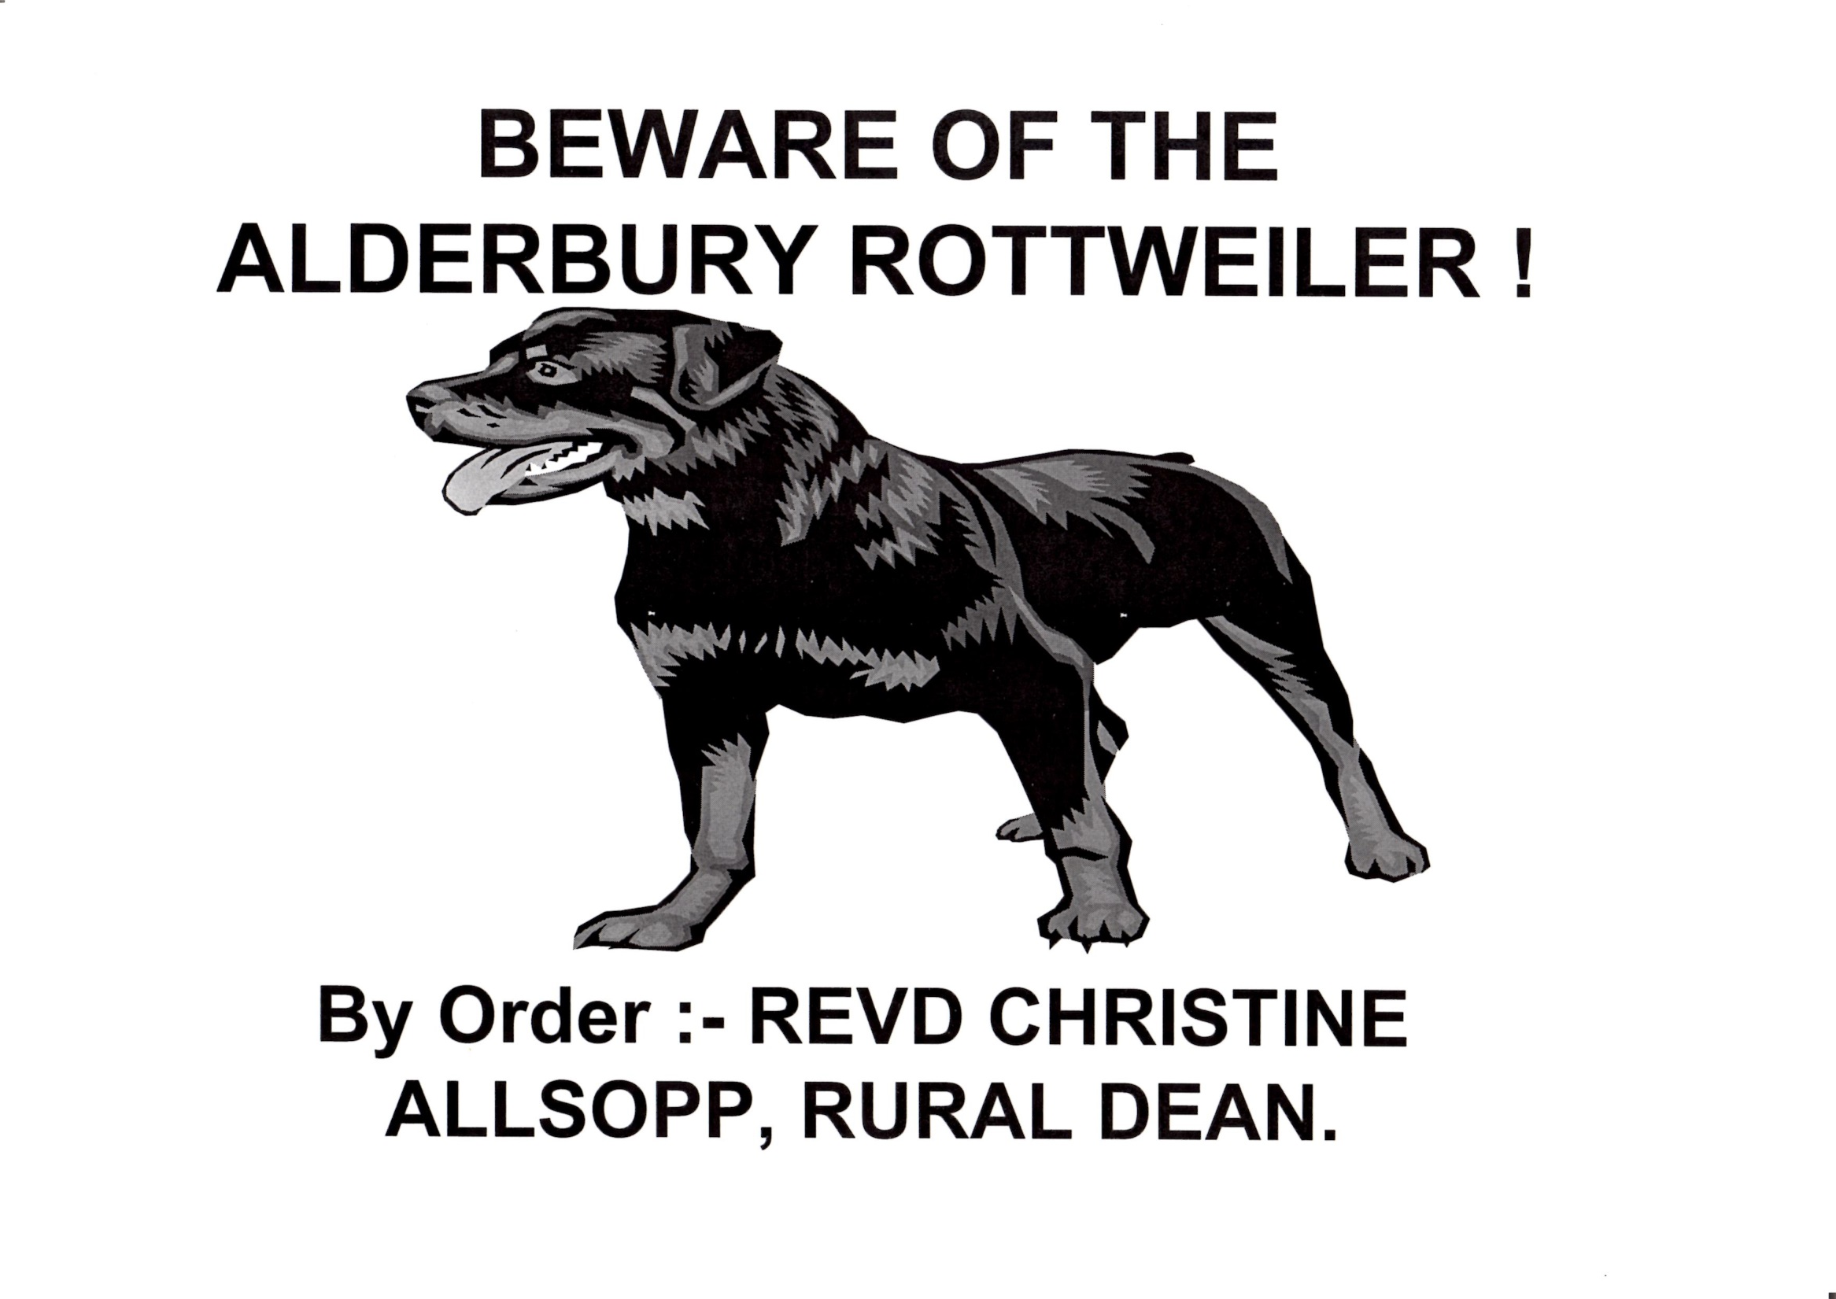
Notes:
Perceptions of how women are supposed to behave were often slow to change. By 1999 I was a Team Rector (that is, a team leader) of six parishes and also the Rural Dean of the Alderbury Deanery with a responsibility for all its parishes. I was called a “Rottweiler” by one of the churchwardens (lay leaders), like a bullying dog. If women were assertive, if we exercised leadership, then we could be seen as bossy, even bullying. My supportive husband made a joke of it.
In one of my parishes a churchwarden, a retired army colonel, was very anxious when I chaired my first church council meeting. He admitted to me afterwards that he had thought that a woman would not be capable of chairing a meeting well.

Slide 8
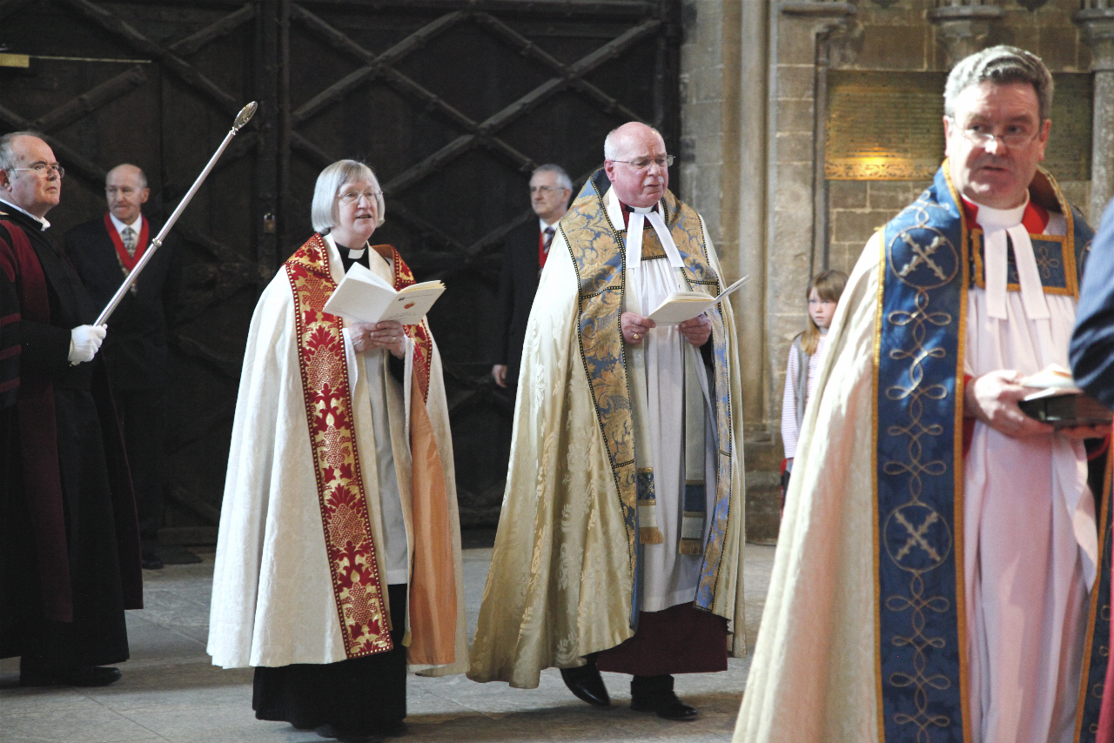
Notes:
At the beginning of 2005 I was appointed as the sixth woman Archdeacon in the Church of England, a senior post, traditionally described as “oculus episcopi” (“the eye of the bishop”). An archdeacon is expected to “ bring to the bishop's attention what calls for correction or merits praise” (Canon C22) in their archdeaconry. In my case the archdeaconry had 180 parishes.

Slide 9
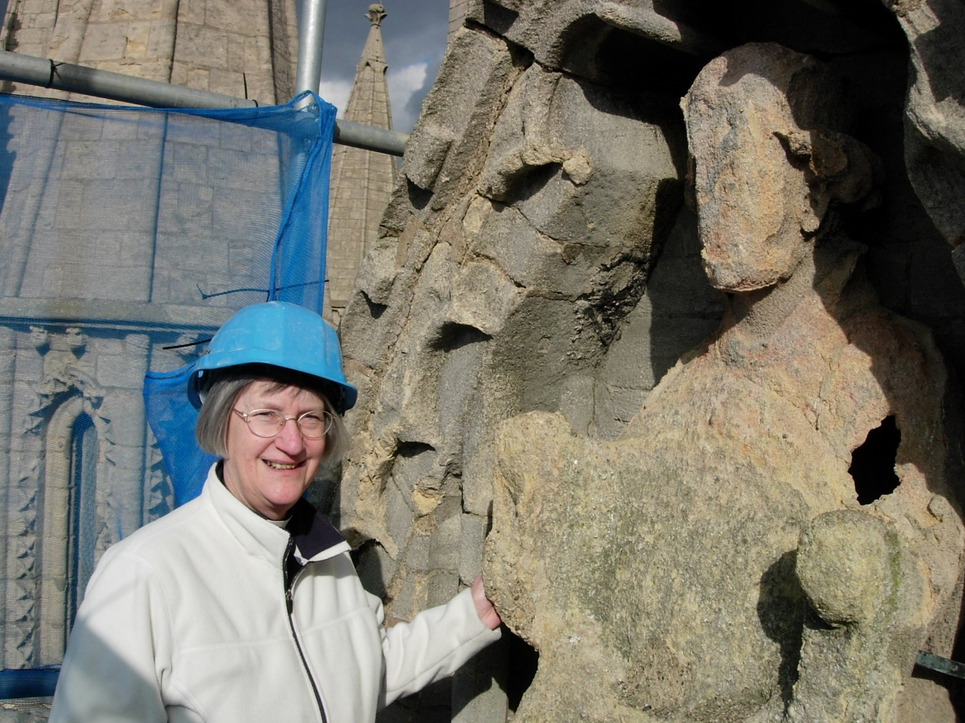
Notes:
I had responsibilities relating to the church buildings…

Slide 10
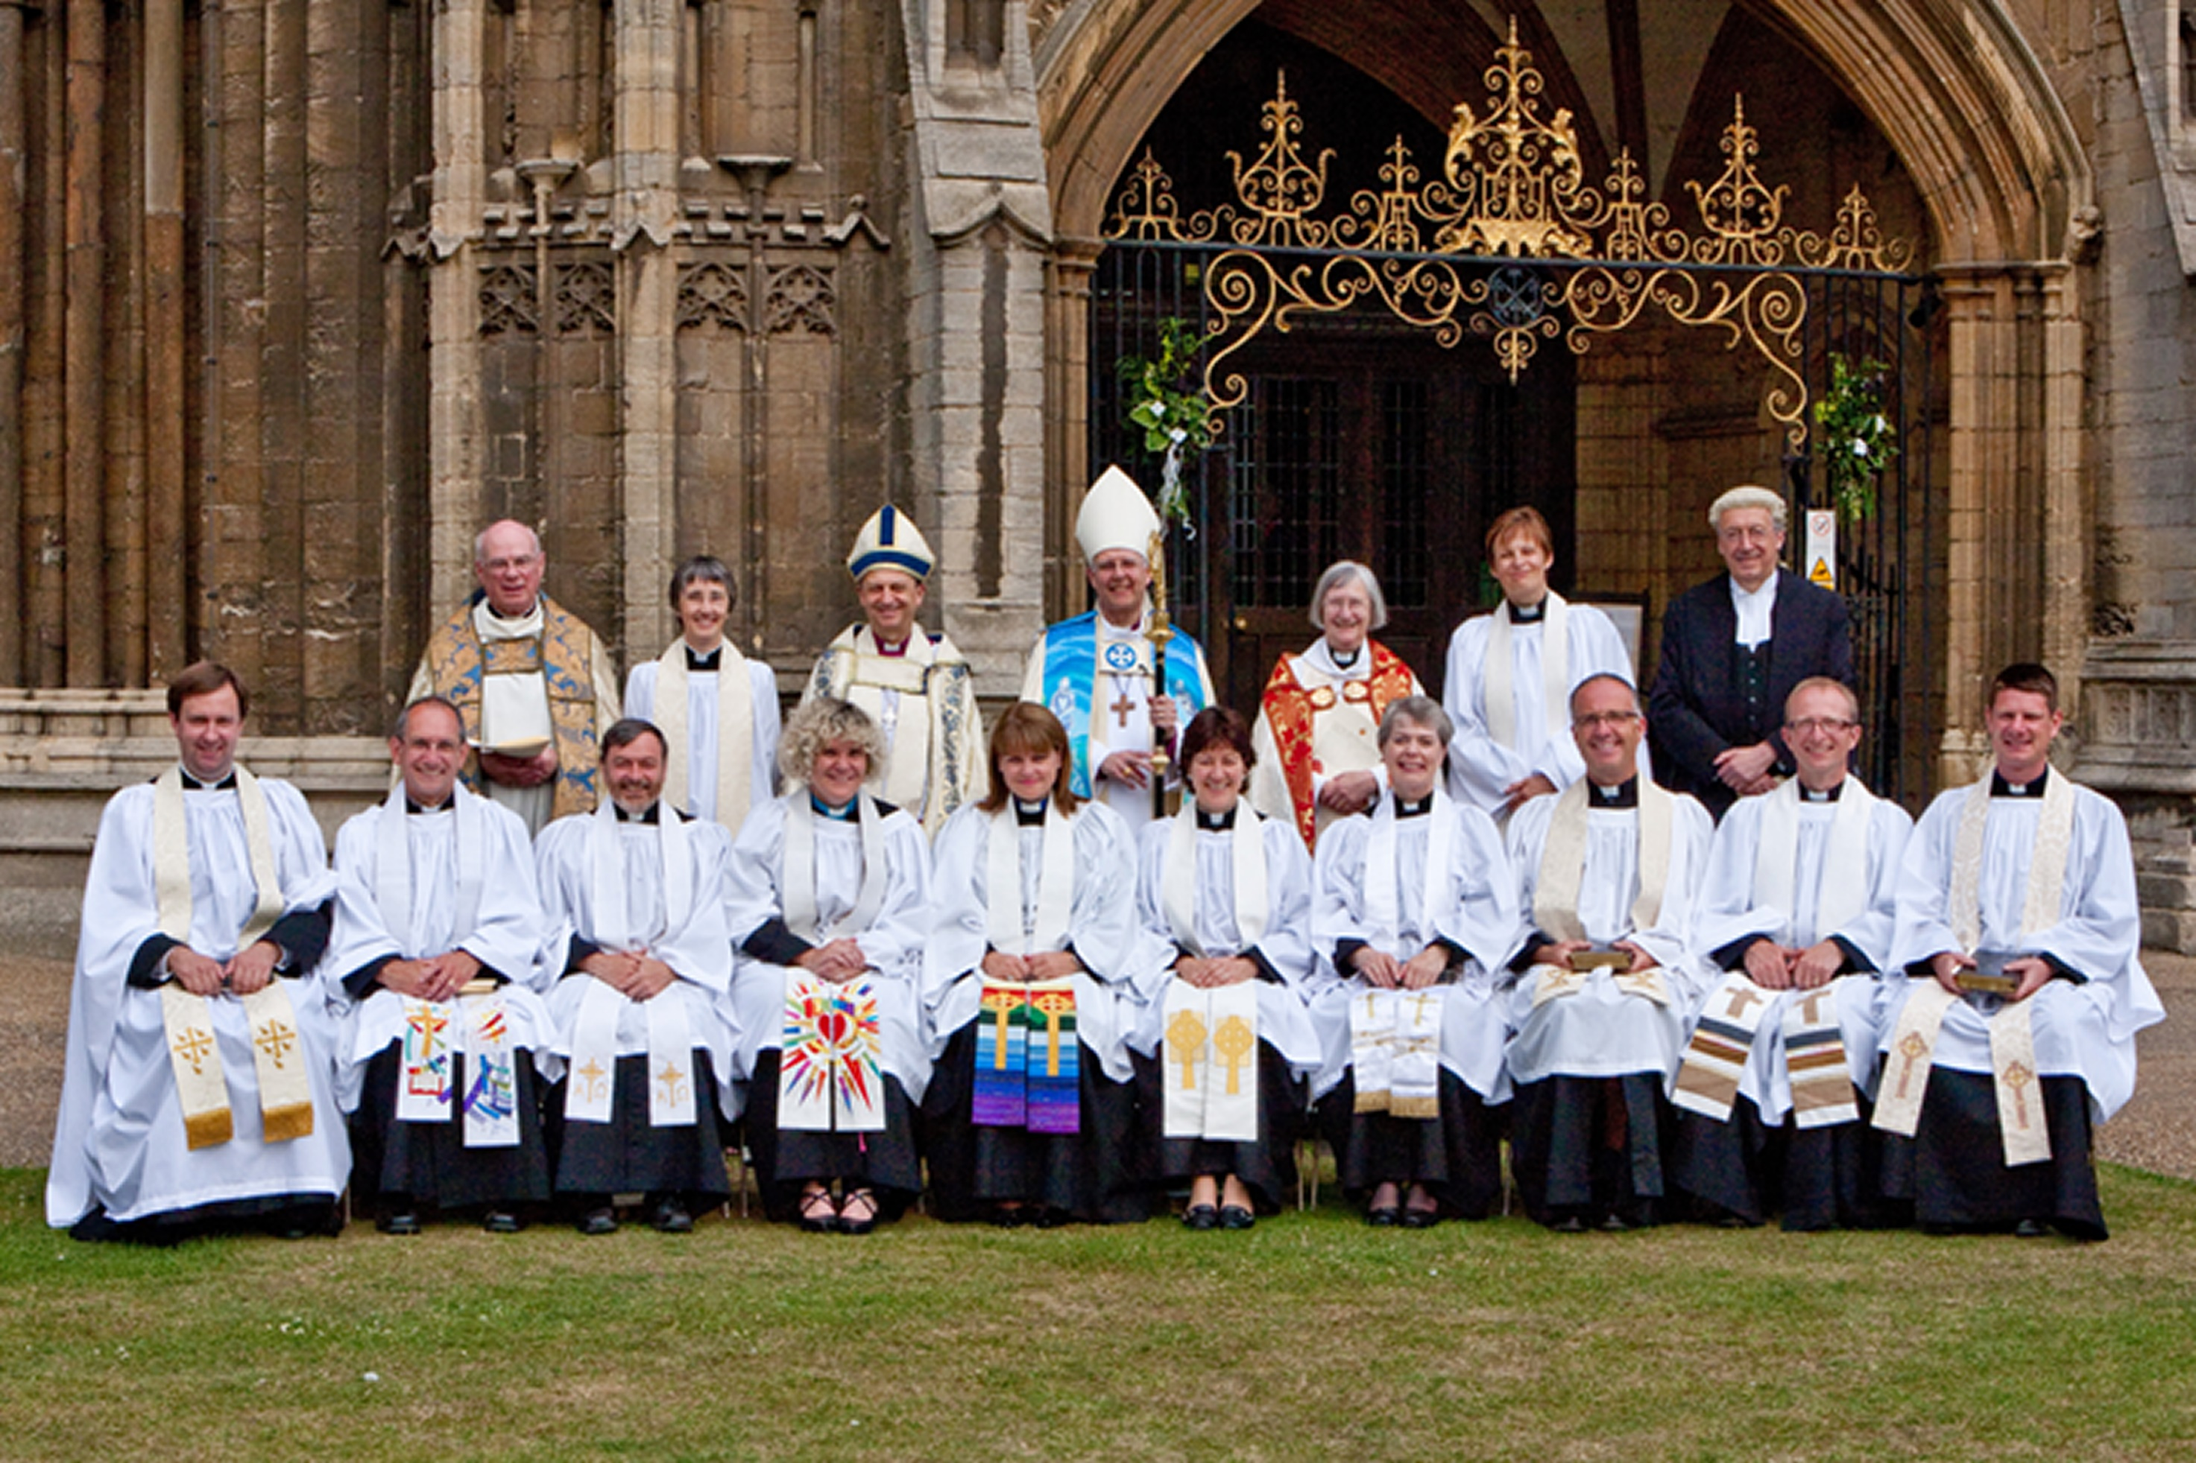
Notes:
….presenting candidates for ordination, and sharing with the bishop the pastoral care of the clergy. This included dealing with the appointment and discipline of the clergy.
Even the parishes that did not accept that women could be priests realised that they had to work with me, especially if they needed my permission for work to be undertaken on their church buildings or if they needed a new pastor to be appointed.

Slide 11
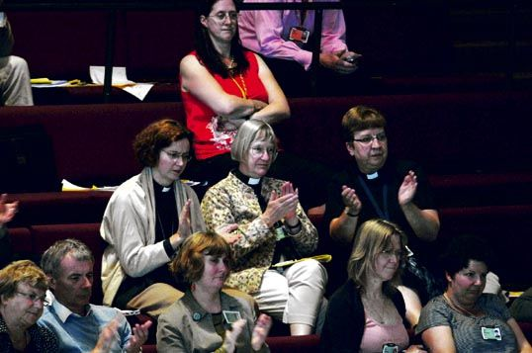
Notes:
I was elected to the Church of England’s General Synod in 2005.The process for allowing women to be bishops had started in 2000. It was a long, slow, painful process. We had to hear repeated over and over again the arguments against ordaining women at all. The focus was on provisions to help those opposed to stay within the church rather than removing discrimination against women. The language of “protection” from us women was frequently used.
We fought against having anything discriminatory enshrined in the primary legislation. Nevertheless, once again, the Church sought exemption from UK Equality Legislation.
In 2010 draft legislation was sent to the dioceses of the Church of England to be voted on by Diocesan Synods. 42 out of 44 voted in favour.

Slide 12
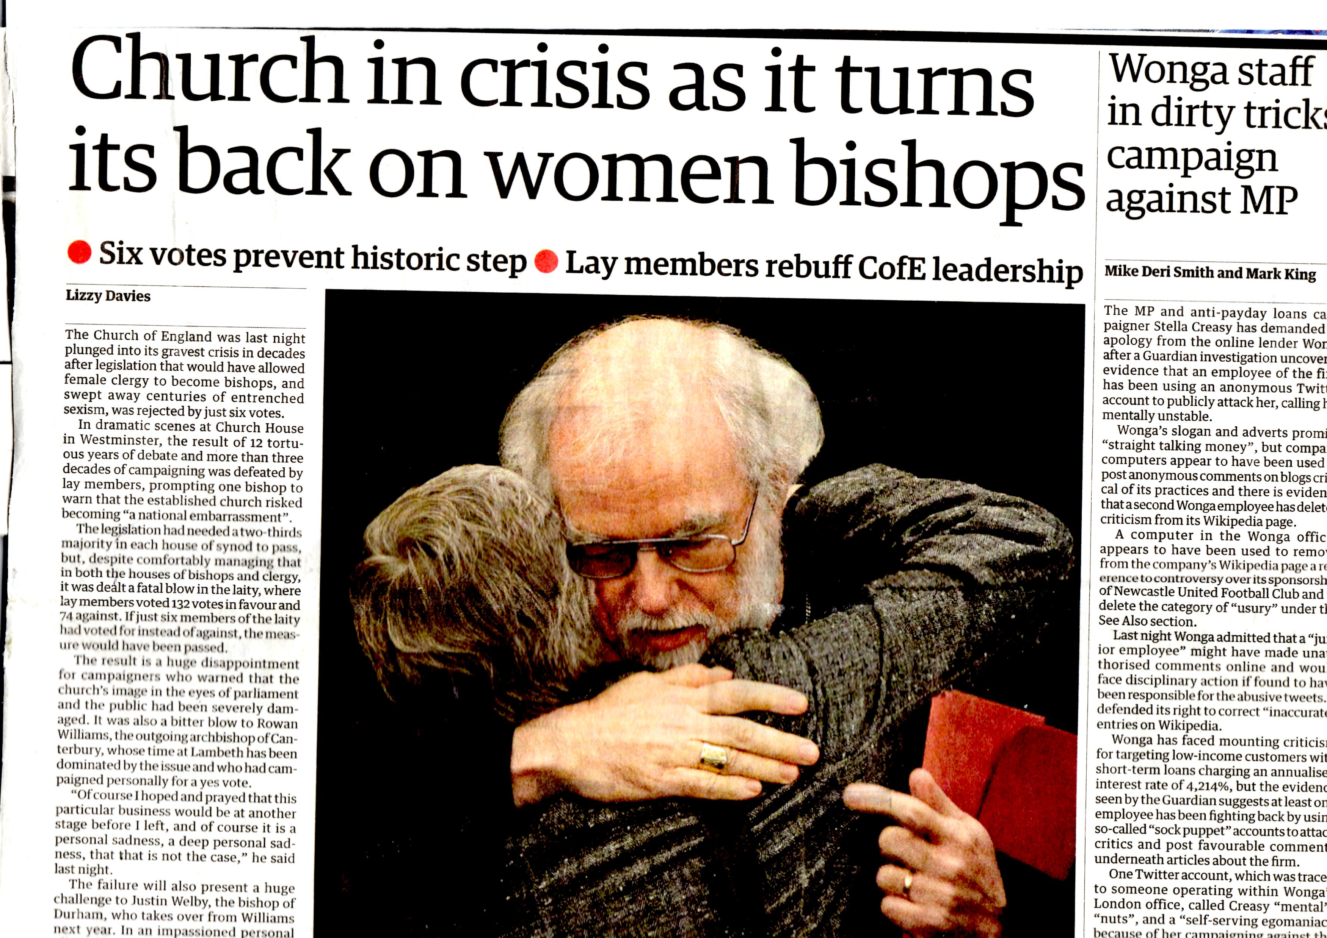
Notes:
After various attempts to amend the draft legislation, in 2012 it came back to General Synod for “Final Approval”. Once again, it needed a two thirds majority in each of its three Houses. It failed by 6 votes in the House of Laity.
We were all in shock. I was very despondent. I started to think about retirement. I could not see how, as a senior leader, I could defend the official position of the Church of England any longer. At the beginning of 2013 I gave notice to my bishop of my intention to retire towards the end of the year.

Slide 13
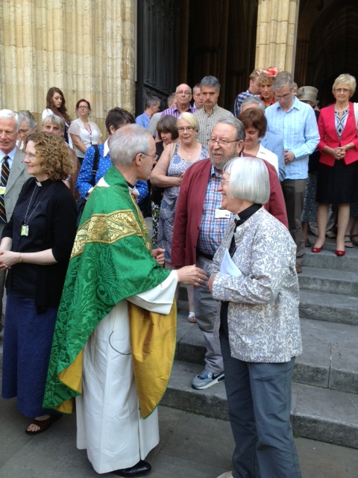
General Synod July 2013
A new Archbishop of Canterbury, and after “Facilitated Discussions”, the legislative process moves forward at a quicker pace.
Notes:
The July 2013 General Synod was my last and the first for our new Archbishop of Canterbury, Justin Welby. We shook hands on the steps of York Minster. He had experience of processes for reconciliation and initiated “Facilitated discussions” between members of General Synod with opposing views. The legislative process was speeded up. At a final vote in 2014 the measure to allow women to be admitted to all three orders of ministry was passed at last.

Slide 14
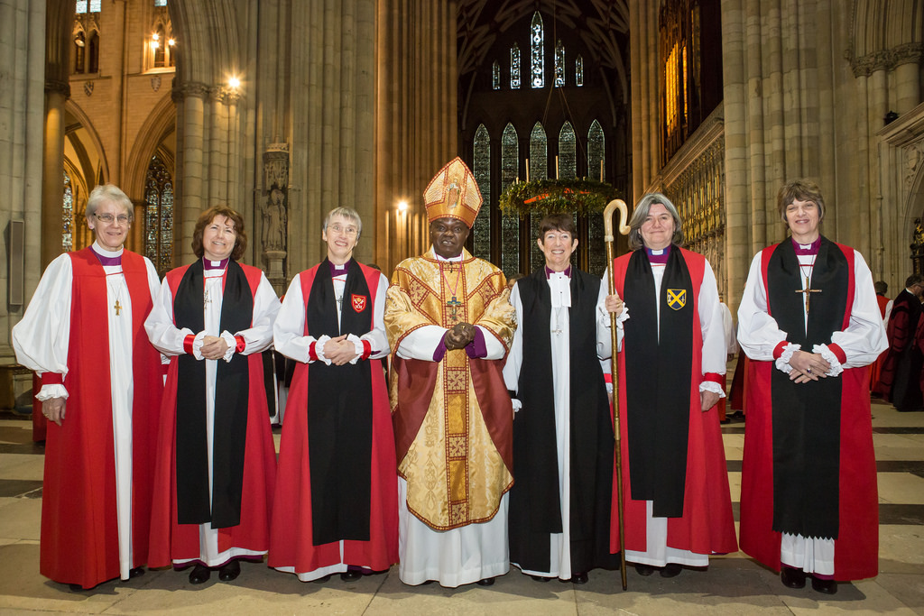
10 women have now been appointed as Bishops
Notes:
From 2015 until the present day 10 women have been appointed as bishops. Here are five of them, together with a bishop from the US on the left of the picture, and the Archbishop of York.

Slide 15
WHAT DID WE LEARN?
Support each other as women and welcome male supporters
Organise MOW and WATCH campaign organisations
Engage with the opposition
Persevere 90 years campaigning for women to be bishops
Keep a sense of humour
Notes:
Support: our male supporters were important as they often had more influence than we did.
Organise: the campaigning organisations were very important: MOW the Movement for the Ordination of Women campaigned for women priests; WATCH Women and the Church campaigned for women bishops as one of its objectives and continues to have a vision of the Church of England as a community of God’s people where, regardless of their gender, justice and equality prevail.
Engage with the opposition: we did not want them to leave the church. By engaging some of them changed their minds.
Persevere
Keep: a sense of humour – show WATCH tea towel (A Woman’s Place is in the House – of Bishops), this was one way of keeping cheerful, and they made wonderful presents!

