Slide 1

CEC/CCME Summer School – Rights under threat - Stand up for refugees & migrants
Addressing statelessness in Europe
Palermo, 4 July 2017
Chris Nash
Director, European Network on Statelessness

Slide 2


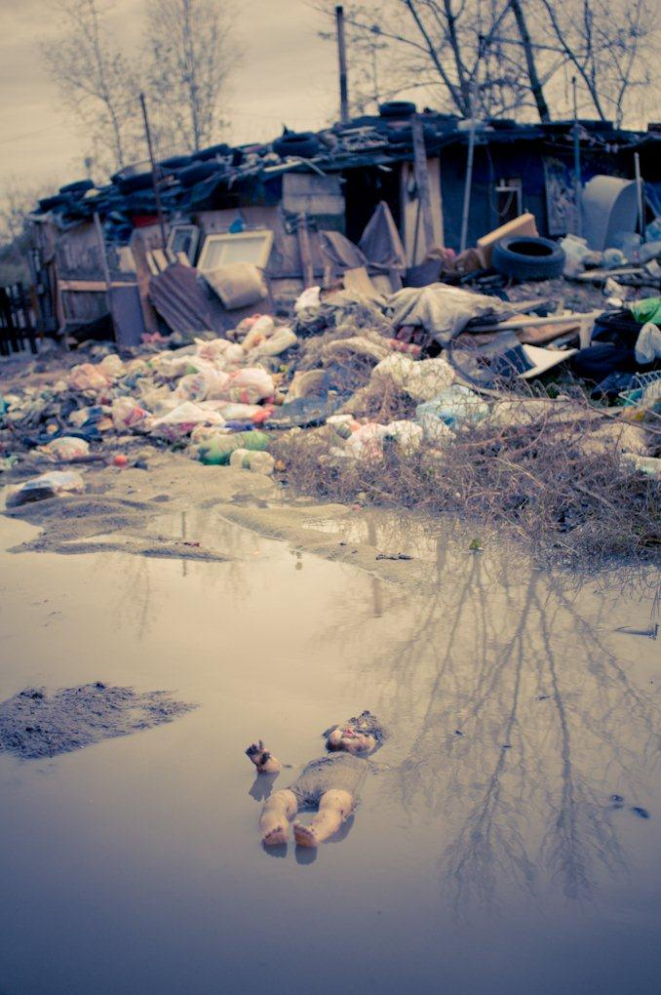

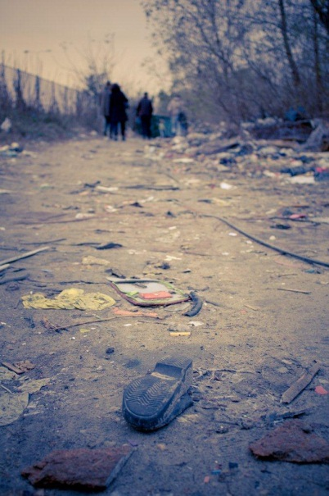
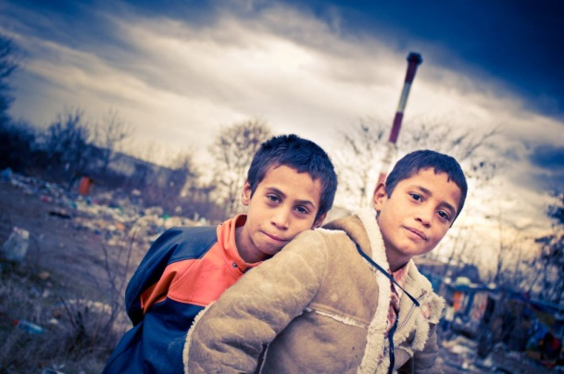
European Network on Statelessness
The European Network on Statelessness (ENS) is a network of non-governmental organizations, academic initiatives, and individual experts committed to address statelessness in Europe.
We believe that all human beings have a right to a nationality and that those who lack nationality altogether – stateless persons – are entitled to adequate protection.
We are dedicated to strengthening the often unheard voice of stateless persons in Europe, and to advocate for full respect of their human rights. We aim to reach our goals by conducting and supporting legal and policy development, awareness-raising and capacity building activities.

Slide 3
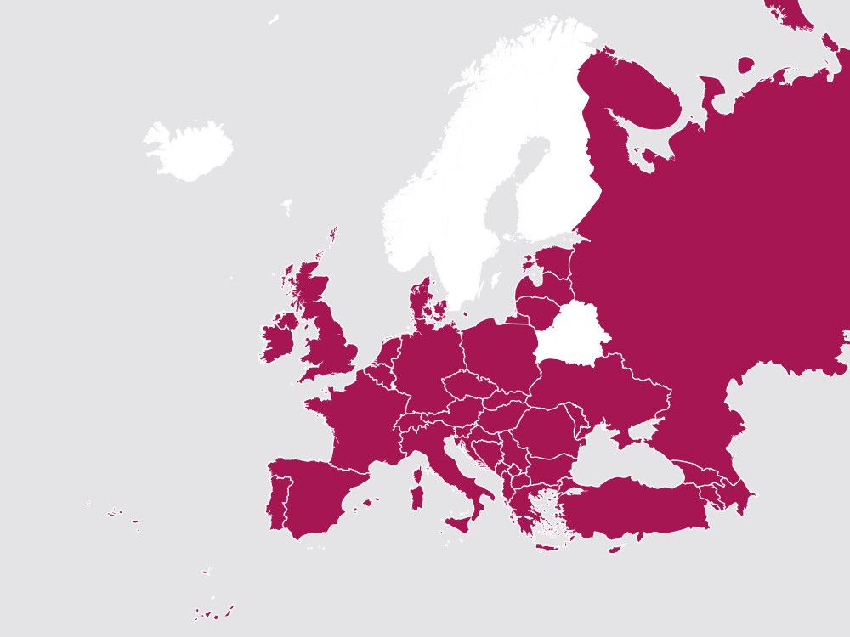
Who Who we are?
110 members in 40 European countries
Organisations range from large international NGOs to small grassroots set-ups
Individuals range from leading academics to PhD students and private lawyers
Key partnerships – UNHCR, OSCE, EU and Council of Europe

Slide 4
Setting the scene – a (quick) overview of statelessness
Who is stateless?
Consequences of statelessness
Scale of the problem
What are the causes?
International legal framework

Slide 5
What is being done about it?
Issue emergence
Growing global coalition
UNHCR #ibelong campaign
Regional developments
Finding entry points – incl. nexus with forced displacement

Slide 6
Statelessness in Europe
In situ populations and Europe as a ‘producer’ of statelessness
The migratory context
Interaction between statelessness and the refugee crisis
ENS #StatelessKids and #LockedInLimbo campaigns

Slide 7



Slide 8
Causes of statelessness among refugee & migrant children
How the majority of refugee children acquire nationality but a minority don’t …
Where family link cannot be established e.g. obstacles to birth registration
Where children are born to stateless parents (18,765 and 21,340 ‘unknown’)
Where discriminatory laws prevent parents transferring nationality to their children

Slide 9

International commitment
Domestic safeguards
Implementation in practice

Slide 10
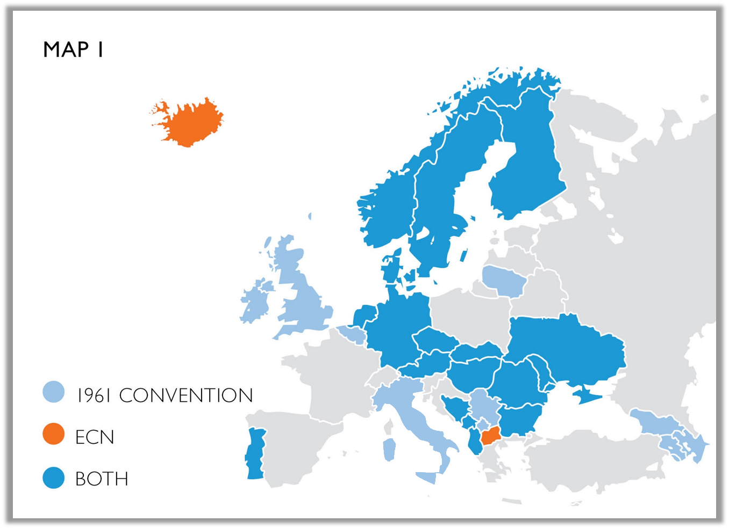

International
commitment
32 states in Europe are party to 1961 Statelessness Convention, ECN, or both

Slide 11
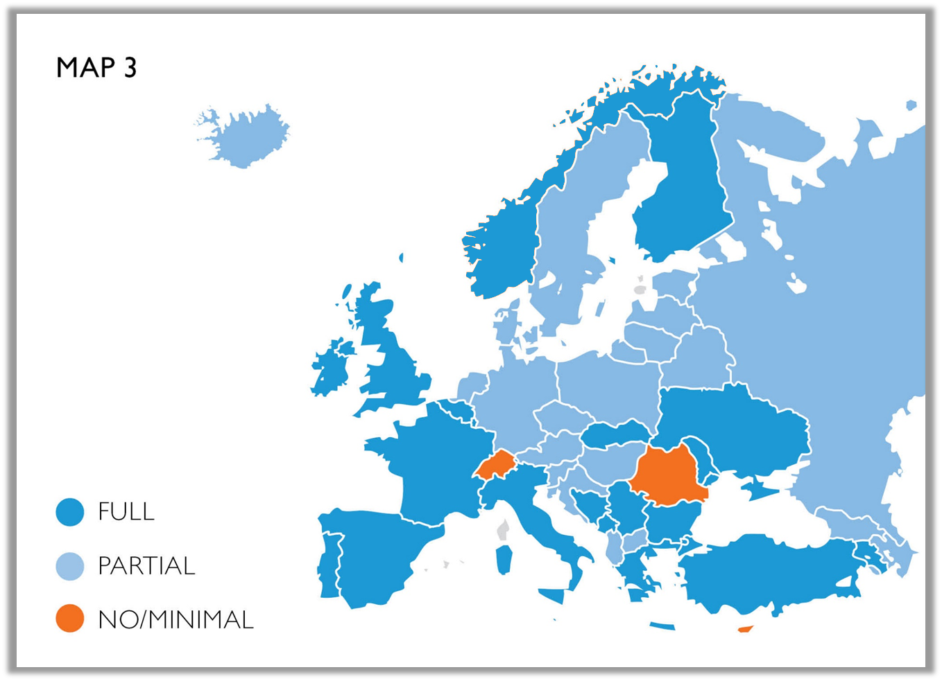

Domestic
safeguards

Slide 12
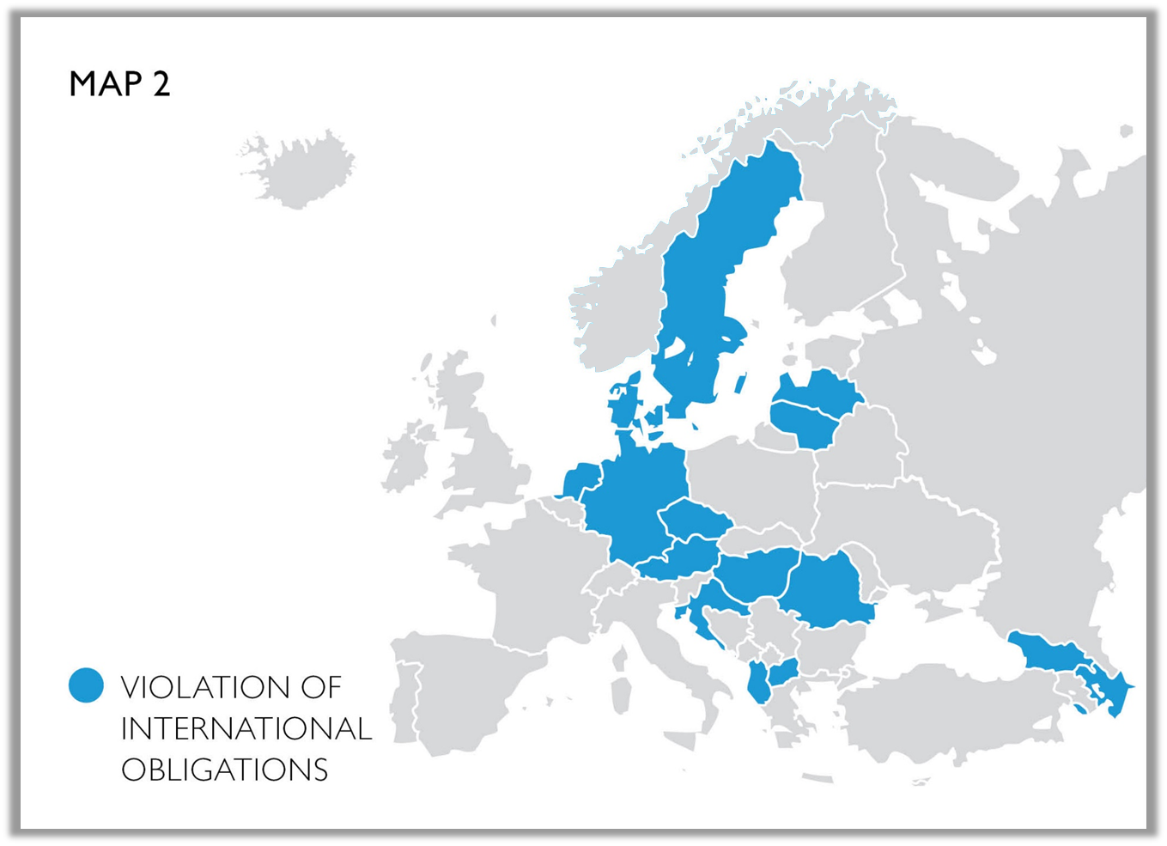


Slide 13
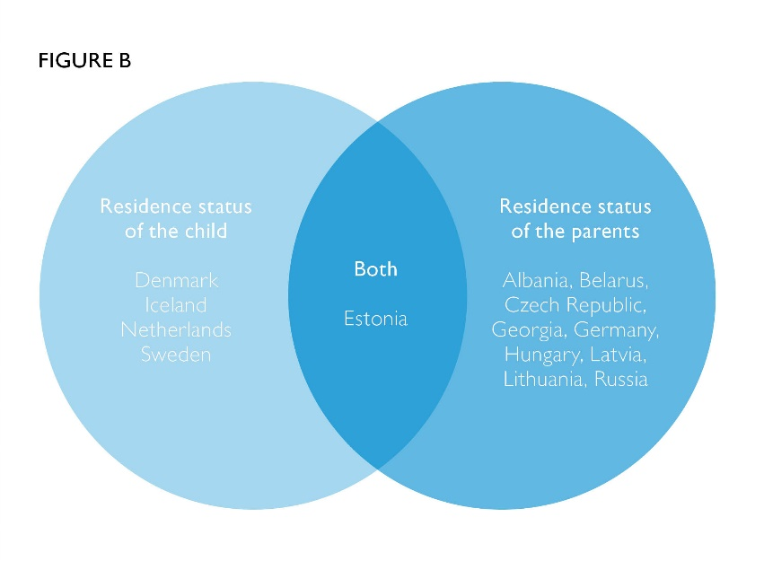


Slide 14

“Everyone must be able to establish the substance of his or her identity”
Implementation in practice

Slide 15
Improving identification practices
Why safeguards are being ‘missed’ …
Registration must accurately record all relevant information (incl. statelessness)
Training, capacity building – sharing expertise e.g EMN statelessness platform
Framework for addressing statelessness through EU’s external relations policy

Slide 16
Steera and Mohammed

Slide 17
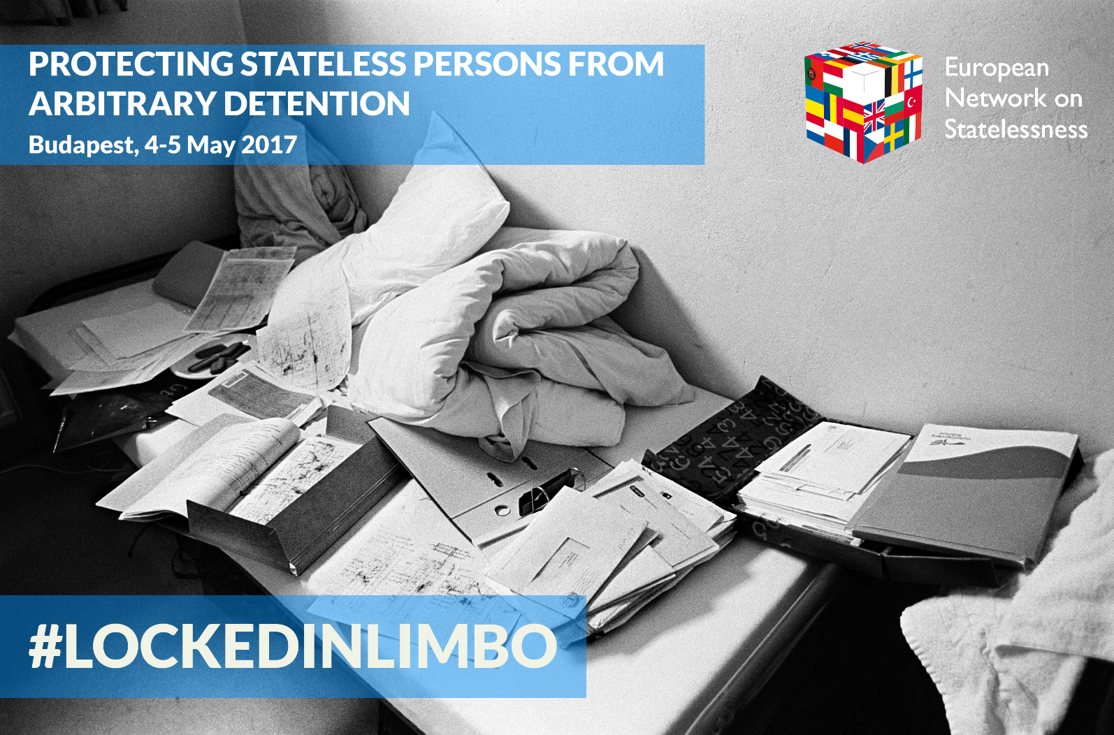
PROTECTING STATELESS PERSONS FROM ARBITRARY DETENTION
A brief overview ...

Slide 18
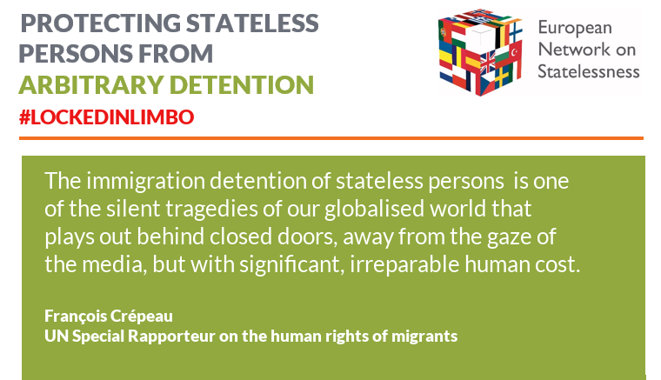

Slide 19
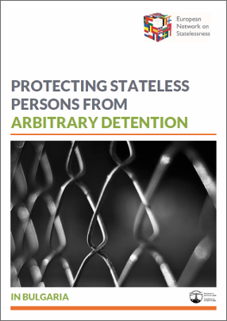
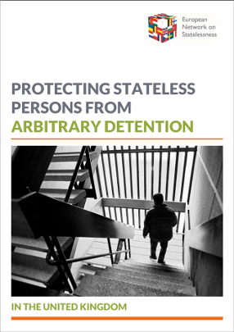
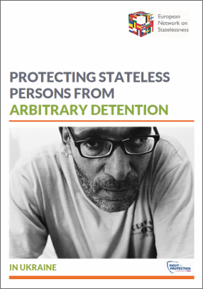
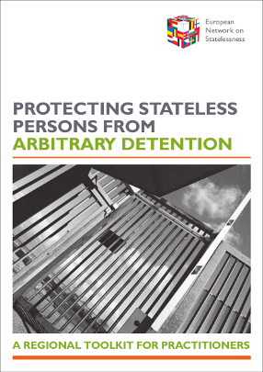
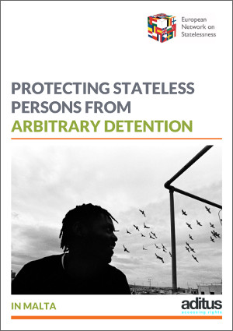
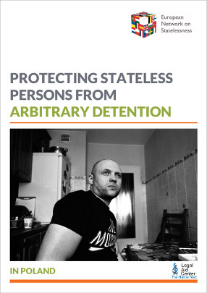
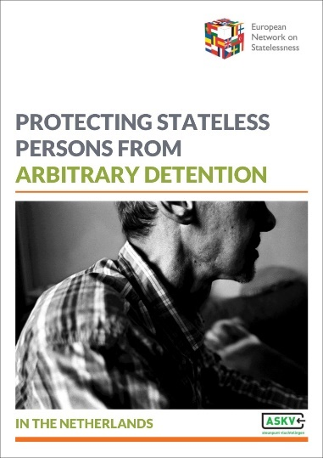
Protection from arbitrary detention

Slide 20
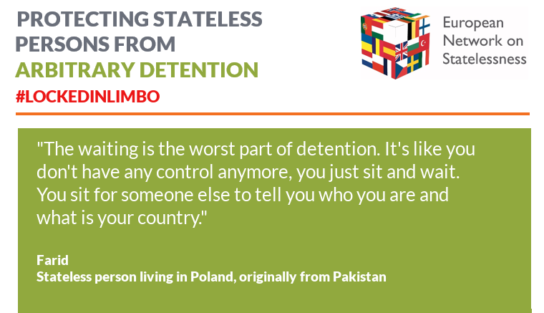

Slide 21
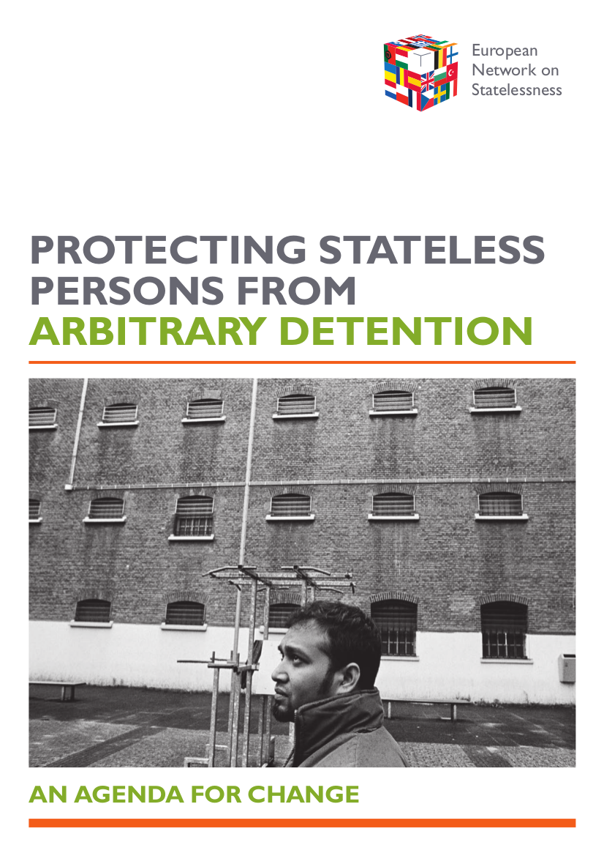

Slide 22
#LockedInLimbo Recommendations
Implement a range of alternatives to detention
Develop statelessness determination procedures
Put in place robust mechanisms to protect rights, respond to vulnerabilities and not discriminate
Facilitate integration in the community
Improve recording and reporting on statelessness

Slide 23

Roman’s story

Slide 24
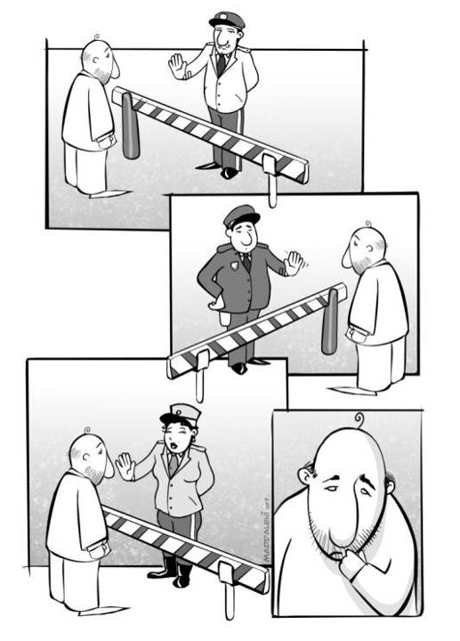

THANK YOU!
Chris Nash
European Network on Statelessness

