Slide 1
BBB+
Municipality of Groningen

Slide 2
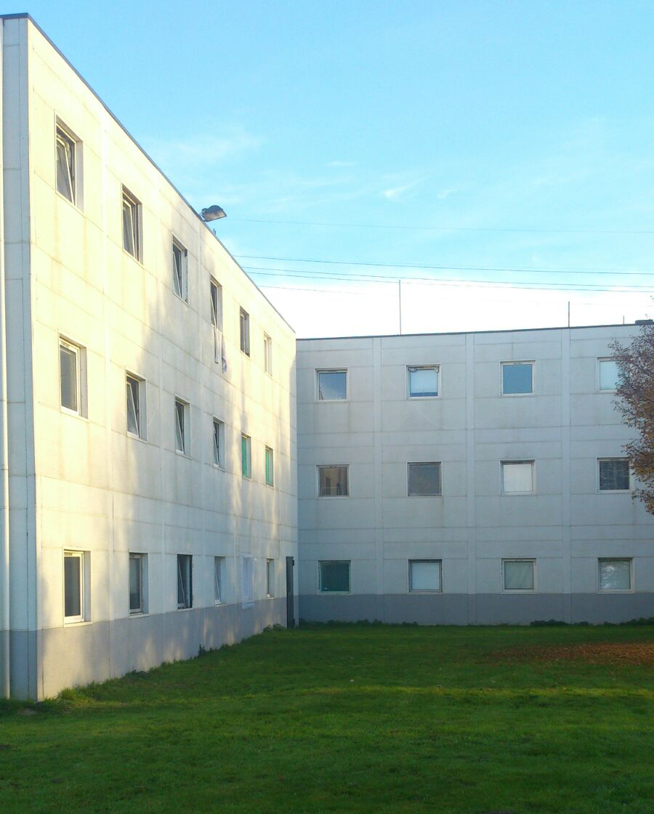
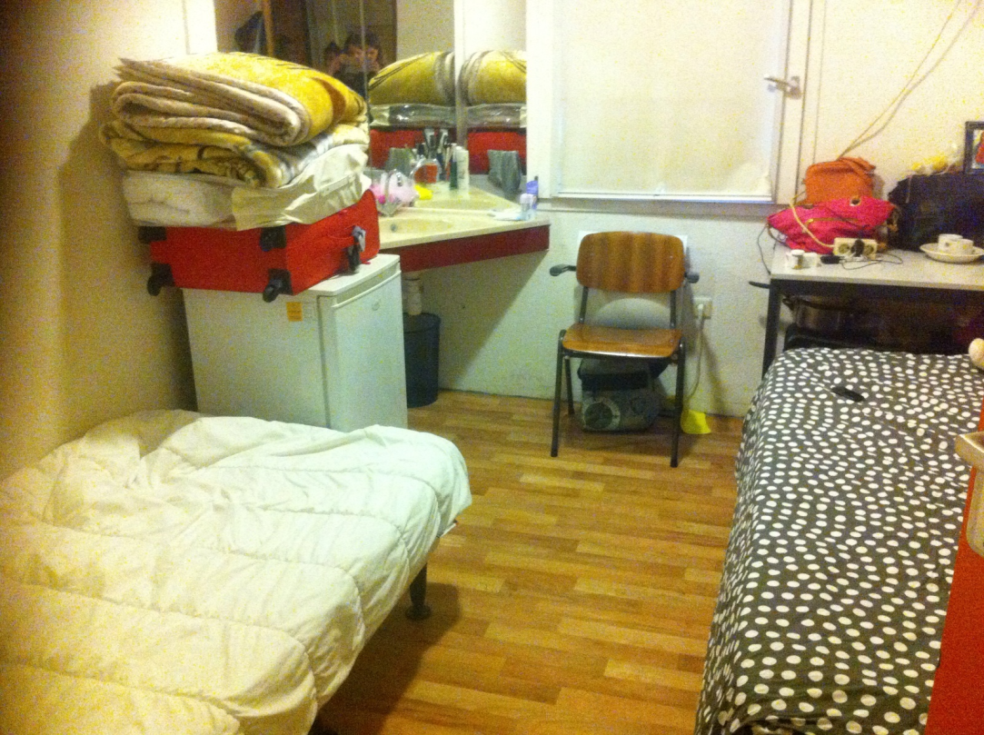
On March 16, 2015, Groningen opened the BBB+ in the former Formula 1 Hotel

Slide 3
Starting point
The street is never
part of the solution,
but always
part of the problem

Slide 4
Application
With every application we investigate:
Is a prior facility available
Does the person have a V-number
Which central municipality is responsible

Slide 5
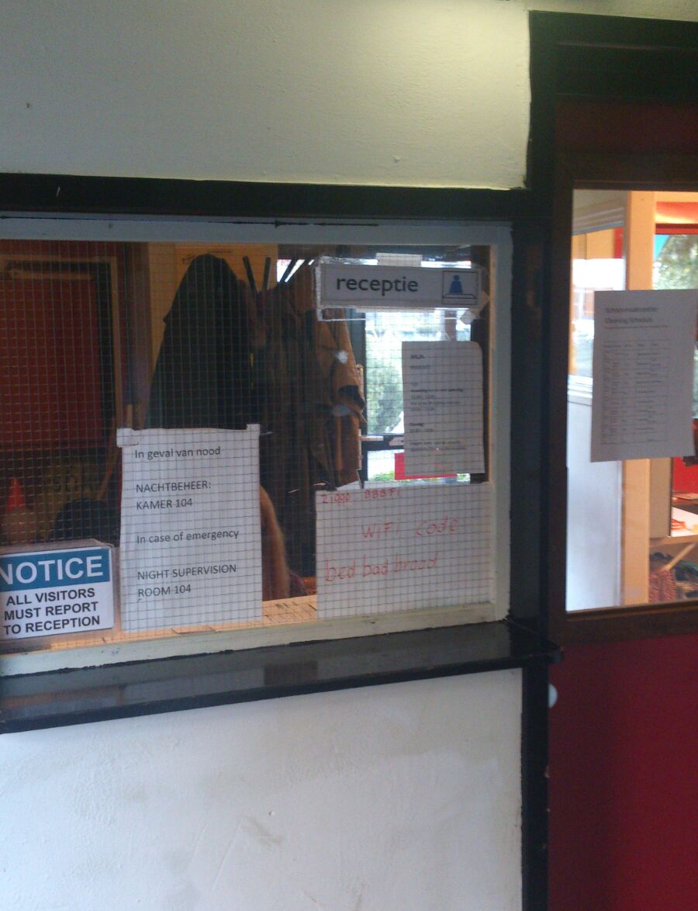
After the test: reception at the BBB+ location

Slide 6
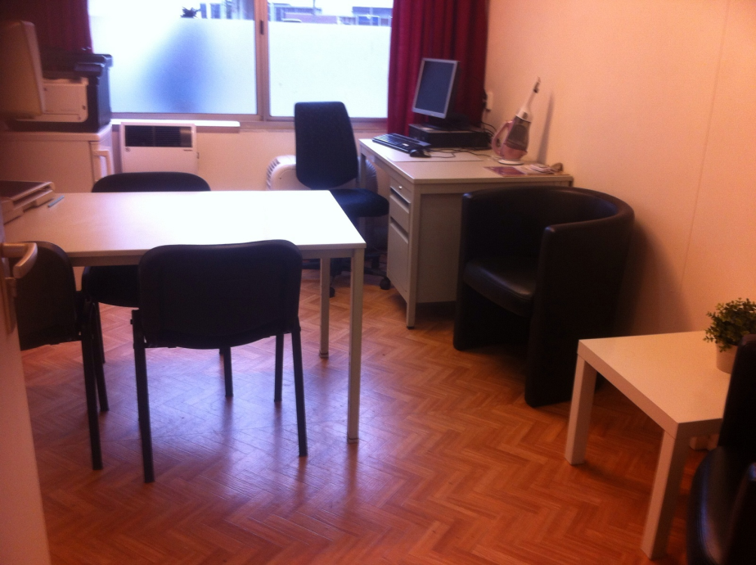
New guests will get a thorough interview, a tour and a cleaning schedule!

Slide 7
Bound in freedom
Everyone may go where he or she wants;
However, we are working together towards a realistic perspective

Slide 8
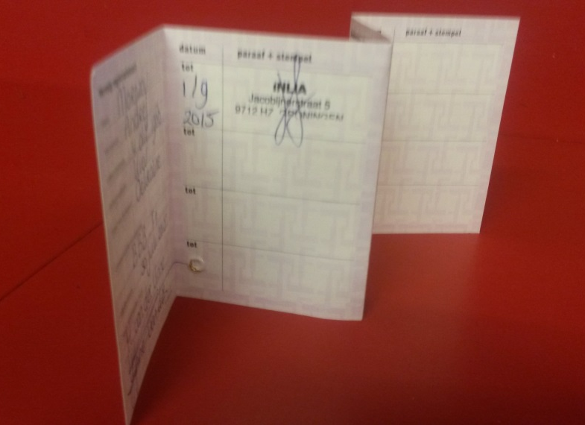
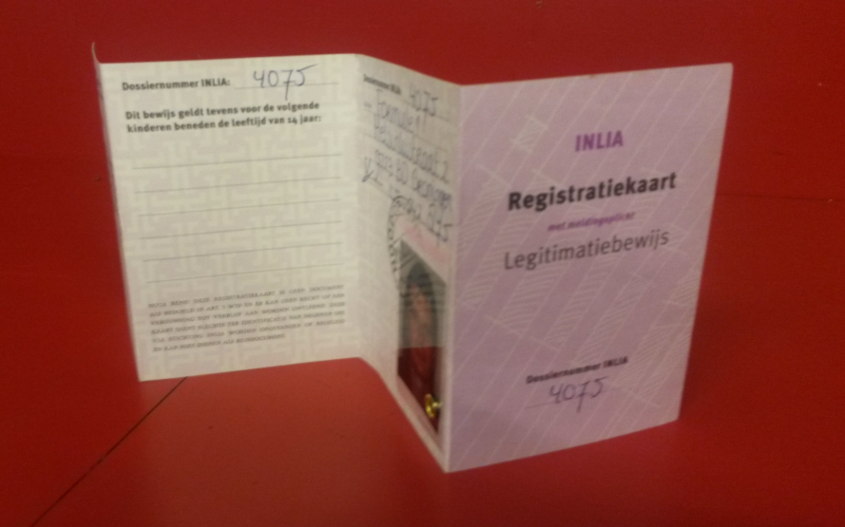
Bound in freedom (2)
No interference from judicial services

Slide 9
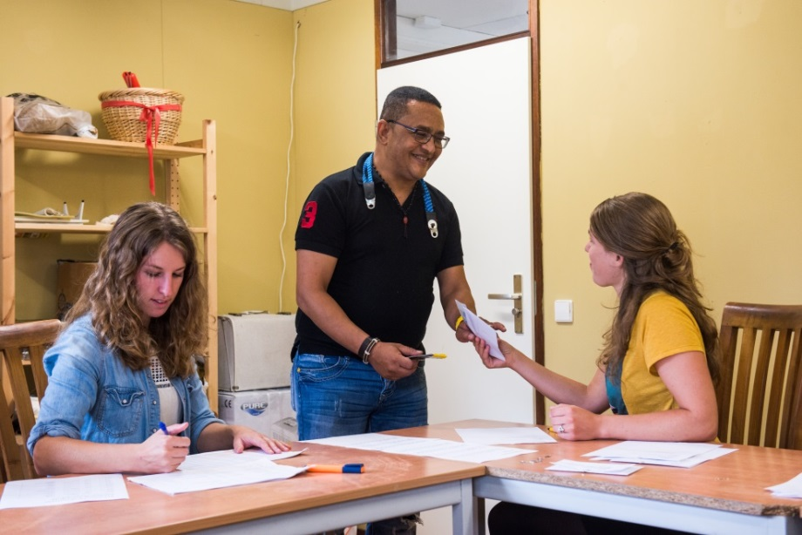
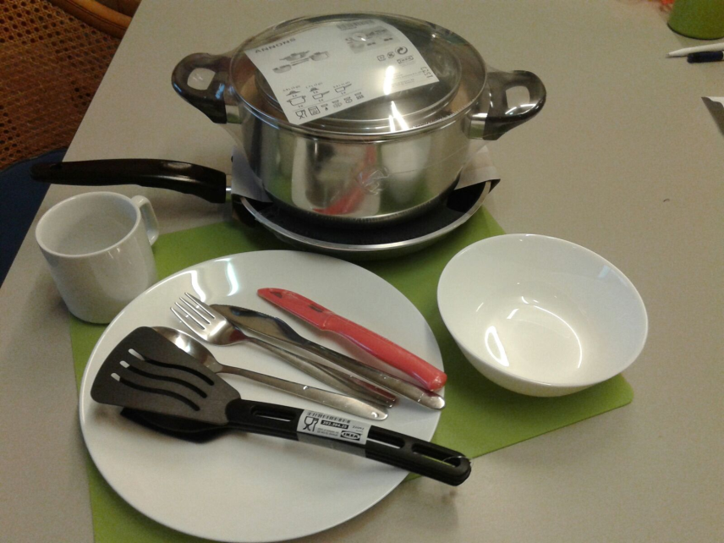
The guests receive a weekly allowance

Slide 10
BBB+ not the final station
Safe resettlement
Residence permit

Slide 11
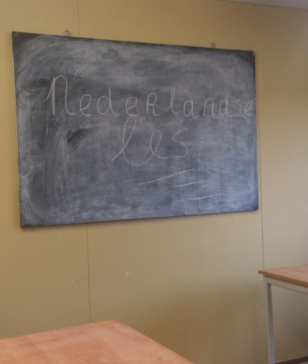
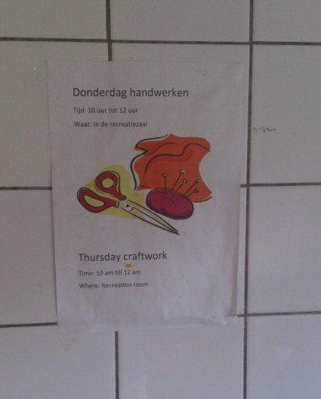
This we try to accomplish together with them through:
Lessons & courses
Social office hours
Legal office hours
Perspective talks and activities
Contacts with embassies

Slide 12
Determination of ID
Per May 1st:
44 embassy visits
15 people acquired their identity documents
10 people received another declaration
6 people awaiting a decision
2 people in need of additional papers
11people did not get their documents

Slide 13
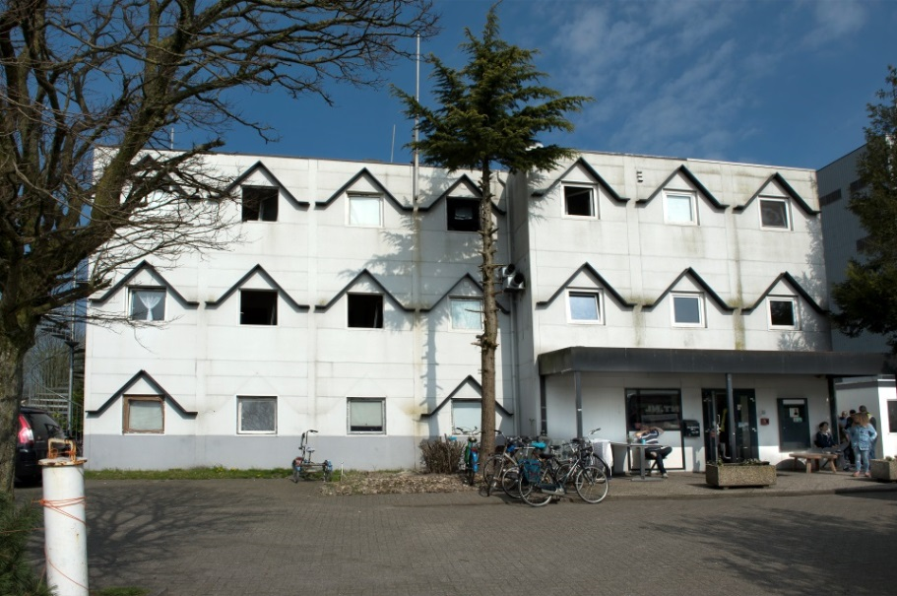
310 in BBB+ 115 central Formula 1 112 central BBB-Boat 83 decentral (10 locations)

Slide 14
People of age 60 and over in BBB+ 28
Of which 65+ 13
Eldest person in BBB+ 78 y/o

Slide 15
Over 100 patients
Partly overlap between physical and mental illnesses
Physical illness in BBB+ 74 (e.g. aids-, kidney-, liver-, heart-, diabetes-patients, also with transplantations)
Mental illness in BBB+ 58
Addicts in BBB+ 26

Slide 16
Outflow
Reason | Ground | No. of people
Return/transfer |  | 15
Shelter again at COA/Residence permit |  | 92
 | Won appeal
 | Won higher appeal
 | Allotted interim measure (‘vovo’)
 | Sent to extended procedure (‘VA’)
 | Departure moratorium
Allotted to another central municipality |  | 19
In custody/VBL |  | 14
Left with unknown destination* |  | 81
Deceased |  | 2
Total outflow |  | 223
Total inflow |  | 498
*Explanation

Slide 17
More important

Slide 18
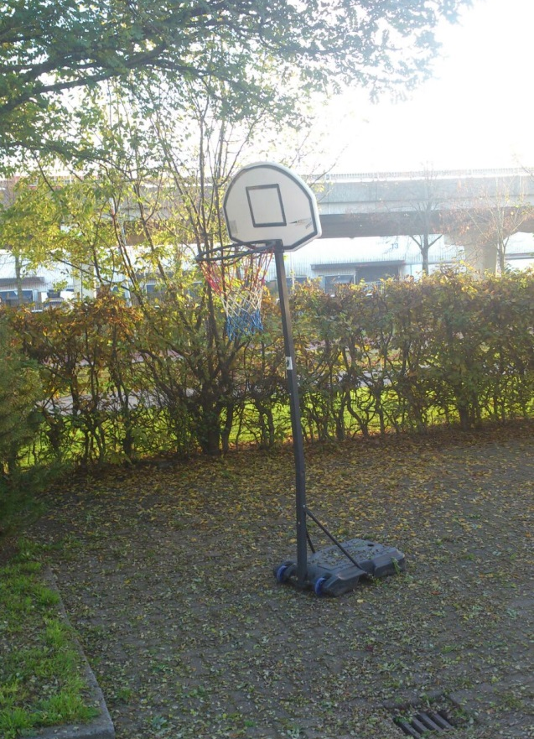
Peace, Space and Respect
Trust
Sharing responsibility
Abolishing barriers
Working together towards a realistic perspective

