Slide 1
Good afternoon

Slide 2
Themes
Nice to meet you
Living Serbia
Life in Europe
Last but not least

Slide 3
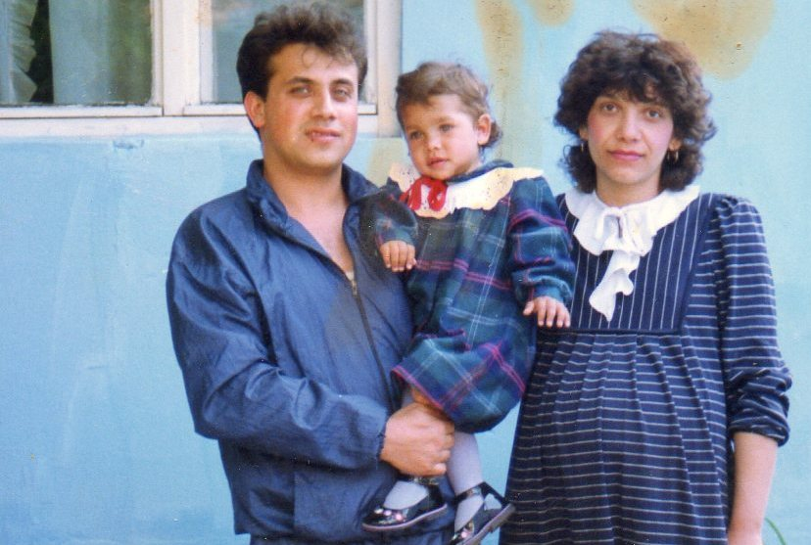
Nice to meet you!
Born in Serbia
1990
1995/1996 went out of Serbia

Slide 4
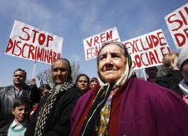
Living Serbia
https://www.youtube.com/watch?v=z70wX8wLRtI
Roma People
No rights
No documents
Violence

Slide 5
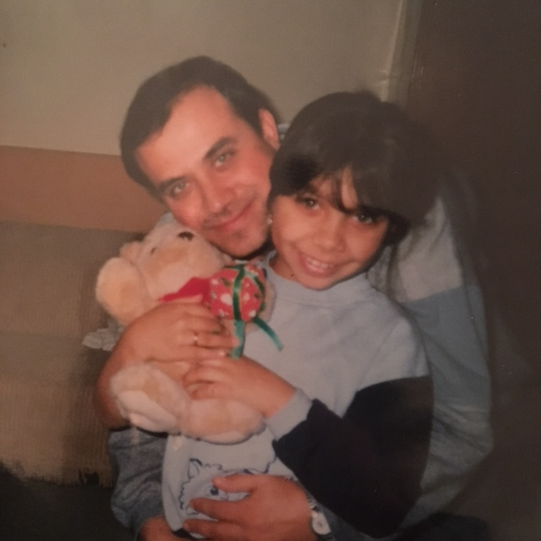
Life in europe
Asylum apply in Germany
Prison in Heerlen
Asylum apply in Holland
Movements
Study -> always a stranger?
The residence permit 2012

Slide 6
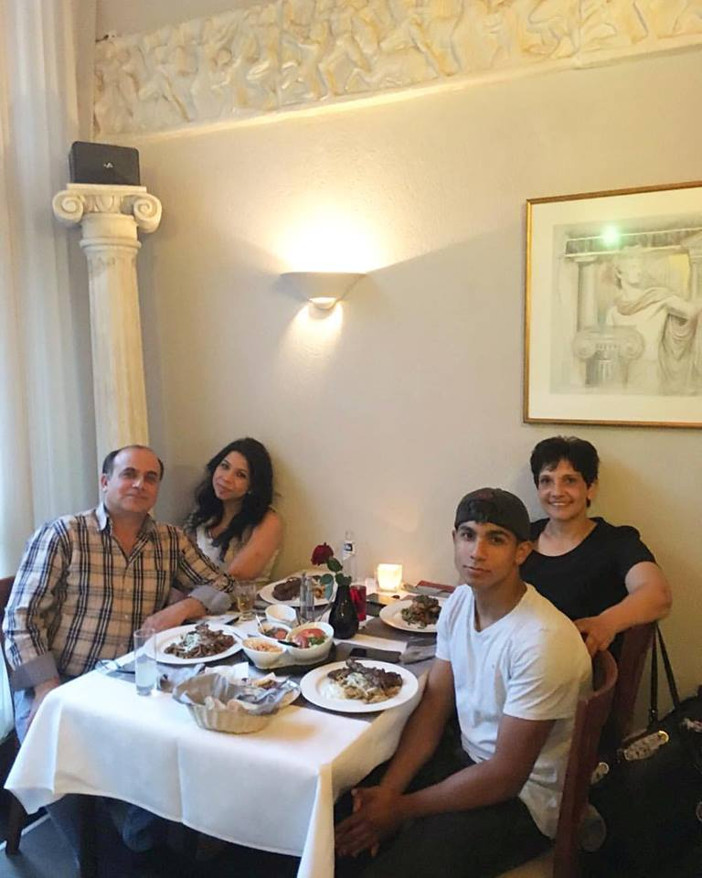
Last but not least
Trust
Happiness
Faith

Slide 7
.

