Slide 1
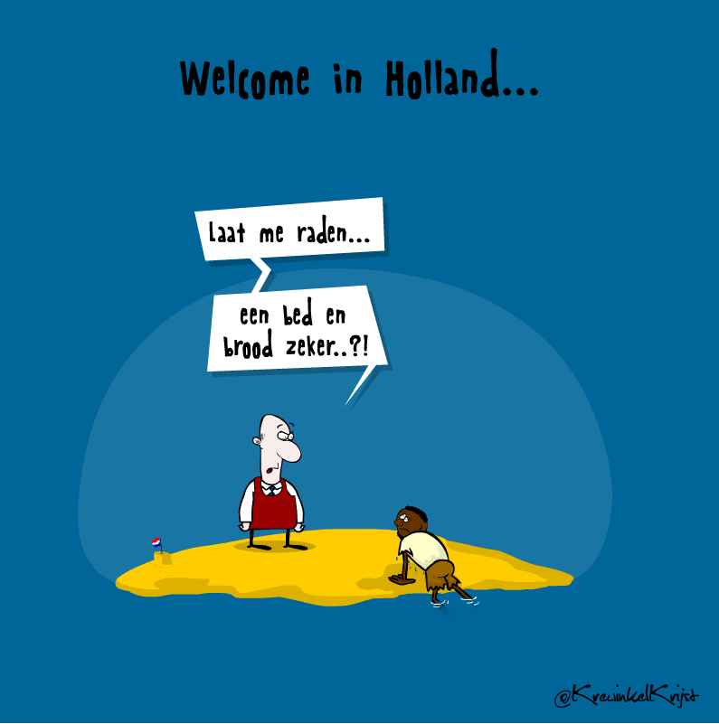
Bed, Bad en Brood.
The Status Act 1998 makes it impossible for illegal immigrants to obtain a social security number. For illegal immigrants who worked continuously for six years and have paid tax there will be a rule that gives them a work and residence permit

Slide 2

Bed Bad en Brood.
New Aliens law. Mr. Job Cohen. 2001 Bus trip against effects on Migrants
Beginning in April 2001 drew a bus turned, but not illegalised refugees and members of support groups through various cities. The protesters criticized the new policy of refugees still waiting for the completion of their second asylum application, already are dumped on the street. Since the introduction of the Benefit in 1998 are becoming more excluded groups of refugees of all kinds of amenities. No shelter and no income are their biggest problems. And put the introduction of the new Aliens Act on 1 April in the coming months there will be thousands more people on the street. Within 28 days after receiving the negative decision in their first procedure, refugees are now thrown out of their shelter.

Slide 3

Bed, Bad en Brood
Protests against the new aliens law
Precognizing law 2007
Kinderpardon 2012-nu
Individual cases
Collective Complaint Families with children

Slide 4
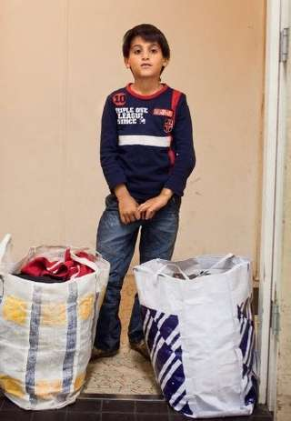
Bed Bad en Brood
The right on shelter
The government can not just put children out of shelters even if they are "illegal". Because many 'illegal' children were put on the street, Defence for Children has partnered with other organizations in 2008, filed a complaint with the European Committee of Social Rights (ESRB). On July 27, 2010 the Hague Court of Appeal ruled that children were not allowed on the street. This was then confirmed by the Supreme Court. This has led to family locations. The first opened in 2011

Slide 5
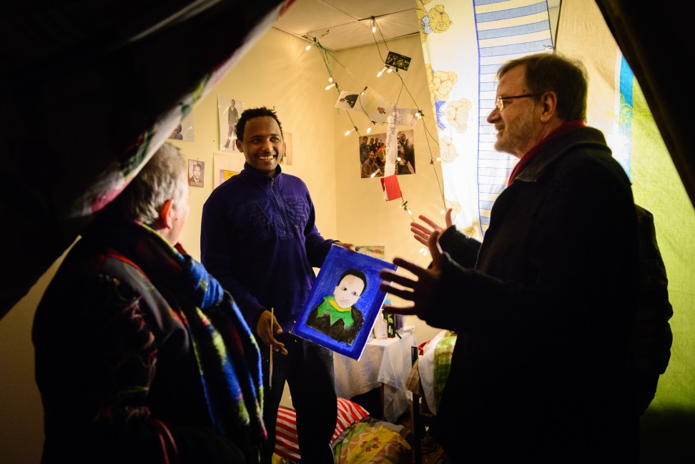
Bed Bad en Brood
Tentenkamp
Vuchtkerk
Vluchtgebouw
Vluchtkantoor
Vluchtgarage
Vluchttoren
Vluchkloods-nu

Slide 6

Bed Bad en Brood
content Charter
Chapter I: Dignity (human dignity, right to life, right to the integrity, prohibition of torture and inhuman or degrading treatment or punishment, prohibition of slavery and forced labor);

Slide 7
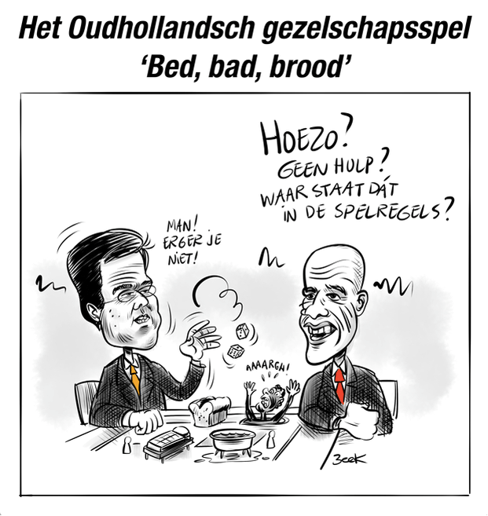
Bed Bad en Brood
Klacht ingediend nr. 90/2013 door CEC
The complaint was registered on 17 January 2013.
Admissibility 1July 2013
Immediate measure 25-10-2013
Decision 9 July 2014

Slide 8

Bed Bad en Brood
Uitspraak lagere rechtbanken op grond van ECSR
Uitspraak Centrale Raad van Beroep 19 november 2014
Comité van Ministers
Compromis Kabinet
Zitting Raad van State

Slide 9
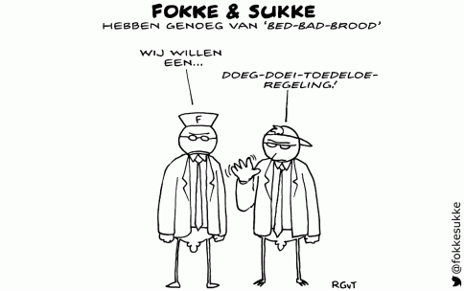
Bad Bed en Brood
Hoe gaat het verder?
Protest lokale overheden
Raad van State
Centrale Raad voor beroep
Wiens verantwoordelijkheid
Wat kunnen kerken doen?

Slide 10
Bed Bad en Brood .
Mythes
Bijzondere kerkgeschiedenis.
We hebben zegen nodig.
Rol kerk als het gaat om de waardigheid van mensen.

