Slide 1
Securitization of migration
CCME/CEC Summer School in Human Rights, 2–6.7.2017 Palermo
Talvikki Ahonen / University of Eastern Finland & Finnish Ecumenical Council
talvikki.ahonen@uef.fi

Slide 2
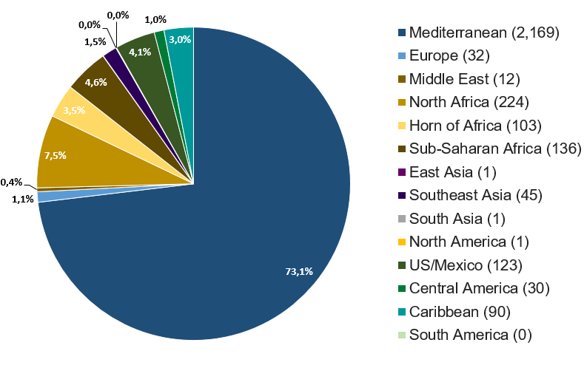
Violent borders
3 700 migrants died at the Mediterranean 2015, and 5 000 on 2016
In many cases the bodies are never found
Outer borders of the EU: the most dangerous borders in the world
Source: IOM

Slide 3
Violent borders, security & securitization
AND STILL: migrants themselves are portrayed as a threat to Europe
Security as a fundamental value → security issues are often prioritized → narrative is a very powerful tool
When talking about security, whose security are we talking about?
What threats migrants are assumed to cause?
https://www.youtube.com/watch?v=XkRRdth8AHc

Slide 4
Security, threats, and fears
What threats/fears immigration is assumed to cause?
Socio-economic threats
Cultural threats
Existential threat
Threat to domestic/internal security

Slide 5
Criminalization of migrants: undocumentedness
Labeling undocumented as ”illegals” is insincere for multiple reasons:
People move from one legal status to other, sometimes often and quickly
Lines between categories of migrants are in reality blurred (forced vs. voluntary migration; economic migration etc.)
State’s ability to recognize all ”real” refugees is not perfect; assumed uniformity of the EU asylum system
Undocumented are in the most precarious situation in the society

Slide 6
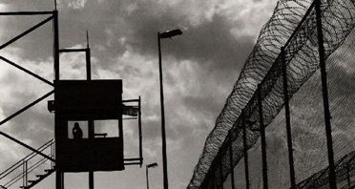
Criminalization of acts of solidarity
The EU states combat ”illegal immigration” by framing it as ”smuggling” → criminalization of humanitarian aid
e.g. members of NGO’s have been arrested for sea rescue as ”smugglers”
Often it’s migrants who get involved in
facilitating border crossings!
Photo: Sara Prestianni, Noborders Network

Slide 7
Churches’ counter strategies
Theological reflections of migration: Christians’ identity as ”migrants”
Not only technical/legislative notion on human rights! Human beings are first and foremost images of God
Questioning discourses and narratives that distort facts and violate the agency of migrants, raising awareness

Slide 8
Conclusions
Framing migration as a security issue conceals societal problems that are caused by the state/society
The cycle of securitization: securitarian discourses legitimate the use of security technologies, which in turn sustain the legitimacy of those discourses
Security can (and should) be an argument for less restrictive migration policies!

Slide 9
Literature
Brazal, A. & Guzman, E. 2015. Intercultural church: bridge of solidarity in the migration context. Borderless press
Greussing, E. & Boomgarten, H. 2017. Shifting the refugee narrative. An automated frame analysis of Europe’s 2015 refugee crisis. Journal of ethnic and migration studies.
Chebel d’Appollonia, A. 2017. Frontiers of fear: immigration and insecurity in the United States and Europe.
Calandrino, T. The emergence of legal trope of ”smuggling” and its consequences. Available at: http://www.borderline-europe.de/sites/default/files/background/kidem-doc-final-2-5-17.pdf
Chebel d’Appollonia, A. 2017. Xenophobia, racism and the securitization of immigration. Bourbeau, P. (edit.) (2017). Handbook on migration and security.
Günay, C. & Witjes, N. (edit.) 2017. Border politics: defining spaces of governance and forms of transgressions. Cham: Springer.
Huysmans, J. 2000. The European union and the securitization of migration. Journal of common market studies 38 (5), 751–77.
Zapata-Barrero, R. & Gabrielli, L. 2017. Ethics and the securitization of migration: reversing the current policy framework. Bourbeau, P. (edit.) (2017). Handbook on migration and security.

