Slide 1
A European legal framework for Migrants´Rights ?!
SSHR Palermo
4 July 2017

Slide 2
Who does what?
MOST IMPORTANT EUROPEAN INSTRUMENTS
Council of Europe: Conventions
ECtHR: Interpretation, mainly of ECHR
European social charter
EU: charter of fundamental rights and directives
ECJ: interpretation of EU law
Notes:
2

Slide 3
Council of Europe
EUROPEAN CONVENTION ON THE LEGAL STATUS OF
MIGRANT WORKERS (1977):
-principal aspects of the legal situation of migrant workers, in particular recruitment, medical examinations, occupational tests, travel, residence permits, work permits, the reuniting of families, working conditions, the transfer of savings and social security, social and medical assistance, the expiry of work contracts, dismissal and re-employment.
- 11 ratifications
Notes:
3

Slide 4
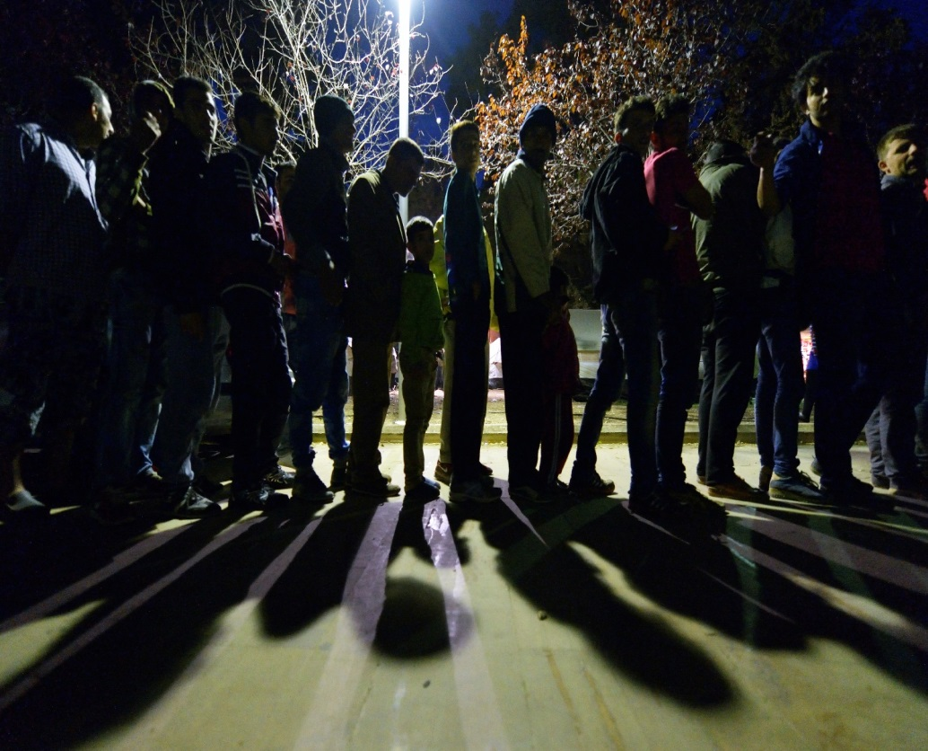
CONVENTION ON ESTABLISMENT (1955)
facilitation of prolonged or permanent residence in its territory; guarantees against possible expulsion; treatment equal to that enjoyed by nationals in respect of the possession and exercise of private rights; legal and judicial protection; and the right to engage in gainful occupations (industrial, commercial, financial and agricultural occupations, skilled crafts and professions), under certain conditions laid down in the Convention.
- 12 ratifications
Council of Europe
Notes:
4

Slide 5
ECHR/ECtHR
Jurisdiction grounded on ECHR often
Article 2 Protocol No. 4 ECHR,in its second paragraph “everyone shall be free to leave any country, including his own”.
Articles 2 (right to life) or 3 (right tpo freedom of torture , inhuman and degrading treatment) ECHR and Article 8 (right to family life)
Increasingly recourse to Article 39 of ECtHR Rules (“Interim measures”), request the member states to stay an administrative and/or judicial measure concerning immigration control until a final decision is reached.
ECHR important in national jurisdiction
47 ratifications
Notes:
5

Slide 6
European social Charter (1961/1996)
Social and economic right, complementing ECHR
43 ratifications
Controversy if migrants in particular irregular are covered
Some countries allow „collective complaint“ by CSO
Conference of European Churches (CEC) v. The Netherlands, Complaint No. 90/2013 : rights of Undocumented adults to „Bed, Bath, Bread“
Article 13§4 (right to social and medical assistance) and with Article 31§2 (right to housing)
NL government crisis by decision of European Committee of Social rights
Notes:
6

Slide 7
EU freedom of movement – a good migration framework
Directive 2004/38/EC :Only covers EU citizens, but grants rights
- Enter another EU country (also family members - whether EU citizens or not) without requiring an exit or entry visa.
Live in another EU country for up to 3 months without any conditions or formalities.
Live in another EU country for longer than 3 months subject to certain conditions
Entitled to permanent residence if they have lived legally in another EU country for a continuous period of 5 years. This also applies to family members.
Have the right to be treated on an equal footing with nationals of the host country. (some exceptions)
Notes:
7

Slide 8
EU Charter of Fundamental rights
Debate if applicable to citizens only
General political and social rights
Specific provisions such as anti discrimination article 21
Unclear if EU member states also bound
Notes:
8

Slide 9
EU legislation
Progress on asylum & refugee protection, little on migrants´rights
Real migration legislation
High skilles migrants („blue card“) directive)
Seasonal workers directive
(Students mobility)
Related
Long term residence directive
Family reunification directive
Return directive
Notes:
9

Slide 10
Blue card
Directive (2009)
Right to stay and live (and bring family) in EU if
higher professional qualifications', by showing a higher education qualification (such as a university degree). Some Member States accept at least five years of relevant professional experience.
For paid employees - EU Blue Card does not apply to self-employed work or entrepreneurs;
gross salary must be high, at least one and a half times the average national salary - except when the lower salary threshold applies;
must present a work contract or binding job offer in an EU country for at least one year;
necessary travel documents. & health insurance also for relatives who come to the EU with you.
fulfil the legal requirements to practice profession, where this profession is regulate
Notes:
10

Slide 11
Seasonal workers
Directive (2014)
- Seasonal workers retain their principal place of residence in /stay legally and temporarily in the EU to carry out an activity depending on the
passing of the seasons, typically in agriculture or tourism.
– Member States : determine a maximum period of stay for seasonal workers between five and nine months in any 12-month period.
– Third-country nationals : fulfil several conditions to be allowed to enter the EU, their application must include a work contract /binding job offer specifying essentials such as pay and working
hours.
- application : include evidence that the worker will stay in accommodation that meets the general health and safety standards of the member state and that the rent will not be excessive or automatically deducted from the
wage.
Notes:
11

Slide 12
Seasonal worker
(cont.)
re-entry of third-country nationals who return every year to the EU to do seasonal work is facilitated.
Seasonal workers are entitled to equal treatment with nationals of the host
member state at least with regard to terms of employment, including the minimum working age, working conditions, including pay and dismissal, working hours,leave and holidays, and health and safety requirements at the workplace.
Equal treatment with nationals will also apply to branches of social security (benefits linked to sickness, invalidity and old-age).
Temporary nature of the stay of seasonal workers, member states will not be obliged to apply equal treatment on unemployment and family benefits
possibility to limit equal treatment on tax benefits and on education and
vocational training.
Seasonal workers also have the right to join a trade union and are entitled to access to social security, pensions, training, advice on seasonal work offered by employment offices and other public services, except for public housing.
Notes:
12

Slide 13
Long term residence directive (2003)
lived legally in an EU State for an uninterrupted period of five years.
having a stable and regular source of income, health insurance and, when required by the EU State, having complied with integration measures.
not constitute a threat to public security or public policy.
EU long-term residence permit, renewable, and the status of EU long-term resident.
Same treatment and rights as nationals in certain areas:
- access to employment and self-employed activity
- education and vocational training
- social protection and assistance (at least core benefits)
access to goods and services, etc
Notes:
13

Slide 14
Family reunification directive (2003)
Sponsor: adequate accommodation, sufficient resources and health insurance,
waiting period of no more than two years.
Possible refusal for spouses who have not reached a required age – which can be 21 years at the highest.
Polygamy is not recognised
Member States may ask third-country nationals to comply with integration measures before or after arrival.
Threat to public order, public security or public health can lead to rejecting the application.
Consequences in the event of fraud as well as marriage, partnership or adoption of convenience are also foreseen.
More favourable rules applicable if the sponsor is a refugee..
family relationships established before and after the sponsor arrived in the Member State.
Sponsors can bring their spouse, minor children and the children of their spouse to the country in which they are residing.
Member States may choose to authorise reunification with an unmarried partner, adult dependent children, or dependent parents and grandparents.
Notes:
14

Slide 15
Return directive (2010)
requirement for a fair and transparent procedure for decisions on the return of irregular migrants
obligation on EU States to either return irregular migrants or to grant them legal status -> no“legal limbo”
promotion of the principle of voluntary departure by establishing a general rule that a "period for voluntary departure" should normally be granted
provision for persons residing irregularly of a minimum set of basic rights pending their removal, including access to basic health care and education for children
a limit on the use of coercive measures in connection with the removal of persons, and ensuring that such measures are not excessive or disproportionate
providing for an entry ban valid throughout the EU for migrants returned by an EU State
Somewhat limiting the use of detention, binding it to the principle of proportionality and establishing minimum safeguards for detainees.
Notes:
15

Slide 16
Rights ????
Many directives bad insufficient compromise
ECJ sometimes migrant-friendly (e.g. Family reunification)
ECtHR as last resort
Even minimum standards under threat by member States and Commission
Implementation undermines rights
Notes:
16

Slide 17
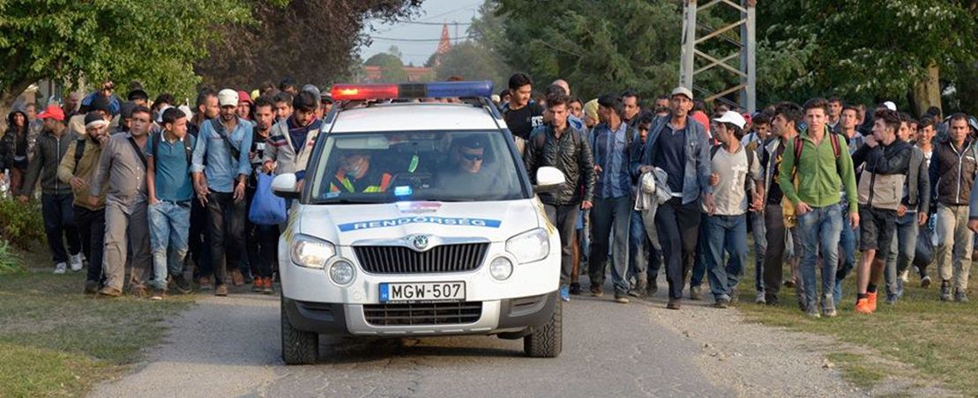
CCME
Thank you for your attention!
Churches’ Commission for Migrants in Europe
Rue Joseph II 174 B-1000 Brussels
www.ccme.eu

