Slide 1
Digitalisation – labour market – social relations - social cohesion The effects of digitalisation on life, the person and society
CALL
Church Action on
Labour and Life
Working group 3, 24 april 2018
Frederic de Coninck

Slide 2
Who am I? What am I speaking about?
A double training: civil engineering and sociology
Ecole Nationale des Ponts et Chaussées (Paris)
Organisational studies in companies and urban studies
Three questions:
The consequences of digitalisation in work situations
The consequences of digitalisation in everyday life
The links between work and non-work situations
Digitalisation is not only the future. It’s also the present and the recent past

Slide 3
Outline
Digitalisation and the labour market : job polarisation and it’s social effects
Digitalisation and real work : a new kind of intensity of work and it’s social effects
The hard question of the “domestication” of digitalised devices in everyday life : opportunities and threats

Slide 4
Digitalisation and the labour market : job polarisation and it’s social effects

Slide 5
Digitalisation and job polarisation
Technical innovation has already killed a considerable number of jobs
In France 5 millions in agriculture since 1950 mainly due to mechanisation
In France 2 millions of non-skilled blue-collars since 1985 mainly due to automation (and only partially to offshoring)
In France 400,000 white-collars since 1985 mainly due to office automation tools
And is also creating a great number of jobs
In France 3 millions of middle and top managers since 1985

Slide 6
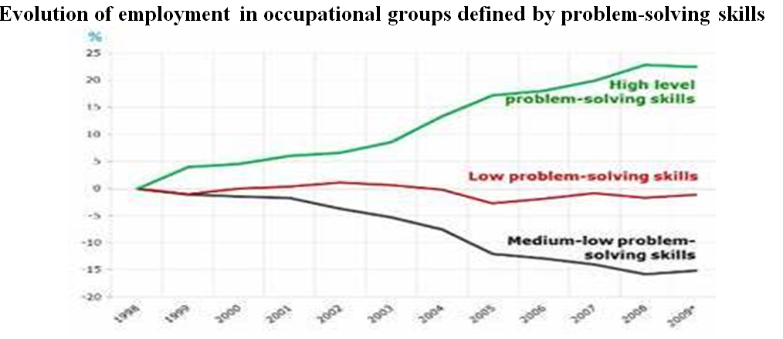
Digitalisation and job polarisation (already visible / Eurostat)

Slide 7
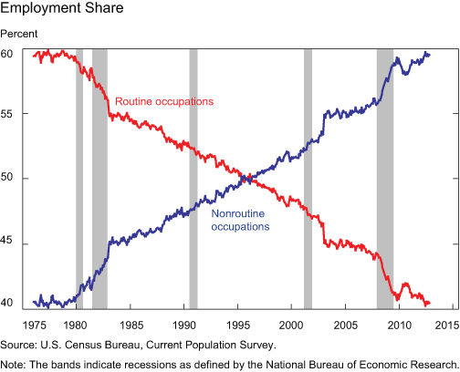
Digitalisation and job polarisation (already visible / US Census bureau)
Non routine jobs include service and protection workers, such as waiters and security guards

Slide 8
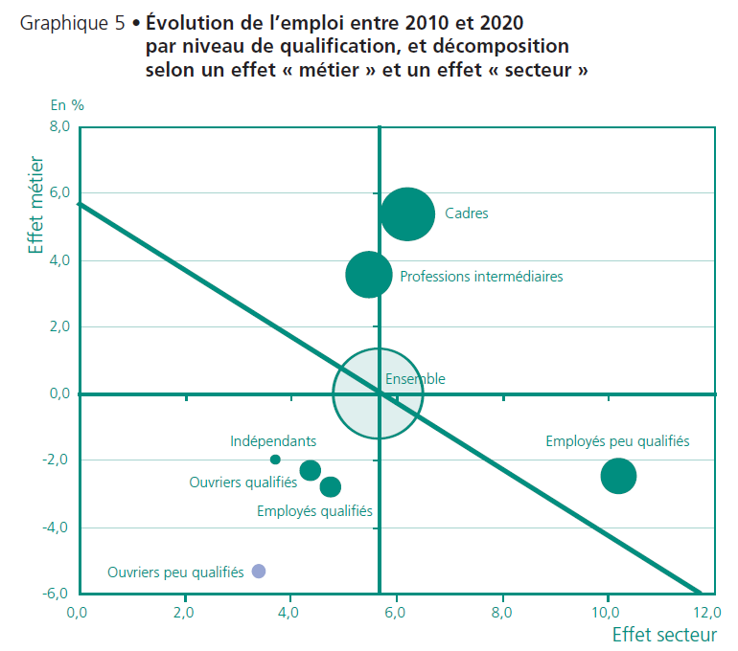
Digitalisation and job polarisation (now at hand, France labour ministry)

Slide 9
Digitalisation and job polarisation (coming effects)
Less middle skill jobs
More control and maintenance of automated systems
Transforming professional activities:
Image recognition in medicine
Automated risk assessments in insurances
Big data and new forms of marketing
Remote working and co-working
Etc.
→ Maybe not less professionals but new profesionnalities
The relevant competences will move very quickly

Slide 10
Job polarisation and populist votes
Main source of populist votes

Slide 11
Digitalisation and centralisation of decisions inside big companies
Supply Chain Management and the development of Enterprise Resource Planning software, at the beginning of the 1990’s, has made it possible for big companies to change outsourcing strategies very quickly and frequently
For people working in peripheral sites, including local top managers, it has been a large loss of autonomy
The centre of the company asks for a lot of reporting, but does not report the logic of its decisions

Slide 12
Digitalisation, concentration of decisions inside companies and it’s social consequences
This has consequences on the wage policies and on the concentration of wealth
This has consequences on the loss of political power for local governments
And again this feeds anger and the conviction that politicians don’t do their job, which causes populist votes
According to the libertarian ideology of Californian computer scientists, digitalisation was to promote equality and empowerment, but the reverse is happening

Slide 13
Digitalisation and real work : a new kind of intensity of work and it’s social effects

Slide 14
Digitalisation and new kinds of work intensity
Work shifts from direct action to action mediated by a digital interface (controlling a system, using data bases, receiving orders, etc.). That’s true for blue-collars, white-collars and managers.
And those interfaces exacerbate the difference between stipulated work and real work: they provoke a lot of discomfort
People say they have to deal with contradictions in demands, frequent changes of orders, etc. And the more they deal with digital interfaces, the more disorganised is their work.

Slide 15
Digitalisation and new kinds of work intensity
The communication tools and software improve far more quickly than optimisation software
Too many information, not enough time for reflexivity and self optimisation
Impossible to know if one is doing “good job” or not
Many workers face directly clients with no more help than a distance connection to a digital base. They are supposed to deal with any situation, even the more complex or dramatic one

Slide 16
Digitalisation and new forms of work intensity
Since the EDI (1960’), then MRP etc. digitalisation has been used to make more present and immediate (just-in-time) commercial demands
A great amount of impersonal and irrational demands converge to any worker
The short term overwhelms the long term
It’s easier to ask for something impossible if you are far from the worker and you do not directly confront him

Slide 17
What workers say about the discomfort of digitalised work
The more they use digital tools the more they say that :
They suffer a skill gap for the job that is asked
Some of their acquired skills are not used
They receive contradictory orders
They often have to urgently abandon a task
They often have to hurry up
They receive internal or external requests to satisfy immediately
They suffer disturbing computer failures
(Nathalie Greenan, Sylvie Hamon-Cholet, Frederic Moatty, Jeremie Rosanvallon, TIC et conditions de travail. Les enseignements de l'enquete COI. Rapport de recherche du CEE, 2012)

Slide 18
The social consequences of that intensification of work
Many mental health problems :
Burn-out, bore-out, brown-out, etc.
Stress, anguish, trouble sleeping, digestive problems, etc.
The danger of “giving everything” anytime, anyhow
A pathology arising from inadequacy in a social context where success is attributed to, and expected of, the autonomous individual (Ehrenberg)
→ Weakening of social ties

Slide 19
Social isolation through remote working
Remote co-working is not building a work collective or a community of affiliation
Many surveys show that people who no longer meet one another suffer from isolation: they cannot speak with one another about little troubles
→ The social danger of digitalisation : from autonomy as empowerment to autonomy as isolation and standing on its own

Slide 20
The hard question of the “domestication” of digitalised devices in everyday life : opportunities and threats

Slide 21
The threat of robots that would govern us is a bit confusing
Let’s not forget that machines have always been dangerous
In Machines That Become Us: The Social Context of Personal Communication Technology (2002 !, James E. Katz ed.), Leslie Haddon shows that non “domesticated” devices are not adopted. So there are maybe more resistance possibilities to “robots invasion” that one can imagine
But there are great inequalities in “domestication” capacities . The digitalisation of social practices is thus producing and elitist society

Slide 22
Any machine demands legislative work
Robots may happen to be dangerous but they are not alone in that case
The first industrial machines were very dangerous and caused millions of deaths
Cars (whether they are autonomous or not) are dangerous as well
Even household appliances may cause accidents and, for this reason, they have to comply with strict regulations
When weapons (whether they are autonomous or not) are poorly regulated, they give rise to carnages
→ The quickness of innovation is a major challenge today: regulation has to be quick as well

Slide 23
Domestication
I have seen an incredible number of failures in the implementation of technical innovations: for instance in home automation
Must of them failed because they were not “user friendly”
People want to make a machine part of their “natural” practices like an animal they want to domesticate. Otherwise they reject that machine
For instance very few people program a programmable thermostat (which is a very simple device) because the interface is ill-conceived

Slide 24
Domestication
The difficulties of domestication is as well a source of resistance to what innovators propose, and of inequalities
For instance the brick and mortar shops tend to be complementary to online shops (less variety proposed locally, sellers less competent). If you are not able (or not willing) to buy something online, you will loose something
Some administrative procedures become difficult if you do not use the Internet
The way people use the advanced possibilities of a smartphone is very uneven
→ Digitalisation is building an elitist society

Slide 25
Digitalisation is adapted to (and reinforces) two major social changes
“The strength of weak ties” (Granovetter, ‎1973)
A redefinition of time and place of work
Information and Communication Technologies have been adopted because they were coherent with those trends

Slide 26
“The strength of weak ties”
In 1973 it was already obvious that traditional social ties were weakened (family, neighbourhood, church, etc.)
The Granovetter article: weaker ties but more ties
The incredible commercial success of mobile phones has been a surprise. Mobile phones made easy a nomad use of the phone that was increasing
The digital social networks look like the Granovetter description
But that “strength” has many limits

Slide 27
A redefinition of time and place of work
Interesting case of a domestication process:
First the developing of emails, and remote communication tools, made it possible an invasion of work in the private sphere
This proved to be very disturbing
So some collective rules of functioning appeared, joined to family regulation
Now the use of mobile phone by colleagues outside working hours is poorly seen; as well as sending business emails at night; and the “out of office” auto-reply messages are spreading
But it is true that working time and place have become more scattered since the 1980s

Slide 28
Are we ready to live in the network society?
Where everyone has to cope with their own difficulties?
Where some belong to a number of diverse networks, and others are rejected by most of them?
Where it is becoming more and more important to be technically able to use a greater number of devices?
A major issue: educational systems as well as regulatory authorities, are frequently overtaken by events

