Slide 1
The state of play of digitalisation and the future of work and social relations
Irmgard Nübler
Research Department
International Labour Organisation
Geneva
Prepared for the Conference Digitalisation and the Future of Work and Social Relations
Berlin, 23 April 2018
organised by the Conference of European Churches (CEC) / Church Action on Labour and Life (CALL)

Slide 2
Outline of presentation
A framework to explain technological change and future of work
  Industrial production system
  Dynamics of technological change (creative destruction)
  Social Capabilities
II. Digitalisation
  what it means
  Major trends in world of work
  Changing employment relationships
III. Shaping the future of work

Slide 3
I. A framework to analyse technological change and the future of jobs
  Understanding of industrial production systems (production, training and work)
  1. Industrial Revolution (250 years ago) introduced new production mode, shifting production from:
    workshop to factories,
    customized to standardized products
    production for subsistence, particular client and community to production for the markets
    competition in design and problem solution to competition in prices and quality
  Market competition resulted in high quest for productivity increase and competitiveness which guided the search for new technologies and innovation behavior.
  Market forces became important drivers of technological change and innovation
  In capitalistic system (private ownership of production factors ) the accumulation of financial, physical and human capital resulted in unequal distribution of productivity gains, income and wealth
Notes:
In order to analyse the effects of digitisation, and to better understand the impact of digitiation in the future, it is important to select a framework that helps to explain the dynamics of technological change.
Since the industrial revolution 250 years ago, market forces have become major drivers of technological change. Industrialisation shifted production from workshops to factories, from customised products to standardised goods and mass production. As a result, factories are largely competing in prices. Competitive pressures in markets are driving search for new technologies that increase productivity. Market forces have therefore created two long-term trends in technological change. These are firstly, automation where machines replace workers and secondly, fragmentation of the production process where workers, firms and countries specialise on particular tasks. Robots, artificial intelligence and globalisation are the latest versions of these two trends.
Empirical evidence shows that phases of job destruction were always followed by phases of job creation.
The jobs are created mainly by two effects. On the one hand, when new process technologies increase productivity and reduce prices, firms in global markets increase their competitiveness and by expanding their markets, they create jobs.
The main mechanism through which new jobs are created is diversification of the production structure and the development of new products and industries. When productivity gains are shared with workers and consumers in form of higher wages, lower working time and lower prices, demand for consumer goods increases. For example, we can observe that new jobs are created in the leisure-related industries such as tourism and sports or in the creative industries.
On the other hand, the new robots, software and artificial intelligence as well as new infrastructure such as broadband need to be developed, designed, built, maintained, and repaired. This will create new jobs for technicians, software developers, IT experts, and managers. The collection of big data and the internet of things will create new occupations, in particular at the intersection of professions, software, and machines, such as big data architects and analysts, cloud services specialists, software developers, and digital marketing professionals.
Moreover, increasing complexity of new technologies requires more research, development and education. It will create jobs for scientist, engineers, teachers and trainers.

Slide 4
I. A framework to analyse technological change and the future of jobs
2. New institutions emerged that regulated the new production system, training and employment relationship
  Regulatory framework of the guilds defining the strict rules that governed the crafts sector, its training saystem and relationships between the master craftsperson, journeymen and workers, did not cover new factories which were organised outside of this framework.
  New legal regulation or “contractualization” of the employment relationship began to emerge in European countries in the latter half of the nineteenth century.
    shaping the legal distinction between employment and self-employment.
    defines standard forms of employment which is full time and indefinite work.
    part of a subordinate and bilateral employment relationship, gives management the power to direct labour and to organise work.
  New laws regulated education and training systems with large differences across countries
    Banning or weakening guilds destroyed apprenticeship systems and shifted responsibility for training from enterprise sector to governments and workers (e.g. England, USA, France)
    Countries which reformed their enterprise-based apprenticeship system while building up formal education developed a shared responsibility between enterprises, governments and workers (e.g. D, CH, AT, DK).
Notes:
In order to analyse the effects of digitisation, and to better understand the impact of digitiation in the future, it is important to select a framework that helps to explain the dynamics of technological change.
Since the industrial revolution 250 years ago, market forces have become major drivers of technological change. Industrialisation shifted production from workshops to factories, from customised products to standardised goods and mass production. As a result, factories are largely competing in prices. Competitive pressures in markets are driving search for new technologies that increase productivity. Market forces have therefore created two long-term trends in technological change. These are firstly, automation where machines replace workers and secondly, fragmentation of the production process where workers, firms and countries specialise on particular tasks. Robots, artificial intelligence and globalisation are the latest versions of these two trends.
Empirical evidence shows that phases of job destruction were always followed by phases of job creation.
The jobs are created mainly by two effects. On the one hand, when new process technologies increase productivity and reduce prices, firms in global markets increase their competitiveness and by expanding their markets, they create jobs.
The main mechanism through which new jobs are created is diversification of the production structure and the development of new products and industries. When productivity gains are shared with workers and consumers in form of higher wages, lower working time and lower prices, demand for consumer goods increases. For example, we can observe that new jobs are created in the leisure-related industries such as tourism and sports or in the creative industries.
On the other hand, the new robots, software and artificial intelligence as well as new infrastructure such as broadband need to be developed, designed, built, maintained, and repaired. This will create new jobs for technicians, software developers, IT experts, and managers. The collection of big data and the internet of things will create new occupations, in particular at the intersection of professions, software, and machines, such as big data architects and analysts, cloud services specialists, software developers, and digital marketing professionals.
Moreover, increasing complexity of new technologies requires more research, development and education. It will create jobs for scientist, engineers, teachers and trainers.

Slide 5
I. A framework to analyse technological change and the future of jobs
The dynamics of technological change and impact on world of work within the industrial and capitalistic production system:
  non-linear, comes in waves and sequences; recurrencies
  creative destruction, increasing complexity
1. Process innovations: job destruction, inequality, technological anxiety
  competitive market pressures drive search for new technologies to enhance productivity
    Two long-term trends in process innovations
      Automation - robots
      Fragmentation of production systems – globalization
2. Product innovation: job creation, new institutions, new demand, technological optimism
Market expansion in existing products
Diversification into new products and jobs creation.
      New consumer, Leisure-related goods and services
      New capital goods industries, robots; New infrastructure
      R&D sector; Education, training sector
  4. The transition period into a Golden Age of job creation not automatic, but needs to be shaped
  Markets alone could not achieve such transformative changes.
    Societies to generate new social consensus on the way forward in technological change
    Social movements, new social demand, new institutions and new political choices

Slide 6
I. Capabilities determine a society’s competences to innovate, manage change and drive transition into a Golden Age of job creation
Such dynamic capabilities
enable countries to
innovate, develop new good, services, industries
shape productive transformation, new jobs and decent work
exist in the knowledge base of society (not in skills of individuals)
are a collective phenomenon
Building up capabilities is a process of societal learning, which enriches and transforms knowledge base.
Notes:
This raises three fundamental questions: where do capabilities reside, how are they created, how do they shape innovation and the world of work?
Capabilities to innovate are embodied in the knowledge base of a society. Capabilities are therefore a collective phenomena, they do not exist at individual levels.
On the one hand, they are embodied in the particular mix of formal, technical and vocational knowledge of the labor force. The composition and structure of the knowledge base determines the feasible new products a country may develop and the jobs it may generate. Enterprises innovate by recombining the distinct competences available in the labour force. As a general principle, the more diverse the technical knowledge sets and competences in the labour force, the wider the range of feasible products which enterprises may develop. For example, a country which only has bakers and lawyers will find it difficult to develop many new products. However, a wide set of different occupations reflects a high diversity of different knowledge sets which firms can recombine and produce a completely new good.
While social capabilities thus reside in the particular nature and composition of the knowledge base, they also reside in the rules and know-how embodied in institutions. Smart institutions guide choices and behavior of people. They enable societies to manage the processes of change, provide incentives to innovate, search for new solutions, and mobilize resources and creativity. The nature of institutions that societies develop is a reflection of its belief systems such as cultures, ideologies, religion or philosophies. For example, starting in the 1920s, a so-called “consumer society” evolved in the United States (and spread to Europe after World War II). This lead to changing consumption patterns and lifestyles, and finally created a Golden Age of innovation and job creation during the 1950s and 60s. This change was induced by a new belief system that provided great promise of unlimited happiness, freedom and social status in return for consuming goods and services. Newly created institutions, in particular mass advertisement and consumer credits, influenced the choices and behavior of consumers.

Slide 7
  I. The nature and carriers of dynamic capabilities
  The particular mix of technical, vocational, professional skills and knowledge (diversity, complexity, specificity of the knowledge base)
  determines the possible patterns of structural change, incremental differentiation and leapfrogging
    the type of new technologies and innovations that can be adopted
    the range of feasible new products that can potentially be produced
  Regional-specific mindsets, “spirits” (e.g. precision, design, craftsmanship; entrepreneurship )
    created through dominant activities performed in the past and inherited” from past generations
    endow regional labor force with specific competences
    drives innovations and product diversification along these knowledge paths
    example: cuckoo clock in 18th century Black Forest and precision industry today.
  Commonly shared belief systems (culture, ideologies, religion, philosophies)
    determine choices, attitudes, values;
    align individual behavior and choices;
    develops joint visions of the way forward, the development goals and aspirations
    (example: consumer society in the US A since1930s)
  Institutions (rules and enforcement mechanisms),
    restrict individual behavior, create regularities and trust,
    reduce transaction costs
    promote investment, innovation, risk taking, and managing change and risks

Slide 8
  II. Digitalisation:
  The current wave of technological change
  1971: introduction of micro-processor launched the era of digitisation
  Rising computer power
  Sophisticated algorithms
  New information & communication technologies (internet, social media, GPS)
  New transport technologies (drones, self-driving cars)
  Artificial intelligence (Big data and self-improving algorithms)
  Autonomous robots
  Smart production systems (industry 4.0)
Notes:
Innovation in the digital technologies have created important impact on the world of work.
Robots replace tasks which had been previously performed by workers and thus may destroy some occupations and jobs. However, the new generation of robots which is mobile and self-improving algorithms allows humans increasingly work with machines which do not destroy jobs, but change the nature of occupations and augment human work. As a long term trend, new technologies have increased complexity of jobs, and we can expect this trend to continue in industries.
Robotisation creates productivity gains, but these gains are often unevenly distributed. The owners of capital and skilled workers capture most of the gains, while the middle skilled workers seem to bear most of the burden as their jobs are at risk and the wage shares in many countries declined.
The new robots have the potential to disrupt global value chains and there is some evidence from the textile sector that reshoring of jobs from low income countries to developed countries takes place. New robots in the textile industry can sew and they have the potential to replace workers in the textile industries in low wage countries. The ILO is currently undertaking further research to understand the impact of new technologies on reshoring.
At the same time, digital technologies will open new opportunities for developing countries. First, the internet has created new business models. Firms offer temporary jobs on internet-based platforms to the so-called “crowd”. This gives skilled workers in any country with access to the internet the opportunity to compete for these jobs. These jobs, however, often fail to provide decent work conditions. The ILO is currently undertaking a major research project on crowd workers in order to better understand these new forms of work.
Second, the new wave of globalization will create more jobs in developing countries. However, while labour-intensive jobs in the manufacturing is expected to decline in global value chains, remote services will increase. The rise of smart production systems such as industry 4.0 will provide opportunities for remote monitoring, maintenance and repair services. Engineers at any place in the world with access to the internet will be able to undertake diagnostics when such digital systems break down, solve problems in the software domain, and inform technicians to repair hardware or computers and robots to replace broken physical parts. In addition, tasks in research and development, in as well as in finance, design, and marketing services is expected to shift to developing countries. The young workforce in many developed countries is well qualified, but has wages one-third of those in developed countries.

Slide 9
  II. Digitalisation:
  The impact on the world of work
  Jobs destruction, creation and employment
  Productivity
  Wages
  Changes in occupational structures
  Inequality
  Nature of new economies and jobs
  Working conditions
  Employment relationship
  Non-standard forms of employment (NSFE)
Notes:
Innovation in the digital technologies have created important impact on the world of work.
Robots replace tasks which had been previously performed by workers and thus may destroy some occupations and jobs. However, the new generation of robots which is mobile and self-improving algorithms allows humans increasingly work with machines which do not destroy jobs, but change the nature of occupations and augment human work. As a long term trend, new technologies have increased complexity of jobs, and we can expect this trend to continue in industries.
Robotisation creates productivity gains, but these gains are often unevenly distributed. The owners of capital and skilled workers capture most of the gains, while the middle skilled workers seem to bear most of the burden as their jobs are at risk and the wage shares in many countries declined.
The new robots have the potential to disrupt global value chains and there is some evidence from the textile sector that reshoring of jobs from low income countries to developed countries takes place. New robots in the textile industry can sew and they have the potential to replace workers in the textile industries in low wage countries. The ILO is currently undertaking further research to understand the impact of new technologies on reshoring.
At the same time, digital technologies will open new opportunities for developing countries. First, the internet has created new business models. Firms offer temporary jobs on internet-based platforms to the so-called “crowd”. This gives skilled workers in any country with access to the internet the opportunity to compete for these jobs. These jobs, however, often fail to provide decent work conditions. The ILO is currently undertaking a major research project on crowd workers in order to better understand these new forms of work.
Second, the new wave of globalization will create more jobs in developing countries. However, while labour-intensive jobs in the manufacturing is expected to decline in global value chains, remote services will increase. The rise of smart production systems such as industry 4.0 will provide opportunities for remote monitoring, maintenance and repair services. Engineers at any place in the world with access to the internet will be able to undertake diagnostics when such digital systems break down, solve problems in the software domain, and inform technicians to repair hardware or computers and robots to replace broken physical parts. In addition, tasks in research and development, in as well as in finance, design, and marketing services is expected to shift to developing countries. The young workforce in many developed countries is well qualified, but has wages one-third of those in developed countries.

Slide 10
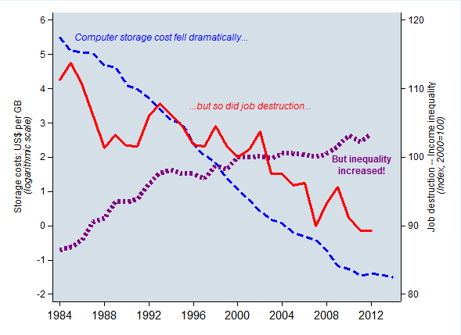
II. Impact on jobs and distribution of productivity gains
Technology, job destruction, and inequality
Impacts of technological changes?
Declining cost of digital technology
After the earlier episode of technological pessimism, a more balanced analysis of net job losses (e.g., job destruction rates have been declining
Growing concerns about the distribution of productivity gains
Note: Job destruction rate is a weighted average of Australia, Belgium, Canada, Denmark, France, Greece, Ireland, Italy, Japan, Luxembourg, Netherlands, Sweden, United Kingdom and United States
Source: ILO, Labour Flows database, 2013; tenure rates: OECD, Labour Force Statistics
Notes:
Note: Job destruction rate is a weighted average of Australia, Belgium, Canada, Denmark, France, Greece, Ireland, Italy, Japan, Luxembourg, Netherlands, Sweden, United Kingdom and United States
Source: ILO, Labour Flows database, 2013; tenure rates: OECD, Labour Force Statistics; computer storage cost: Muehlhauser, L. 2014 ''Exponential and non-exponential trends in information technology'', available at: https://intelligence.org/2014/05/12/exponential-and-non-exponential/

Slide 11
II. Wage productivity gaps
Wage repression (wage deflation) and growing inequality (falling labour income share), which is associated with the previous wave of technological changes
Figure. Wage-productivity gaps
Source: ILO, Global Employment Trends, Nov 2017; Global Wage Report 2016-17
Notes:
Source: ILO, Global Employment Trends, Nov 2017; Global Wage Report 2016-17

Slide 12
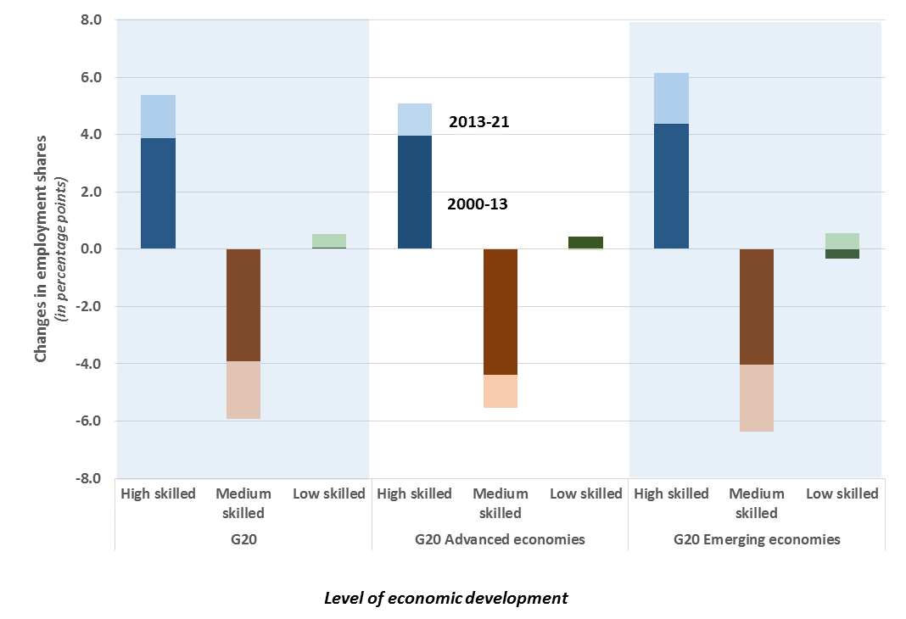
II. Job Polarisation: past and projection
And occupational inequality increased almost everywhere
Note: Change in employment shares, in percentage points; *: forecasts after 2016
Source: ILO, Trends Econometric Models, Nov 2016
Notes:
Note: Change in employment shares, in percentage points; *: forecasts after 2016
Source: ILO, Trends Econometric Models, Nov 2016

Slide 13
II. Changing Employment relationship: Increase in Non-standard forms of employment
Multi-party employment relationship
Temporary employment
Part-time and
on-call work
Disguised employment/
dependent
self-employment
NSE can be either formal or informal

Slide 14
II. Temporary employment

Slide 15
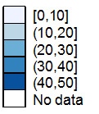

II. Part-time wage employment
Less than 35 h a week
MEN
WOMEN

Slide 16
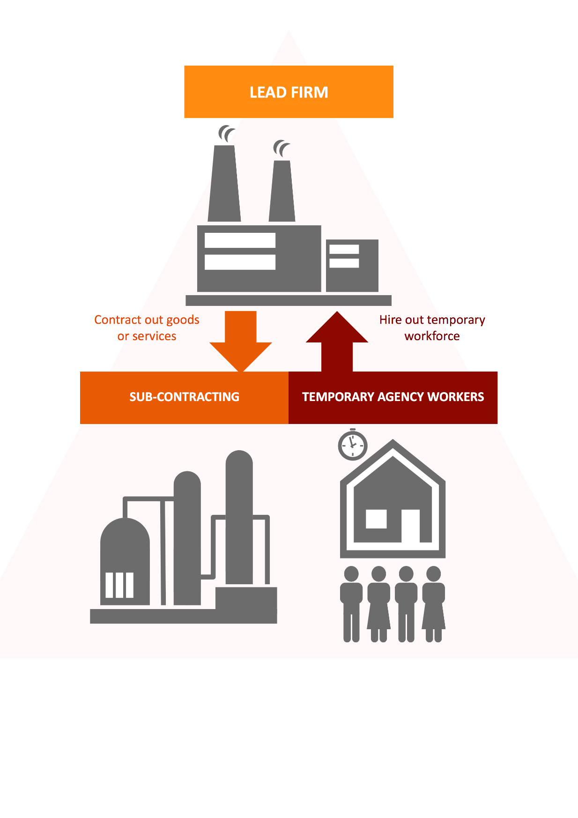
II. Multi-party employment relationship
World Employment Confederation largest markets: United States, China, Europe, and Japan
Republic of Korea: TAW - 4.4% of wage employees;
“in-house subcontracting” - 55% of firms
The Philippines: “agency-hired” workers - 62% of firms
South Africa: labour brokering - 6.5% of workforce
India: 1/3 of manufacturing workers in organized sector are contract labourers

Slide 17

II. Disguised employment / dependent self-employment
Slovakia: 3.6% of employed are ‘false self-employed’
Chile: 12–17 % of subcontracting firms made up of former employees
Argentina: 2.3% of workers
Mexico: 4.1% of workers
United States: 8 -13 per % of workers in construction
Businesses in the “on-demand” or “gig” economy hire “independent contractors”
Approximately 0.5% of labour force in U.S. and Europe, but potential for growth is high

Slide 18
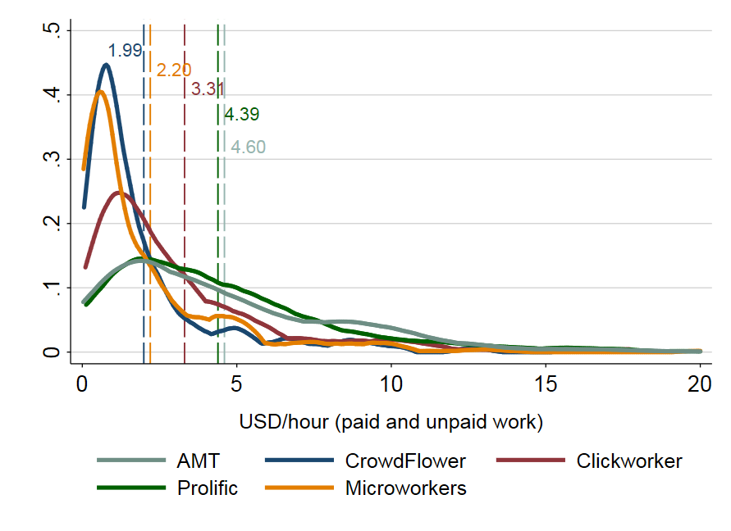
II. Crowdwork (platform-based tasks performed on demand):
Hourly earnings distribution
High inefficiencies:
  ¼ of workers’ time is on unpaid activities
  lack of communication between employer and worker
  Lack of social protection
  Lack of training

Slide 19
III. Shaping the future of work
What needs to be done?
While we know the past trends, the future is uncertain, and we may not imagine the future innovations, jobs and occupations. We need to adopt frameworks and models that explain the dynamics and patterns of technological change, innovations, diversification.
These frameworks suggest that the future of work is not deterministic, but needs to be shaped, and that it needs transformative changes to shape a future we want.
Policies and institutions need to find a fair distribution of the benefits and burdens: support workers and enterprises to exploit the opportunities new technologies bring for better work, life and business, and mitigate or prevent the negative impact and unintended effects.

Slide 20
V. Shaping the future of work
Market forces alone cannot achieve such transformative processes.
It requires governments and societies to learn and develop new social demand and policy choices.
Build capabilities in labour force, entrepreneurs and societies that
enable the country to take advantage of emerging technologies, and
innovate and transform production structures to create new economies and jobs.
Education and training policies is key as it plays a dual role:
enriches the knowledge base of society and thus enhances capabilities to innovate
fills skills gaps and matches demand with supply once a new activity has been created.
Develop social institutions that reward entrepreneurship, craftsmanship to
encourage creativity, investment, innovation and new jobs, and
redistribute productivity gains created by new technologies to workers for new demand.
Design mission-oriented technology, science, innovation and industrial policies to
shape the direction of technological and structural transformation
for development, employment and social justice.
New institutions need to regulate work and protect workers in newly emerging non-standard forms of employment
Create social dialogue for new consensus on the way forward, new social demand and policy choices

Slide 21
Thank you
Irmgard Nübler
Email: nubler@ilo.org
Skype: Irmgard.nubler
Twitter: IrmgardNubler

