Slide 1
Freedom of religion and expression
POSTSECULARISM AND THE CHALLANGES OF POPULISM
Jónatas E.M. Machado

Slide 2
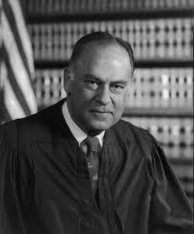
What is populism?
“I know it when I see it“
  Justice Potter Stuart

Slide 3
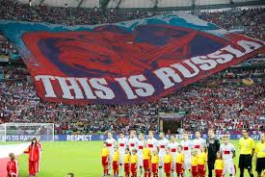
The Roots of Populism (ideology)
Tribalism
Nationalism (political, economic and social)
Antiestablishment (big government; millionaires; media)
Antiglobalism
Identity politics (left & right)
Anti-muslim populism
Anti-migrant populism

Slide 4

Populist nationalism
“There is no global anthem, no global currency, no certificate of global citizenship, we pledge allegiance to one flag and that flag is the American Flag!”
Donald Trump, Cincinnati, 2016

Slide 5
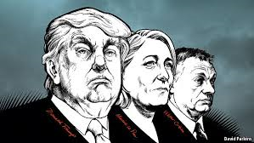
Characteristics of Populism (discourse)
Not a compreensive and coherent worldview
  Left and right
  Religious or secular
  Broadband concept
Endangered objects:
  Western (judeo-christian) values
  Liberal way of life
  Modern civilization
  Laicism and secular State (Le pen)
  Public order and national security
  Common people (v. global elite)
  Middle class

Slide 6
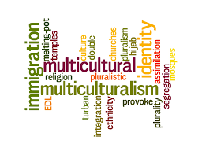
The targets of populism (discourse)
Migrants
Multiculturalism
Political correctness
Globalism
Elitism

Slide 7
Populist Manichaeism
Good | Evil
Friend | Foe
Virtue | Vice
Nativist | Migrant
People | Elite (or diversity)
We | They
Nation | Globalization (UN; EU; WTO; ICC)
Main Street | Wall Street

Slide 8
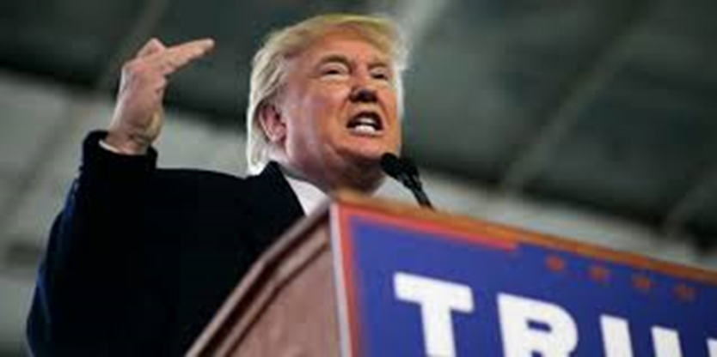
Populist rethoric
The only antidote to decades of ruinous rule by a small handful of elites is a bold infusion of popular will. On every major issue affecting this country, the people are right and the governing elite are wrong. The elites are wrong on taxes, on the size of government, on trade, on immigration, on foreign policy.
--Donald J. Trump, The Wall Street Journal,
April 14, 2016

Slide 9
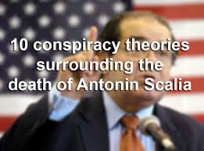
The ways of populism (strategy)
Simple rethoric
Anti-elitism (anti-experts)
Collectivism (majority; nation; state; people)
Fake news and incitement to violence
Conspiracy theories
Fear mongering
Attacks on the media

Slide 10
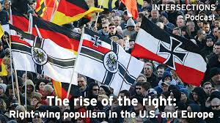
The populist mindset (style)
Anxiety
Fear
Pessimism
Resentment
Mistrust
Suspicion
Indignation
Simplism

Slide 11
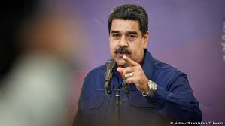
The populist leader (style)
Charisma
Common sense
Sophistry
Father (Mother) Figure
Conviction (certainty)
Will to Power
Opportunism

Slide 12
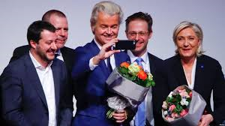
Populism in Europe
(political mobilization)
UK (UKIP, Brexit)
Holland (G. Wilders FP)
Poland (Law & Justice)
Germany (AfD)
Hungary (Fidesz)
France (FN)
Spain (Podemos)
Italy (5Star)
Greece (Syriza; Golden Dawn)

Slide 13
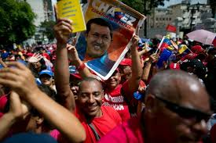
Populism in the Americas
Argentina
  Peron, Kirschner
Bolívia
  Evo Morales
Venezuela
  Chavez; Maduro
USA
  Occupy All Street
  Tea Party
  Alt-Right
  Antifa
  Trump
    “Trumpenvolk”

Slide 14
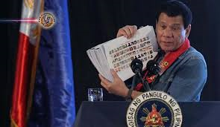
Populism in the World
Russia: Vladimir Putin
Turkey: Recep Tayyip Erdoğan
Philipines: Rodrigo Duterte
China: Xi Jimping
Egypt: Abdel Fatah Al-Sisi

Slide 15
Democracy and Populism
Democracy | Populism
People = majority + minorities | People = majority
Fundamental Rights | Rights of the majority
Separation of powers | Concentration of powers
Rule of law (“government of laws not of men”) | Populist leaders above the law
Freedom of expression and religion | Organic and collective thinking
Democracy as ceaseless critical discussion | “Führerprinzip”
Civic virtue of the typical politician | Bad manners and disruptive behavior

Slide 16
Populism and governance
Populist national governance | International governance
Hijack the state apparatus | Realpolitik
Corruption | Unilateralism
Mass clientelism | Distrust of external centres of power

Slide 17
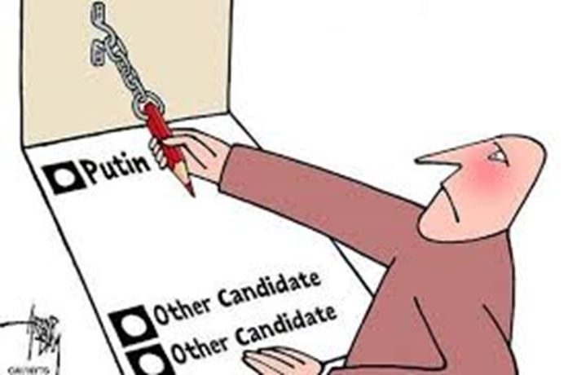
Constitutional impact of Populism
Attack on the existing order
  Impeachment
  Anticorruption laws
  Gerrymandering
  Voter identification laws

Slide 18
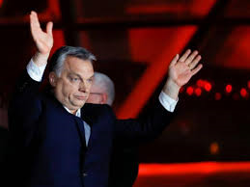
Populism and liberal democracy
“We have to abandon liberal methods and principles of organizing a society”
  Viktor Orban

Slide 19
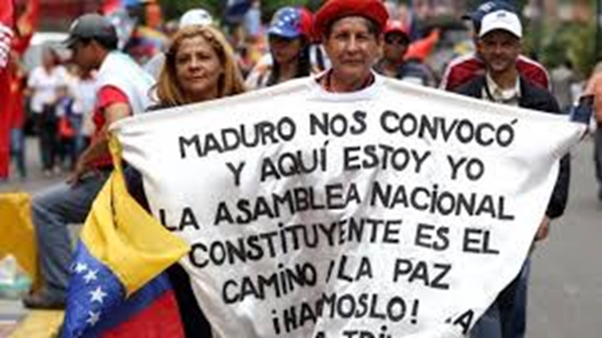
Constitutional impact of Populism
Attack on liberal democracy
    Personalization of power
    Hyperpolarization
    Constitutional changes
      Populist constitutional “improvements”
    Weakening of civil society and NGO’s
    Blame foreign entities (v.g. Putin; Soros; speculators)
    Create a new oligarchy
    Proto-authoritarianism

Slide 20
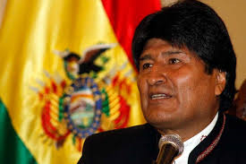
Constitutional impact of Populism
Institutional arrangements
  Centralization of executive power
    Presidencialism
    Extension of term limits
    Expansion of emergency powers

Slide 21
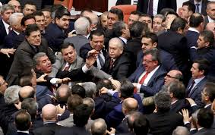
Constitutional impact of Populism
Institutional arrangements
  Weakening of parliament
    Changes in electoral laws
    Control of election administration
    Limiting parliament´s control powers
    Limiting opposition’s rights
    Referenda and “direct dialogues with the people”

Slide 22
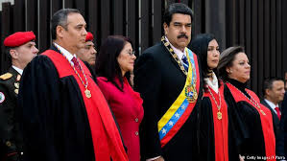
Constitutional impact of populism
  Controlling “independent” agencies
  Weakening of the courts
    Control of Constitutional Court
      Removing hostile justices
      Apoint friendly justices
      Expanding the size of the Court
    Removal of hostile justices from other courts

Slide 23

Populism and freedom of expression
  Creation of a post-human rights world
  Control “private” media outlets through friendly tycons
  Control of the labor unions
  Attacks on journalists
  Attacks on the news media
  Tougher laws on defamation

Slide 24
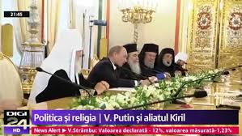
Populism and freedom of religion
  Alliance with the dominant religions
  Restriction of religious freedom
  Social hostility towards religious minorities
  Incitement to hatred and violence against minorities

Slide 25
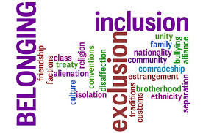
Important lessons of Populism
Historical and cultural identity matters
Moral and normative values matter
Freedom of critical thinking cuts both ways
Politicians should take the feelings and fears of the people seriously
State religious and moral neutrality can never be absolute
There are social limits to migration flows

Slide 26
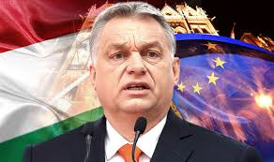
Overcoming Populism
“My lesson from history is that if there is a strong moderate centrist party which can lead the country, there is no room for extremists from the right or left.”
  Viktor Orban

Slide 27
Postsecularism
Philosophical naturalism lack of ontological and epistemological priviledge
Science has no objective answer to ultimate questions about the Universe and Life
Religion is as legitimate presence in public life as athersm and naturalism
There are fidelistic, traditional, rational and logical elements in both science and religion
Importance of freedom of open and critical discussion of religious and non religious worldviews
Allow for a plurality of religious and non religious voices and perspetives

Slide 28
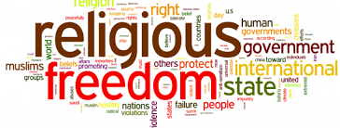
Overcoming Populism through freedom of religion
  Recognize the existence of national conceptions of morality
  Recognize a reasonable amount of religious and moral plurality of views
  Accomodate recessive worldviews within a dominant worldview
  Allow:
    religious teaching in public schools
    private religious schools and homeschooling
    theology programs within public universities
  Establish plural commissions on religious freedom

Slide 29
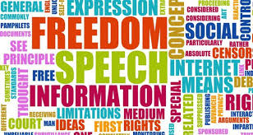
Overcoming Populism through freedom of expression
  Robust free marketplace of secular and religious ideas
  Critical thinking and cross-examination in the realm of religious and non-religious belief
  Policentric structure of communication
  Religious and secular media outlets
  Accept a limited scope of concepts such as hate speech, group defamation, religious defamation, islamophobia (and CEE’s) to prevent them from censuring and stiffling legitimate debate

Slide 30
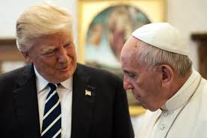
Overcoming Populism
"Solidarity with migrants and refugees must be accompanied by the courage and creativity necessary to develop, on a world-wide level, a more just and equitable financial and economic order, as well as an increasing commitment to peace, the indispensable condition for all authentic progress.“
  Pope Francis

Slide 31
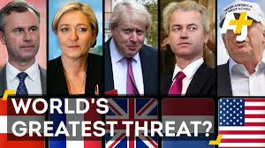
Overcoming Populism
Draw on universal elements of religious doctrines
Don’t underestimate populismo and its dangers
Don’t undersestimate cultural and moral diferences
Don’t neglet people’s fears and anxieties
Uphold the moral dignity and worth of all human beins
Offer reasoned and realist solutions
Sustain freedom of conscience, thought, religion and expression
Strenghten constitutional governance

