Slide 1
FREEDOM OF EXPRESSION AND HATE SPEECH
Jónatas E.M. Machado
Notes:
1

Slide 2
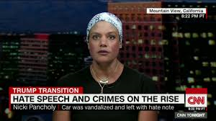
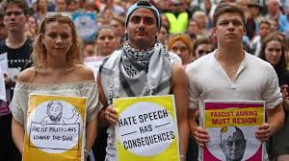
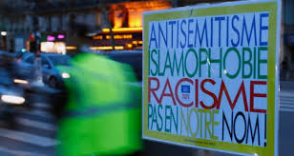
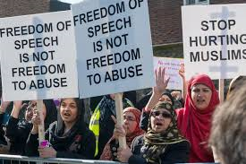

Slide 3
Origins of the concept of hate speech
In the aftermath of Weimar Republic, rise of Nazism, WWII and the Holocaust
Propposed by Karl Loewenstein and Karl Mannheim
Defensive democracy (Wehrhaften demokratie) of militant democracy (Streitbare demokatie)
It may be necessary to restrict freedom of speech in order to protect human rights and democracy from agressive ideological atacks

Slide 4
Basic ideas of militant democracy
Totalitarian forces can use freedom of expression systematically with the aim of subverting democracy, freely defaming its leaders and institutions, inciting public opinion, spreading falsehoods, attacking the character of ethnic communities or vilifying whole groups.
Freedom of conscience, thought, religion and expression should be understood as instruments of individual and social liberation and not as tools for dehumanisation, oppression and annihilation.

Slide 5
ECHR Council of Europe 1953
ARTICLE 10
Freedom of expression
1. Everyone has the right to freedom of expression. This right shall include freedom to hold opinions and to receive and impart information and ideas without interference by public authority and regardless of frontiers. This Article shall not prevent States from requiring the licensing of broadcasting, television or cinema enterprises.
2. The exercise of these freedoms, since it carries with it duties and responsibilities, may be subject to such formalities, conditions, restrictions or penalties as are prescribed by law and are necessary in a democratic society, in the interests of national security, territorial integrity or public safety, for the prevention of disorder or crime, for the protection of health or morals, for the protection of the reputation or rights of others, for preventing the disclosure of information received in confidence, or for maintaining the authority and impartiality of the judiciary.
Notes:
5

Slide 6
ICCPR (1966)
1. Everyone shall have the right to hold opinions without interference.
2. Everyone shall have the right to freedom of expression; this right shall include freedom to seek, receive and impart information and ideas of all kinds, regardless of frontiers, either orally, in writing or in print, in the form of art, or through any other media of his choice.
3. The exercise of the rights provided for in paragraph 2 of this article carries with it special duties and responsibilities. It may therefore be subject to certain restrictions, but these shall only be such as are provided by law and are necessary:
(a) For respect of the rights or reputations of others;
(b) For the protection of national security or of public order (ordre public), or of public health or morals.

Slide 7
Convention on the Prevention and Punishment of the Crime of Genocide (1948)
Article III
The following acts shall be punishable:
(c) Direct and public incitement to commit genocide;

Slide 8
Racial Discrimination Convention (1965)
States Parties condemn all propaganda and all organizations which are based on ideas or theories of superiority of one race or group of persons of one colour or ethnic origin, or which attempt to justify or promote racial hatred and discrimination in any form, and undertake to adopt immediate and positive measures designed to eradicate all incitement to, or acts of, such discrimination and, to this end, with due regard to the principles embodied in the Universal Declaration of Human Rights and the rights expressly set forth in article 5 of this Convention, inter alia:
(a) Shall declare an offence punishable by law all dissemination of ideas based on racial superiority or hatred, incitement to racial discrimination, as well as all acts of violence or incitement to such acts against any race or group of persons of another colour or ethnic origin, and also the provision of any assistance to racist activities, including the financing thereof;
(b) Shall declare illegal and prohibit organizations, and also organized and all other propaganda activities, which promote and incite racial discrimination, and shall recognize participation in such organizations or activities as an offence punishable by law;
(c) Shall not permit public authorities or public institutions, national or local, to promote or incite racial discrimination.

Slide 9
ICCPR (1966)
Article 20
1. Any propaganda for war shall be prohibited by law.
2. Any advocacy of national, racial or religious hatred that constitutes incitement to discrimination, hostility or violence shall be prohibited by law.

Slide 10
Relevant distinctions
Free speech | Hate Speech
Hold opinions without interference | Advocacy of (national, racial or religious) hatred
Seek, receive or impart information and ideas of all kinds | Incitement to discrimination, hostility and violence
Regarless of frontiers | Direct and public incitement to commit genocide
Orally, in writing or in print, in the form of art, or through any other media of his choice | Racist propaganda
 | Justification or promotion of racial hatred and discrimination in any form
 | Incitement to violent acts against any race or group of persons of another color or ethnic origin
 | Propaganda of racial discrimination

Slide 11
Hate speech
Intentionally destructive speech: warning signs
Destruction of the individual's sense of dignity and self-esteem
Creation of a sense of social helplessness
Deliberately provocative, sneering, mocking, deriding
Bullying, silencing and censoring
Humiliating, denigrating, dehumanising
Aggressive, intimidating, menacing, threatening
Fighting words and potentially violent forms of speech

Slide 12
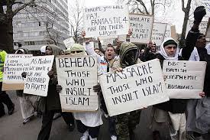
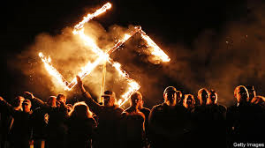
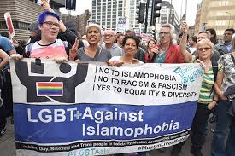
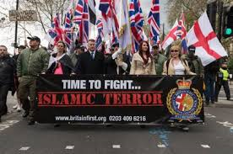
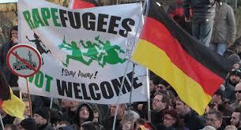
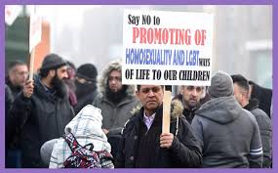

Slide 13
ECHR criteria to assess speech
Criteria used by the ECHR to assess protected speech and hate speech
Whether the statements were made against a tense political or social background
Whether the statements, fairly construed and seen in their immediate or wider context, could be seen as a direct or indirect call for violence or as a justification of violence, hatred or intolerance
Manner in which statements were made, and their capacity – direct or indirect – to lead to harmful consequences.
Interplay between the various factors involved rather than any one of them taken in isolation that determined the outcome of the case.
Restrictions on freedom of speech in the form of criminal sanctions are only acceptable in cases of incitement to hatred

Slide 14
General Policy Recommendation N°15 European Commission on Racism and Intolerance, 08-12-2015
When determining whether an expression constituted incitement to hatred, the following elements are essential for assessment of whether or not there is a risk of acts of violence, intimidation, hostility or discrimination:
(i) “the context in which the hate speech concerned is being used”;
(ii) “the capacity of the person using the hate speech to exercise influence over others”;
(iii) “the nature and strength of the language used”;
(iv) “the context of the specific remarks”;
(v) “the medium used”;
(vi) “the nature of the audience”

Slide 15
The essencial functions of freedom of speech must be preserved
Subjective autonomous expression
Critical discussion
Search for truth and kowledge
Free market place of ideas
Liberal democracy
Rule of law and anticorruption
Control of all social powers
Sphere of public discourse
Peaceful transformation of society
Accomodation of conflicting views
Diversity of ideas and perspetives
Normative change
Notes:
15

Slide 16
Free speech: freedom to discuss controversial topics
Controversial topics
Migration and its regulation
Sexuality, family and community
Religion, society and law
Religious doctrines and practices
Identity, ethnicity and culture

Slide 17
Danger of overusing vague restrictive concepts
 | Restrictive | concepts
Insults | Religious insults | Insults to religious feelings | Defamation
Defamation of religion | Slander | Hurtful comments | Disparaging religion
Emotional distress | Group defamation | Blasphemy | Disturbance of peace
Existential damage | Homophobia | Christophobia | Islamophobia

Slide 18
General Policy Recommendation N°15 European Commission on Racism and Intolerance, 08-12-2015
Anti-hate speech measures must be well-founded, proportionate, non-discriminatory, and not be misused to curb freedom of expression or assembly nor to suppress criticism of official policies, political opposition and religious beliefs.

Slide 19
UN Human Rights Committee’s General Comment No. 34, Article 19: Freedoms of Opinion and Expression, of 12 September 2011,
§ 48
“Prohibitions of displays of lack of respect for a religion or other belief system, including blasphemy laws, are incompatible with the ICCPR except in the specific circumstances envisaged in article 20, paragraph 2, of the ICCPR”

Slide 20
John Locke: the ethics of public debate
‘If a man, as a sincere friend to the person, and to the truth, labours to bring another out of error, there can be nothing more beautiful, nor more beneficial. If party, passion, or vanity direct his pen, and have a hand in the controversy; there can be nothing more unbecoming, more prejudicial, nor more odious.’
On the Reasonableness of Christianity…

Slide 21
Hustler Magazine v. Falwell 485 U.S. 46 (1988)
The facts:
Larry Flynt and Hustler Magazine: promototers of a sexual revolution and critics of traditional morality
Jerry Falwell: Baptist Pastor, leader of the “Moral Majority”, defendor of conservative sexual and family values
Deep political and cultural differences
Collision of different world views
Notes:
21

Slide 22
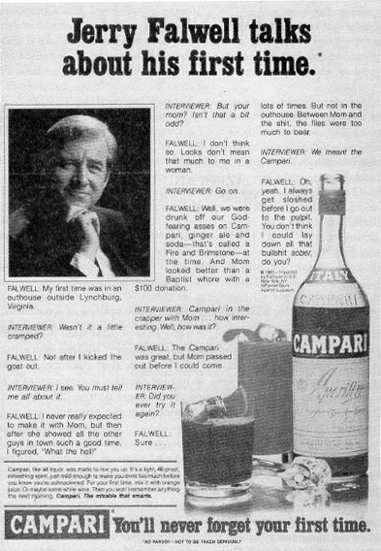
Hustler Magazine v. Falwell 485 U.S. 46 (1988)
The facts:
Hustler magazie satirizes Reverend Jerry Falwell, by suggesting he had incestuous sexual relations with his mother
Jerry Falwell sues Hustler Magazine for damages for emotional distress
Notes:
22

Slide 23
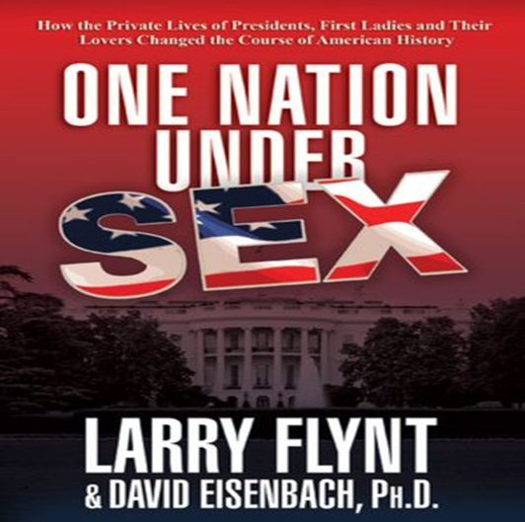
Hustler Magazine v. Falwell 485 U.S. 46 (1988)
Decision:
Importance of freedom of discussion in the public sphere
Public discussion should be unhibited, robust and wide open
This discussion will certainly be hurtful for some people
Public figures cannot ask for compensation for emotional distress
The satirical content didn’t purport to be descriptive of facts relating to Falwell
Satire and political cartoon are very important and would be easy targets for legal action with loss for the public sphere
Concepts such as “ofensive” or “insulting” or “distressing” are too subjective and emotive to limit freedom of expression
Notes:
23

Slide 24
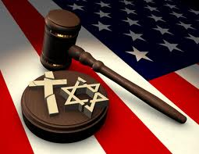
Hustler Magazine v. Falwell 485 U.S. 46 (1988)
Questões:
Has Hustler magazine freedom of expression?
The intensity of the debate justifies more freedom or more careful?
What is the role of satire and caricature in the public sphere?
What is the role of human dignity as limit to freedom?
What rights can be invoked by a public figure?
Notes:
24

Slide 25
Otto-Preminger Institute v. Austria (1994)
Exibition of the Film “Das Liebekonzil” (Councíl of Love) in a “art cinema” of the OPI: very satírical towards the sinful relation between religion, money, sex and power.
Film based on a theater play by Oskar Panizza, of 1894, who had been arrested in Italy, in 1895, for crimes against religion
Promotion of the film in a relatively discrete way; exibition before a selected audience with an age limit of 17
Catholic Church Insbruck, Tirol, sues the director of OPI, por “disparaging religious doctrines”
The Film is censured in Austria
Notes:
25

Slide 26
Otto-Preminger Institute v. Austria (1994)
Against freedom of speech
In favor of freedom of speech
Freedom of speech protects shocking, disturbing and offensive speech
Prohibition of censorship
Artistic freedom
Freedom for minority critical positions
Importance of strong discussion
Freedom of speech must respect the religion of others
Respect for the religious sentiments of others
Right not to be insulted
Special status of the majority religion
Prohibition of gratuitous insults
Notes:
26

Slide 27
Charlie Hebdo Court d’Appel, Paris 12 March 2008
Facts:
Publication of 12 caricatures of Mohamed by the danish newspaper Jyllands-Posten
Criticism of islamic extremist violance and the risk of self-censurship
Islamics acuse the newspaper of Islampphobia, racism and blasphemy
Caricatures are republished in 50 countries
Charlie Hebdo publishes the cartoons in France
Notes:
27

Slide 28
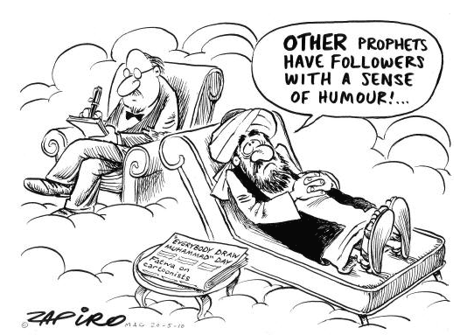
Charlie Hebdo Court d’Appel, Paris 12 - March 2008 Charlie Hebdo Court d’Appel, Paris 12 de Março de 2008
Decision:
Freedom of speech protects a “satírical, caustic and spiritually unrespectful” newspaper
The cartoons were not meant to be insulting, targeting only a small part of the islamic population, namely extremist islamic terrorists
The cartoons do not represent an attack against a religious group, and thus should be protected by freedom of speech
Notes:
28

Slide 29
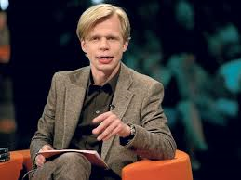
Jersild v. Denmark TEDH,19 Eur. H.R. Rep. at 1 (1994)
Facts
Journalist J. O. Jersild interviewd members of a racist group
During the interview they made some extreme racist and xenophobic statements
Journalist was sentenced for promoting racism
Notes:
29

Slide 30
Jersild v. Denmark TEDH,19 Eur. H.R. Rep. at 1 (1994)
Decision
The restriction to freedom of speech was uncessary in a free and democratic society
The intervew wanted to expose, analise and explain the perspective of the group
The problem of racism is a subject of public interest
Notes:
30

Slide 31
David Irving v Penguin Books and Deborah Lipstadt 11 of April 2000
Facts:
Deborah writes a book denouncing holocaust denial by historian David Irving, acusing him of lying and forging documents
Holocaust denial is depicted as antisemitism
David Irving sues Penguin Books and Deborah Lipstadt for defamation in England
The Author and the Publisher must prove the truth of their statements.
David Irving says he can’t be acused of denying something which does not exist
In the background lays the pressure to criminalize holocaust denial
Notes:
31

Slide 32
David Irving v Penguin Books and Deborah Lipstadt 11 Abril de 2000
Decision:
In a judicial sentence of more than 300 pages, the Court holds that the Holocaust is a historical fact, which means that there was no defamation
It holds that David Irving is in fact a racist and antisemitist, which proves that Deborah Lipstadt was telling the truth
There was no defamation and so no damages were due
Notes:
32

Slide 33
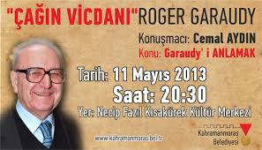
Garaudy v. France TEDH, 2003-IX Eur. Ct. H.R. 369
Facts
Roger Garaudy, a marxist, humanist Christian, converts to islamism
He writes about the “foundation myths of Israel (1995)
He questions the nature and extent of the Holocaust and the Legitimacy of the Nuremberg Trials
Notes:
33

Slide 34
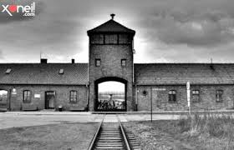
Garaudy v. France TEDH, 2003-IX Eur. Ct. H.R. 369
Decision
Denying the Holocaust is:
Denying historical truth
Rehabilitating Nazims
Acusing the victims of lying
Beeing racist and defamatory towards the Jews
A judicial conviction for denying the holocaust doesn’t violate freedom of expression
Notes:
34

Slide 35
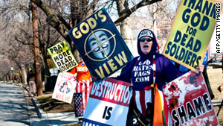
Snyder v. Phelps 131 S.Ct. 1207 (2011)
Facts
Funeral of a US Marine soldier killed in Iraq
Outside there were some protests and demonstrations organized by a Church, linking the death of US soldiers in Iraq with the US Army receptive policy towards homosexuals
Some family members of the Marine sue for defamation, violation of privacy, and emotional distress
Notes:
35

Slide 36
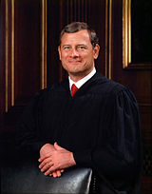
Snyder v. Phelps 131 S.Ct. 1207 (2011)
Decision:
Public interest: the topic of US Army policy is one of public and social relevance;
Religious expression: the content of the protests corresponds to the core of the beliefs of this Church expressão correspondia ao núcleo
Freedom of speech: freedom of speech protects ofensive, insulting and disturbing speech;
Privacy: the protests took place at a considerable distance from the funeral;
Demonstration: the protests were peaceful, and followed police instructions .
Notes:
36

Slide 37
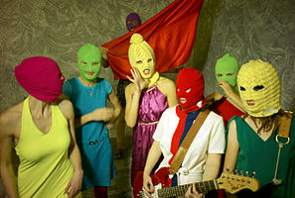
MARIYA ALEKHINA AND OTHERS v. RUSSIA App. No. 38004/12 ECHR III, 17-08-2018
Facts
Pussy Riot
Punk Rock band supporter of LGBT rights
Crític of Vladimir Putin and the Russia Ortodox Church
Performs a satircal concert in the Moscow Cathedral of Christ the Saviour (2012)
Edits a Vídeo “Punk Prayer, Mother of God get rid of Vladimir Putin”
Three band members are convicted in August 2012 on grounds of holiganism fueled by religious hadred
Two of them are inprisoned in separated penitentiaries
Notes:
37

Slide 38
MARIYA ALEKHINA AND OTHERS v. RUSSIA App. No. 38004/12 ECHR III, 17-08-2018
Pussy Riot:
Political criticism (Pussy Riot)
Prisoners of conscience (Amnesty International)
Threat to the moral integrity of the country (Vladimir Putin)
Inciting religious hatred (Ortodox Church)
Notes:
38

Slide 39
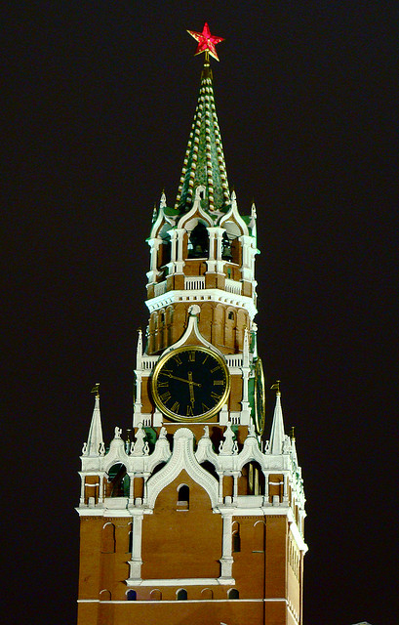
MARIYA ALEKHINA AND OTHERS v. RUSSIA App. No. 38004/12 ECHR III, 17-08-2018
Court
Pussy Riot
Gross insult to the Ortodox Church
Offensive and totally disriespectful towards the religious believers
Eroding the moral social order
ECHR
The individual compartments in which the applicants were transported and the treatment during the court hearings violated Article 3 of the ECHR
The free speech case must be viewed as a whole in its social and political context
Notes:
39

Slide 40
MARIYA ALEKHINA AND OTHERS v. RUSSIA App. No. 38004/12 ECHR III, 17-08-2018
“Freedom of expression, as secured in paragraph 1 of Article 10, constitutes one of the essential foundations of a democratic society and one of the basic conditions for its progress and for each individual’s self-fulfilment. Subject to paragraph 2, it is applicable not only to “information” or “ideas” that are favourably received or regarded as inoffensive or as a matter of indifference, but also to those which offend, shock or disturb; such are the demands of pluralism, tolerance and broadmindedness, without which there is no “democratic society””

Slide 41
MARIYA ALEKHINA AND OTHERS v. RUSSIA App. No. 38004/12 ECHR III, 17-08-2018
216. The Court notes that the domestic courts convicted the applicants of hooliganism motivated by religious hatred and enmity, committed in a group acting with premeditation and in concert, under Article 213 § 2 of the Criminal Code. It is significant that the courts did not examine the lyrics of the song Punk Prayer – Virgin Mary, Drive Putin Away performed by the applicants, but based the conviction primarily on the applicants’ particular conduct. The trial court emphasised the applicants’ being “dressed in brightly coloured clothes and wearing balaclavas”, making “brusque movements with their heads, arms and legs, accompanying them with obscene language and other words of an insulting nature” to find that such behaviour did not “respect the canons of the Orthodox Church”, and that “representatives of other religions, and people who do not consider themselves believers, also [found] such behaviour unacceptable” (see paragraph 52 above). The trial court concluded that the applicants’ actions had “offend[ed] and insult[ed] the feelings of a large group of people” and had been “motivated by religious hatred and enmity” (ibid.).

Slide 42
MARIYA ALEKHINA AND OTHERS v. RUSSIA App. No. 38004/12 ECHR III, 17-08-2018
205. In the case at hand, the applicants, members of a punk band, attempted to perform their song Punk Prayer – Virgin Mary, Drive Putin Away from the altar of Moscow’s Christ the Saviour Cathedral as a response to the ongoing political process in Russia (see paragraphs 7-8 above). They invited journalists and the media to the performance to gain publicity.
206. For the Court, that action, described by the applicants as a “performance”, constitutes a mix of conduct and verbal expression and amounts to a form of artistic and political expression covered by Article 10.
229. In view of the above, and bearing in mind the exceptional seriousness of the sanctions involved, the Court finds that the interference in question was not necessary in a democratic society.
230. There has therefore been a violation of Article 10 of the Convention.

