Slide 1
EU Labour mobility – A gift or a burden?
Brussels 26-28 October 2015
Notes:
1
I

Slide 2
Employment and mobility “Facts and Figures”
Notes:
2
CCME – founded 1964 by the WCC to address migrant worker issues in Western Europe. Today CCME is the Ecumenical agency on migration and integration, refugees and asylum, and against racism and discrimination. It brings together Protestant and Orthodox as well as Pentecostal churches, Councils of Churches and federations of migrant churches, and specialised ministries, like diaconal agencies
Migration is a „ordinary“ phenomenon and exists since the beginning of humankind
Reasons for people to migrate differ, for Christians, however, migration is associated with new beginnings, news steps in life: Abraham and Sarah are called to leave their home; Moses led the people of God from slavery and exploitation to the land promised by God; Jesus was a refugee in Egypt; he had no home of his own; the desciples spread out to tell the Gospel to the world and layed the foundation to the church all around the Mediterranean Sea

Slide 3
Freedom of Movement of EU citizens
Migration and Mobility - Definitions
Right of EU citizens to move to and reside in any EU member state, take up employment or undertake self-employed activities
Rights include family members, even if they are not EU citizens
Notes:
3
Migration is defined: Every person who lives in an other country than that of his or her nationality for more than one year
Migrant workers and their family members
Students
Persons who wish to change their residence and have sufficient resources (pension, own property and income, business persons, prominent persons)
Mobility is though as moving to an other country for some time and move back, it is related also to circular migration of third country nationals, but in the EU discourse, currently mobility is understood as freedom of movement of EU citizens.
Mobility: positive connotations, rich experience from studying or working abroad (Erasmus programmes etc),
Migration: negative connotations, particularly in the current refugee discourse.
CCME wishes to maintain however, that migration ought to be understood in principle as positive, but that forced migration ought to be minimised and reduced as far as possible

Slide 4
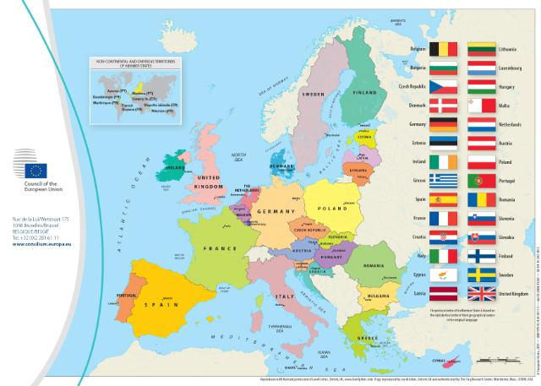
EU Enlargement
Notes:
4
EU enlargement in 2004 10 countries
2007 BG and RO
2013 Croatia
Candidate countries Balcan and Turkey
Schengen rules: Internal freedom of movement and opening of borders, strengthening of external EU/Schengen borders (EU+, NO and CH)

Slide 5
Migration of EU citizens and third country nationals
For EU citizens, freedom of movement is a fundamental right
Third country nationals have to apply first for a (temporary) residence permit linked to employment, studies or training, or as volunteers; special situation for highly-qualified: Blue Card
Third country nationals have the right to family reunification, however, this may be regulated (and restricted according to the family reunification directive
Notes:
5

Slide 6
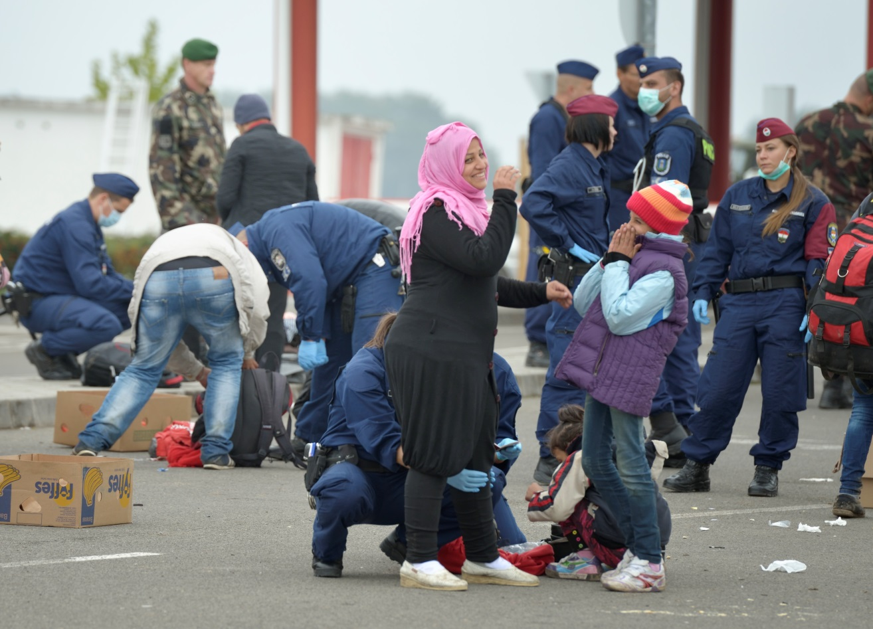
Refugees and migrants
In statistics, refugees are counted as migrants
Globally and in most countries, refugees are about 10 % of the migrant population
Specific rights Refugee Convention
Notes:
6
Photo: Paul Jeffrey

Slide 7
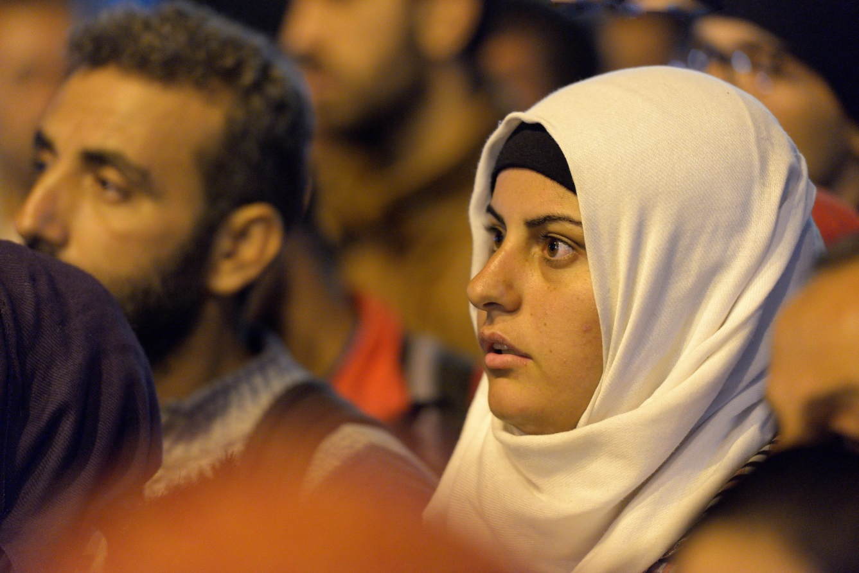
Undocumented migrants
EU citizens working without social security and taxes
Third country nationals without right to work
Undocumented but with fundamental rights
UN Convention for the rights of all migrant workers and the members of their families 1990
December 18
Notes:
7
Photo: Paul Jeffrey

Slide 8
CCME
Thank you for your attention!
Churches’ Commission for Migrants in Europe
Rue Joseph II 174 B-1000 Brussels
www.ccme.eu

