Slide 1
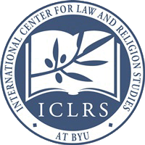
Women’s and Children’s Rights in the International Legal Framework
Keynote Address at the
Summer School on Human Rights:
“Stand Up for Women’s and Children’s Rights”
31 May – 4 June 2016
Thessaloniki, Greece
Prof. W. Cole Durham, Jr.
President, International Consortium for Law and Religion Studies and
Founding Director, International Center for Law and Religion Studies
J. Reuben Clark Law School
Brigham Young University
Notes:
Vice Rector Stogianidou, Dean Konstantinou, Metropolitan Anthimos, Archimandrite Sotiriadis, Rev. Dr. Gunner, Ladies and Gentlemen:
It is a great honor for me to be here in Thessaloniki, and I deeply appreciate the hospitality that has already been shown me here.
I have been asked today to speak about “Women’s and Children’s Rights in the International Legal Framework.” I approach this theme from the perspective of someone who has spent much of his professional life working on freedom of religion or belief. With that in mind. With that in mind I will approach the general theme from the vantage point of how Women’s and Children’s Rights fit together with freedom of religion or belief in the overall legal framework of international human rights. For the most part these rights reinforce each other in powerful and synergistic ways.

Slide 2
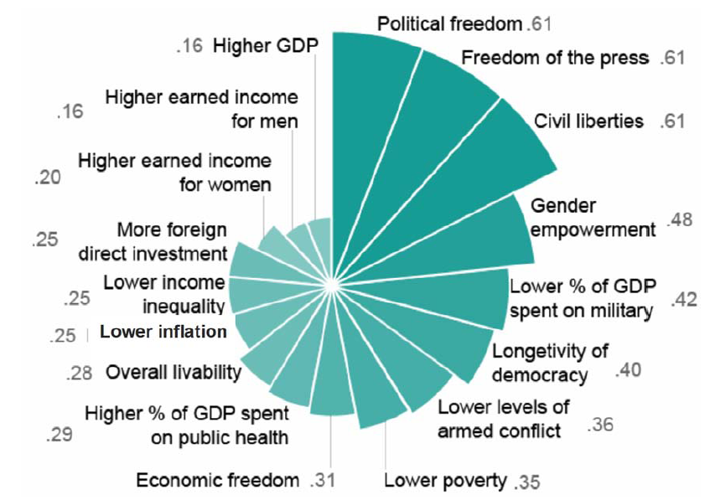
Religious Freedom Correlations
Brian J. Grim and Roger Finke, The Price of Freedom Denied (2011) 206
Notes:
Thus, recent research drawing from global data shows that there are strong correlations between countries with high levels of religious freedom, and numerous other social goods.
The correlations of religious freedom with civil and political rights such as political freedom, freedom of the press, and other civil liberties are not surprising. But the high correlation with gender empowerment is striking. Several of the correlations redound to the benefit of both women and children: lower levels of armed conflict, lower poverty, overall livability, lower income inequality, higher earned income for women, etc. Other correlations not shown on the chart are similarly beneficial: for example, increased literacy rates. What this reflects is the significant tendency of freedom of religion or belief to unleash and help tap social capital in ways that benefit everyone in society, including the most vulnerable.

Slide 3
Religion and Human Rights
Louis Henkin: “all the major religions proudly lay claim to fathering” human rights.
Abba Hillel Silver: “Religion was not only tardy in championing human rights; at times it was actually retarding and reactionary.” 13
Robert Traer: “Clearly, something new is occurring when women and men of different faith traditions join with those of no religious tradition to champion human rights.”
World Council of Churches played a vital role in the struggle for human rights from the inception.
Notes:
From the beginning of the modern human rights movement after the Second World War, religious voices have played a key role in building the modern framework of international human rights.
Robert Traer’s book on “Faith in Human Rights” helps point out the ways that differing religious traditions have played a role from differing perspectives in supporting human rights. Many of the key features of current international human rights law would not have been adopted without support from various religious groups.
World Council: Traer at 21.
Louis Henkin, The Rights of Man Today (Boulder, Colo.: Wesview Press, 1978), xii.
Abba Hillel Silver, “Prophetic Religion and World Culture,” in Religious Faith and World Culture, ed. Amandus William Loos (Freeport, N.Y.: Books for Libraries Press, 1951; reprinted 1970), 138.
Robert Traer, Faith in Human Rights: Support in Religious Traditions for a Global Struggle (Georgetown University Press, 1991).

Slide 4
Ambivalence of Religious Attitudes
Religious traditions support core notions of human rights.
But, the rhetoric of rights has often been leveled against religious traditions.
The “ambivalence of the sacred” results in differing attitudes toward religion, matched by different responses
Attitude of Catholic Church to human rights rhetoric after French Revolution
Response of Muslims in many parts of the world
Where human rights are experienced as an attack on religion, human rights lose credibility in the religious community attacked.
Where resources within religious traditions are shown to support human rights precepts, support for those precepts is strengthened.

Slide 5
Need for Wise and Sensitive Religious Voices Addressing Human Rights Issues
Need to find ways that accommodate distinctive religious concerns and beliefs while respecting others.
Need to promote mutual understanding.
Need to find ways that people with very different beliefs can live together in peace.
Notes:
Because of the “ambivalence of the sacred,” [Scott Appleby’s book of that title] and the resulting ambivalence of attitudes toward religion and within religious communities, there have long been tensions between advocates of human rights coming from a secular perspective, and advocates coming from religious perspectives. There is often suspicion of agendas on both sides of this divide. The divide is being aggravated by a range of “culture war” issues. This means that we particularly need competent and committed human rights workers who can help bridge this divide.
In my remarks today I hope that I can not only help describe the international legal framework relevant to our discussion this week, but also help suggest ways that religious voices can make wise contributions to efforts to improve implementation of human rights in religiously sensitive ways.

Slide 6
Framework
Overview of key international human rights instruments
Pluralistic grounding of the international framework
This helps make human rights framework both universal and particular
Universal in that it applies to all mankind (and womankind)
Particular in that it can be justified for reasons that make sense to different religious and cultural traditions
Children’s rights
Women’s rights (gender perspective)

Slide 7
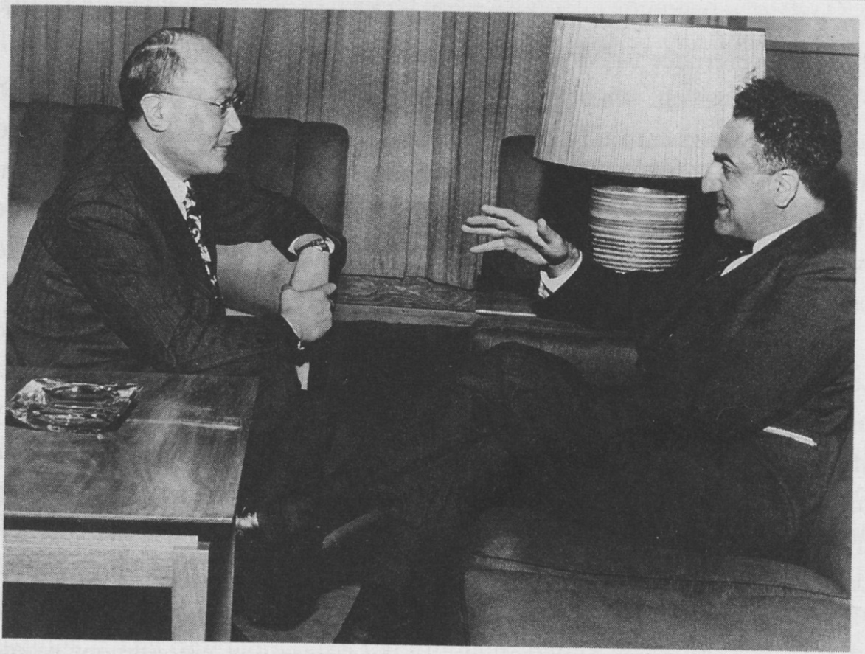
P.C. Chang and the U.N. Human Rights Commission
P.C. Chang and Charles Malik
“All human beings are born free and equal in dignity and rights. They are endowed with reason and conscience and should act towards one another in a spirit of brotherhood.”
—Article 1 of the Universal Declaration of Human Rights

Slide 8
Four Crucial Delegates & Eighteen Nations
Two intellectual polestars of the declaration:
P.C. Chang: Chinese philosopher, diplomat, and playwright, and vice-chairman of the commission.
Charles Malik: Lebanese philosopher and diplomat - Secretary of the commission.
A legal architect: Rene Cassin: The legal genius of Free France.
A powerful personality: Eleanor Roosevelt: Former American first-lady. Chairman of the Commission
The 18 Nations on the Commission on Human Rights:
Australia, Belgium, Chile, China, Egypt, France, India, Iran, Lebanon, Panama, Philippines, the Soviet Union, the United Kingdom, the United States, and Yugoslavia.

Slide 9
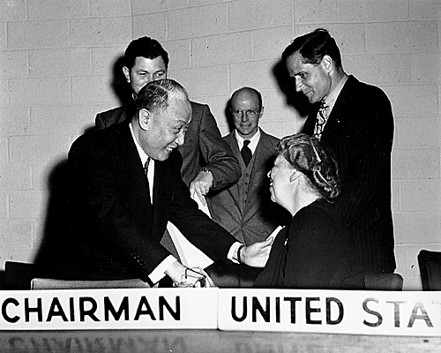
The Drafting Committee
P.C. Chang and Eleanor Roosevelt
18-member delegation found drafting an “international bill of human rights” difficult because of enormous political and social obstacles.
So the commission chose Roosevelt, Chang, Malik, and John Humphrey to prepare a preliminary draft.

Slide 10
Drafting Process
Existing norms
Consensus not theory
Malik: “Yes, we agree about the rights, but on condition no one asks us why.”
Sovereign state’s treatment of their own citizens not only a domestic matter.
Shift from minorities approach to protection of individuals

Slide 11
Fundamental Provisions of UDHR:
Article 1. “All human beings are born free and equal in dignity and rights. They are endowed with reason and conscience and should act towards one another in a spirit of brotherhood.”
Article 2. “Everyone is entitled to all the rights and freedoms set forth in this Declaration, without distinction of any kind, such as race, colour, sex, language, religion, political or other opinion, national or social origin, property, birth or other status. . . . .”
Other articles (5-28) list specific freedoms: e.g., right to life, liberty and security of person; no one shall be held in slavery; slave trade forbidden; anti-torture provisions; equality before the law; right to effective remedies; procedural rights; freedom of religion, expression, association; social and economic rights.

Slide 12
Limitations: Article 29
1. Everyone has duties to the community in which alone the free and full development of his personality is possible.
2. In the exercise of his rights and freedoms, everyone shall be subject only to such limitations as are determined by law solely for the purpose of securing due recognition and respect for the rights and freedoms of others and of meeting the just requirements of morality, public order and the general welfare in a democratic society.
3. These rights and freedoms may in no case be exercised contrary to the purposes and principles of the United Nations.
Notes:
In addition to affirmation of basic rights, there is a recognition of limitations.
Everyone has duties in addition to rights. Rights generate duties and duties generate rights. One of the hazards of the rights culture in which we live is that it can generate a kind of moral bankruptcy, where there are more rights claims than duties to fulfill them.
Limitations: must be prescribed by law (i.e., conform to the rule of law), and must be necessary for securing “due recognition and respect” for the rights and freedoms of others and for meeting the just requirements of morality, public order and general welfare in a democratic society.
Rights should not be abused.

Slide 13
The Deeper Framework
“A free, liberal, and democratic state can only be built and sustainable on a foundation that it in itself is unable to create.”
--Ernst-Wolfgang Böckenförde
Former Justice
German Federal Constitutional Court

Slide 14
Böckenförde Paradox
The tragedy of liberty
Other political passions override the desire for liberty
Dostoevsky’s Grand Inquisitor is a recurrent tale not only at the level of individual moral choice, but also at the level of political freedom
Liberty is overridden by other political passions: envy, equality, social and economic rights, sexual liberation, fear, corruption
The need for voluntary compliance
The need for moral striving to provide the inputs for the vision, convictions and ideas that provide the value inputs for democracy

Slide 15
Pre-Modern Assumptions
Religious homogeneity necessary for political stability. It provided:
the necessary glue for social coherence and
the ultimate motivation for loyalty and obedience to the state.
Religious truth demanded state backing of religious beliefs

Slide 16
The Lockean Insight
Locke rejected the pre-modern assumptions
A Letter Concerning Toleration (1689)
State coercion ineffective
Cannot force someone to heaven
At best extracts hypocrisy
Coerced toleration is a source of religious violence rather than peace
Respecting difference breeds loyalty, stability and peace

Slide 17
The Role of Dissenting Groups in Forging Religious Freedom
Early thinking on religious freedom goes back to Protestant dissenters
Significance of figures such as Roger Williams and William Penn
Smaller groups understood the need for and framed the arguments in favor of free exercise of conscience.

Slide 18
Freedom of Religion or Belief
Article 18 UDHR (later, Article 18, ICCPR):
Everyone has the right to freedom of thought, conscience and religion; this right includes freedom to change his religion or belief, and freedom, either alone or in community with others and in public or private, to manifest his religion or belief in teaching, practice, worship and observance.

Slide 19
Article 9 ECHR
1. Everyone has the right to freedom of thought, conscience and religion; this right includes freedom to change his religion or belief and freedom, either alone or in community with others and in public or private, to manifest his religion or belief, in worship, teaching, practice and observance. 2. Freedom to manifest one’s religion or beliefs shall be subject only to such limitations as are prescribed by law and are necessary in a democratic society in the interests of public safety, for the protection of public order, health or morals, or for the protection of the rights and freedoms of others.

Slide 20
The Foundational Character of Freedom of Religion or Belief
Historically Foundational
Philosophically Foundational
Institutionally Foundational
Empirically Foundational
Notes:
The right to freedom of religion or belief is historically foundational because so many other rights emerged as additional supports for or expansions of legal protections originally provided in the name of religious freedom. It is philosophically foundational because it protects the comprehensive belief systems and world views in which our other ideas are rooted and from which they derive their meaning. It is institutionally foundational because it protects and fosters the institutions that engender the vision, the motivation and moral support that translate religious and moral ideals into personal and communal practice. It often overlaps with other rights, such as freedom of expression, freedom of association, rights to non-discrimination, rights to protection of an intimate or private sphere, and so forth, but its sum is greater than any of these individual parts.

Slide 21
Current Needs in Protecting Freedom of Religion or Belief
Drawing on the strength of the internal resources of religious communities calling for respect for the rights of others.
Resisting the persecution syndrome: the tendency of groups to engage in oppressive behavior when they acquire power.
Recognizing that secular power is as prone to lead to the persecution syndrome as religious power.
Need for a flexible notion of secularity

Slide 22
The Ideological Setting: Secularism v. Secularity
Ideology
Neutralizing
French laicite
Freedom from religion
Religion consigned to private sphere
Rigid
Formal Equality
Framework
Neutrality
American separation
Freedom of religion
Religion accepted in open public sphere
Flexible
Substantive Equality

Slide 23
Three Limitations (ECHR 9(2))
Freedom to manifest one’s religion or beliefs shall be subject only to such limitations as are prescribed by law and are necessary in a democratic society in the interests of public safety, for the protection of public order, health or morals, or for the protection of the rights and freedoms of others.
Rule of Law Constraint
Legitimating grounds for limitations
Necessary in a democratic society
Pressing social need
Proportionality
Notes:
Note: restricted list of limitations.

Slide 24
Additions to the Framework: Treaties and Treaty Bodies
CERD: International Convention on the Elimination of All Forms of Racial Discrimination (1965)
ICCPR International Covenant on Civil and Political Rights (1966)
ICESCR International Covenant on Economic, Social and Cultural Rights (1966)
CERD: Committee on the Elimination of Racial Discrimination
HRC Human Rights Committee
CESCR Committee on Economic, Social and Cultural Rights

Slide 25
Women and Children Treaties and Treaty Bodies
CEDAW Convention on the Elimination of All Forms of Discrimination against Women (1979)
CRC Convention on the Rights of the Child (1989)
CEDAW Committee on the Elimination of Discrimination against Women
CRC Committee on the Rights of the Child

Slide 26
Reporting Cycle
Notes:
From: Handbook for Human Rights Treaty Body Members, p. 4. available at:
http://www.ohchr.org/Documents/Publications/HR_PUB_15_2_TB%20Handbook_EN.pdf

Slide 27
CEDAW Procedures
Reporting
Individual communications and complaints
Inquiries (including country visits)
Notes:
Handbook for Human Rights Treaty Body Members, p. 8.
Handbook, p. 8.
Individual communication procedures are optional (typically provided for in an optional protocol)
Subject to admissibility criteria (e.g., exhaustion of domestic remedies
Committee views are then published. No enforcement power, but decisions are highly persuasive
Inquiries. Treaty bodies can conduct inquiries when they receive reliable information indicating grave or systematic violations of rights in the treaty. Treaty body invites the state to cooperate, and State may invite treaty body to make a visit. Treaty body prepares a confidential report and sends it to the State for comment. Procedure is confidential, though final report may be published with the consent of the state concerned.
Visits. Generally need to be consented to by state (except Subcommittee on Prevention of Torture)
Handbook, p. 5

Slide 28
CRC Procedures
Reporting
Individual communications and complaints
Inquiries (including country visits)
Inter-State Complaints
General Comments
Request for studies of the Secretary-General/Special Representatives of the Secretary-General
Notes:
Handbook for Human Rights Treaty Body Members, p. 8
Interstate complaints. CRC allows one State party to complain that another State party is not giving effect to provisions of the treaty. CRC can make its good offices available for working out a friendly settlement. The procedure is optional; states must make a declaration that they accept the procedure before making or being subject to a complaint. To date, no interstate complaints have been filed under any of the treaties.
Follow-up Procedures: Most treaty bodies have adopted written follow-up procedures related to both the reporting procedure and the individual communications procedure. Typically this takes the form of making recommendations, and then giving the state some time (one to two years) to respond. OHCHR and other UN agencies follow up through technical assistance and advocacy, which is separate from the Committee processes.
Handbook, pp. 7-8.
General Comments: Comments prepared to elaborate the meaning of specific provisions in treaties, to facilitate implementation
Request for Studies: CRC stipulates that its Committee may recommend that the GA request the Sec-General to undertake studies on specific issues relating to the rights of the child. Two such studies have been under taken: (1) impact of armed conflict on children (1996) and one on violence against children (2006). These have led to establishment of Special Representatives on these issues.

Slide 29
Major Women’s Issues
Child Care and Early Learning
Health Care and Reproductive Rights
Abortion
Birth Control
Pregnancy and Parenting
Health Care Insurance Coverage
Notes:
From National Women’s Law Center website: nwlc.org

Slide 30
Poverty and Economic Security
As a result of employment discrimination, caregiving responsibilities and other factors, women are at greater risk of poverty than men throughout their lives. High risk groups:
Single mothers
Women of color
Elderly women living alone
Women are breadwinners, or co-breadwinners in two-thirds of families
Need for fair work schedules
Need support for unpaid caregiving (children, parents, others)
Family tax credits extremely helpful
Challenge of unemployment
Notes:
http://nwlc.org/issue/poverty-economic-security/

Slide 31
Challenges in the Workplace
Women are still paid only 79 cents for every dollar paid to men. Worse for women of color.
Child care workers deserve fair pay and good working conditions
Women more than twice as likely as men to be in low wage jobs: child care, restaurant servers, maids, and cashiers.
Challenges associated with pregnancy—need for fair treatment
Sexual harassment in the workplace—from derogatory comments to sexual assault
Unemployment

Slide 32
Trafficking, Sexual Assault
Tragically, these are issues for both women and children
Need for appropriate responses
Under-reporting

Slide 33
Scope of Trafficking Problem
UN estimates that a total of 27 million people are enslaved worldwide.
2.4 million are being trafficked at any given time.
79% are sexually exploited
18% subject to forced labor
80% are women; 50% are children
Carried out by “extensive and highly sophisticated international crime networks” that are increasingly globalized.
Highly lucrative: estimated $150 billion per year and growing.
Palermo Protocol to UN Convention Against Transnational Organized Crime, adopted in 2000. Underenforced.
Notes:
27 million: Carlis Williams, Human Trafficking is Modern Day Slavery, United States Department of Health and Human Services, (February 13, 2013), http://www.acf.hhs.gov/blog/2013/02/human-trafficking-is-modern-day-slavery.
2.4 million: UN Senior Officials Urge Countries to Boost Their Efforts to Combat Human Trafficking, UN NEWS CENTRE (April 3, 2012), http://www.un.org/apps/news/story.asp?NewsID=41696#.Vw2yyRMrKb8.
Exploitation: Human Trafficking FAQS, UNODC, https://www.unodc.org/unodc/en/human-trafficking/faqs.html#How_widespread_is_human_trafficking (last visited February 2, 2016).
Female / Child: Elizabeth Wheaton et. al., Economics of Human Trafficking, International Migration, 114, 118 (2010), https://www.amherst.edu/media/view/247221/original/Economics%2Bof%2BHuman%2BTrafficking.pdf (last visited March 14, 2016).
International crime networks: Human Trafficking FAQS, UNODC, https://www.unodc.org/unodc/en/human-trafficking/faqs.html#How_widespread_is_human_trafficking (last visited February 2, 2016).
$150 billion Id.
Palermo: G.A. Res. 55/25, Protocol to Prevent, Suppress and Punish Trafficking in Persons Especially Children, supplementing the United Nations Convention Against Transnational Organized Crime (November 15 2000), https://www.unodc.org/unodc/treaties/CTOC/ (last visited February 2, 2016) (hereinafter Palermo Protocol).

Slide 34
Special Issues in Refugee Situations
Concern for education of children
Healthcare
Food and nutrition
Shelter
Return to normalcy

Slide 35
Issues linked to religious beliefs
Unequal succession rules under Shariah
Honor killing

Slide 36
Problems with CEDAW
More reservations than virtually any other human rights treaty
Article 5. State parties shall take all appropriate measures:
(a) To modify the social and cultural patterns of conduct of men and women, with a view to achieving the elimination of prejudices and customary and all other practices which are based on the idea of the inferiority or the superiority of either of the sexes or on stereotyped roles for men and women; (b) To ensure that family education includes a proper understanding of maternity as a social function and the recognition of the common responsibility of men and women in the upbringing and development of their children, it being understood that the interest of the children is the primordial consideration in all cases.
Notes:
Taken literally, this could call for states to coerce elimination of countless religious practices

Slide 37
Issues linked to religious beliefs
Unequal succession rules under Shariah
Honor killing

Slide 38
CEDAW Article 5
States Parties shall take all appropriate measures:
(a) To modify the social and cultural patterns of conduct of men and women, with a view to achieving the elimination of prejudices and customary and all other practices which are based on the idea of the inferiority or the superiority of either of the sexes or on stereotyped roles for men and women; (b) To ensure that family education includes a proper understanding of maternity as a social function and the recognition of the common responsibility of men and women in the upbringing and development of their children, it being understood that the interest of the children is the primordial consideration in all cases.

Slide 39
CEDAW Article 16
1. States Parties shall take all appropriate measures to eliminate discrimination
against women in all matters relating to marriage and family relations and in
particular shall ensure, on a basis of equality of men and women:
(a) The same right to enter into marriage; (b) The same right freely to choose a spouse and to enter into marriage
only with their free and full consent; (c) The same rights and responsibilities during marriage and at its dissolution; (d) The same rights and responsibilities as parents, irrespective of their
marital status, in matters relating to their children; in all cases the interests
of the children shall be paramount; . . . (f) The same rights and responsibilities with regard to guardianship,
wardship, trusteeship and adoption of children, or similar institutions where
these concepts exist in national legislation; in all cases the interests of the
children shall be paramount; . . . (h) The same rights for both spouses in respect of the ownership, acquisition,
management, administration, enjoyment and disposition of property whether
free of charge or for a valuable consideration.
Notes:
I don’t want to be misunderstood. I believe all these norms are worth pursuing, but for anyone with a modicum of knowledge about Muslim and other systems, there are many problems here.

Slide 40
Responses:
Where possible, find ways to accommodate religious difference.
Remember that religious rights have profound significance, and should only be overridden by the most serious considerations.
Find a less restrictive alternative when possible

Slide 41
Examples:
Martha Minow—now Dean of Harvard Law School.
Humility is of course a virtue within many religious traditions. It is also central to the liberal commitment at the core of constitutional democracy, though less commonly so seen. The virtue of tolerance at the heart of freedom of speech depends on acknowledging that our truths may be wrong, and should be tested in the marketplace of ideas. . . . Might a gesture of humility offer a thread of commonality even between religious people confident of their faith and civil rights advocates and enforcers, confident of theirs? Respect for the opposing side means not presuming bad faith or idiocy motivates the opponents. Flexibility requires listening and refraining from equating principled views with a required outcome. Humility does not mean self-doubt or doubt about principle, but it does involve restraint and making room for open and respectful exploration of the other point of view. . . . It is in the open and respectful exploration of other points of view that negotiations can identify new, enlarged options.
Notes:
Martha Minow, Should Religious Groups Be Exempt from Civil Rights Laws?, 48 Boston College L. Rev. 844-45 (2007).

Slide 42
UN Special Rapporteur Heiner Bielefeldt: Gender Report
Reminder that FoRB and gender rights are not necessarily in conflict, and in many areas are mutually supportive
Need for a “holistic perspective” that recognizes that “[a]ll human rights are universal, indivisible and interdependent and interrelated.”
While norms may clash with respect to concrete issues, it is a mistake to assume that that is a thoroughgoing clash at the abstract level.
Human rights norms protect people with differing beliefs, not the differing beliefs themselves.
FoRB opens religious traditions to questions and debates, which can result in more gender sensitive interpretation of texts.

Slide 43
Gender Report continued:
Anti-discrimination norms may collide with autonomy of religious communities in their internal affairs. Need for empirical precision, communicative openness, and normative diligence with a view to doing justice to all human rights claims involved.
Female genital mutilation, forced marriage, honor killings, enforced ritual prostitution, or denying girls rights to education: where limitation provisions apply, a religious defense is not sufficient. “It can no longer be taboo to demand that women’s rights take priority over intolerant beliefs used to justify gender discrimination.”
Forced conversion and forced marriage: need to avoid forcing women to choose either their religion or freedom and equality.

Slide 44
Hobby Lobby and Recent Cases
Portrayed in media as corporations trying to control bedroom practices of female employees.
In fact, a very narrow decision, holding that were it is possible both to respect the conscientious beliefs of a closely held corporation AND assure women contraceptive care they desire, religious freedom requires approval of this less restrictive alternative.

Slide 46
Children’s Rights: Children, Parents and the Family
The CRC is the most widely ratified of all the Human Rights Conventions. The United States is the only country to have refused ratification.
Fears of insensitive interpretation lie behind non-ratification
Holistic interpretation could resolve worries.

Slide 47
Concerns about CRC
Two mutually supportive but potentially clashing views run through American legal tradition.
The Individual Tradition
Movement toward political autonomy
But until 1960s, children were excluded because of insufficient capacity
The Family Tradition
Family had responsibility for educating and caring for the young
Unit of older societies was not the individual, but the family
Common law assumed family was the basic social, economic and political unit
Origins of parental rights viewed as more fundamental than property rights, and carried higher levels of responsibility
Constitutional Rights of Parents
Protecting children against abuse
Concern about excessive state intervention in the family

Slide 48
Hazards of Abandoning Children to Their Rights
Tendency to simply assume children’s rights are essentially incipient adult rights—adults in miniature
Apply rights rhetoric without sufficient adjustment
Children benefit from strong relationship with parents.
‘Liberating’ them from matrix of family life can be detrimental
Who is best situated to assess “best interests of the child”—parents, or state officials?
Distinction between rights of protection and rights of choice

Slide 49
Rights of protection:
protections against abuse, abandonment, neglect
Right not to be imprisoned without due process
Rights to property
Rights to physical protection
Right to education
Juvenile justice system

Slide 50
Rights of Choice
Abortion (where health of teenage mother is not at risk)
Desire to leave family on grounds of incompatibility (no evidence of abuse)
Choice rights involve those with serious long-term consequences that have traditionally required parental approval
Evolving capacity needs to be taken into account, but allowing premature choices may have lifelong unfortunate effects.
Rights to special treatment to protect minors from their own immaturity and to optimize development of mature capacities that are in their best interests.
Presumption that capacity exists when it does not can result in abandonment of protections otherwise available.
Notes:
U.S. Supreme Court tended to endorse protection rights only—not necessarily choice rights. Though that has been changing over the past decades.

Slide 51
Evolution of Children’s Rights
ICCPR Art. 18(4): The States Parties to the present Covenant undertake to have respect for the liberty of parents and, when applicable, legal guardians to ensure the religious and moral education of their children in conformity with their own convictions.
CRC Art. 14:
1 States Parties shall respect the right of the child to freedom of thought, conscience and religion.
2. State Parties shall respect the rights and duties of the parents and, when applicable, legal guardians, to provide direction to the child in the exercise of his or her right in a manner consistent with the evolving capacities of the child. 3. (same as Art. 18(3): Limitations.

Slide 52
Examples of Concerns
Unanticipated consequences of legal reform
No fault divorce:
Intent was to spare children the trauma of living with fighting parents.
Result in many cases has been to leave them with a single mother trying to survive, but living below the poverty line.

Slide 53
Fear that Legitimate Parental Interests Will Be Overridden
“Threat to freedom of belief no less grave when it comes from private orthodoxies, and injury from private coercion is no less grievous.”
“The realm of intellect and spirit is invaded when children are forced to believe what other people believe, or kept from believing what other people do not believe, even if—and, perhaps, especially when—those “others” are their parents or religious mentors.”
“It is only natural for parents to want a child to embrace their values, to believe their beliefs, and the legal system, as it ought, leaves parents free to transmit their religious values; but parents abuse that freedom when they give children no real opportunity to embrace other values and to believe other beliefs.” --Jeffrey Schulman, Who Owns the Soul of the Child?
Notes:
Jeffrey Shulman, Who owns the Soul of the Child?: An Essay On Religious Parenting Rights and
the Enfranchisement of the Child, 6 CHARLESTON L. REV. 385 (2012).

Slide 54
Difficulty
One may be in a better position to evaluate deep commitment if one has experienced a deep commitment of one’s own.
Overlooks legitimate expressive interests of parents.
Just as one learns grammar of a language by being immersed and educated in it, so one learns the grammar of religion by immersion.

Slide 55
Suspension of Parental Rights During Custody Proceedings
Determination of custody while divorce proceedings are under way.
Custody, like property involves a cluster of rights.
Often, custody is assigned to one of the parents pending the outcome of litigation. While this tends to have significant effect on the outcome, the decision is often made without proof that there is a compelling need to cut off one parent’s rights.
Notes:
Donald C. Hubin, Parental Rights and Due Process, Journal of Law and Family Studies, Vol. 1, 123-150 (1999).

Slide 56
State’s Parens Patriae Interest
Classical interpretation: fundamental right to determine care and custody of the child resides with state and not with parents. Parents are trustees of state’s interest.
Limitations on parental interest suggest state might be ultimate rights holder. State is the trustor, parent the trustee, and child the beneficiary of the trust.
But: right of the state is also not absolute. No reason to think that the state is better protector of children than natural or adoptive parents. State bound to protect interests of the child.
Parent-child is archetypal natural relationship—not a creation of the state.
Parental rights protect the interests of parents and children in a relationship that is natural and independent of the existence of the state.
Notes:
Donald C. Hubin, Parental Rights and Due Process, Journal of Law and Family Studies, Vol. 1, 123-150 (1999).

Slide 57
Best Interest Standard
One might assume that the state is justified in intervening in parental rights claims whenever it can show this is in the best interest of the child.
Seems to be analytically (logically) true.
But, acceptance of the idea that the best interest of the child is the goal does not automatically mean that should be the standard that the state should apply in making decisions.
We have no assurance that the state’s assessment of the child’s best interests will be correct.
Individuals may in fact make choices contrary to their best interests, but it does not follow that government enforcement of the preferred course will be in the best interests of the individual (or the child).
Notes:
Hubin, 131

Slide 58
Galston: Expressive Interest of Parents
While parents may often fail to choose wisely [in making decisions for their children], there are reasons to believe the state typically will do even worse.
Parents understand their children’s individual traits betters
Their concern is deeper
They are not subject to the homogenizing imperatives of even the best bureaucracies.
Presumption in favor of parents is strong, but rebuttable.
Parents cannot prevent child’s immunization
State may act to prevent educational neglect
But state cannot define a concept of the child’s best interests that is so detailed that it rob’s parents of right to make decisions concerning their children’s education.
Must be room for parental discretion
Room for parents to live in ways that express their deepest beliefs
Notes:
Galston, William A. &quot;Parents, Government, and Children: Authority over Education in the
Liberal Pluralist State.&quot; In Liberal Pluralism: The Implications of Value Pluralism for Political
Theory and Practice, 93-109. Cambridge, UK: Cambridge University Press, 2002. 101 ff.

Slide 59
Special Rapporteur Bielefeldt on the Rights of the Child
Here, as with respect to gender issues, Heiner Bielefeldt suggests sound responses.
Holistic response is necessary—taking full range of instruments into account
Child is a rightsholder, but the capacity of the child evolves.
Child needs a supportive environment typically provided by family and parents
Parents (guardians) have primary responsibility for upbringing of a child.
Due respect needs to be paid for “evolving capacities”

Slide 60
Bielefeldt continued
Interpreted appropriately, Article 14 CRC cannot and should not be read as eroding parental rights.
Similarly, worries that state agencies would use the child’s right to freedom of religion or belief as a pretext for undue interference are understandable, but not supported by the texts. State interventions in this area are often inappropriate.
Children of converts should not suffer discrimination.
Erosion of parental rights is a serious problem and leads to grave violations of freedom of religion or belief.
Article 18(4) ICCPR and Article 14(2) CRC need to be read together.

Slide 61
Bielefeldt continued
There is no obligation to provide a religiously neutral upbringing.
Children can change their religion, but that doesn’t imply a right to a religiously neutral environment.
Parents may choose to socialize their children in a religious manner, consistent with their beliefs.
Parents may involve their children in religious rituals early in life
Religious instruction within the family is legitimate
Children may participate in the life of a religious community
Religious instruction in schools is permissible, but not without parental consent

Slide 62
Conclusion
Religious beliefs are deeply involved in the framework of human rights
There is broad consensus on key human rights notions, though the theological and philosophical grounding may differ.
Finding pathways of accommodation is significant.
Human rights workers coming from religious backgrounds need to stand for human rights in ways that align with their beliefs and can help others to understand why religious outlooks sometimes vary.
There will be times when protection of rights of women and children is so compelling that some religious beliefs may be overridden.
But we need to find wise and sensitive approaches.

Slide 63
What can human rights workers in religious communities do?
Take advantage of opportunity for input on reports
Interact with relevant committees and committee members
Bring awareness of international standards to local processes that may violate rights.
Contribute to dialogue finding sensitive solutions to tensions between human rights provisions and religious beliefs where that is the case
Help identify resources within religious traditions that contribute to implementation of human rights standards
Contribute to education of members of belief communities regarding human rights standards
More to be discussed during the Summer School Program

