Slide 1
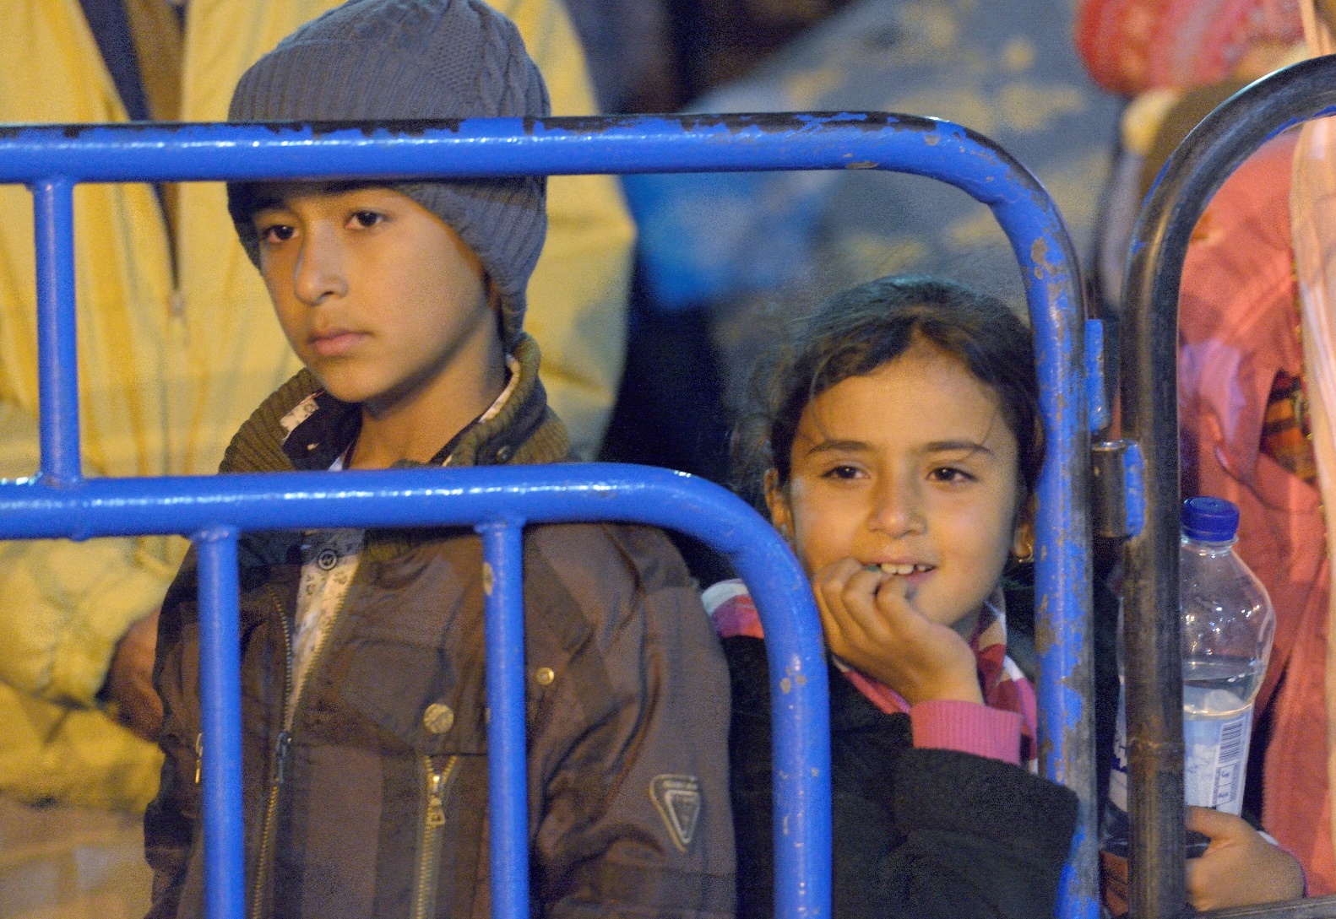
Women and
Children as
Refugees –
between Vulnerability
and Empowerment
CEC Summer School
Thessaloniki
3rd June 2016
Photos: Paul Jeffrey
Notes:
1
Im Arbeitsbereich Rassismus war die Situation und Diskriminerung der Roma Minderheiten seit 1999 Schwerpunkt von CCME. Gemeinsam mit der Konferenz Europäischer Kirche Konferenz in Bratislava:
Leben in Gemeinschaft – auf dem Weg zur Chancengleichheit
und Überwindung von Diskriminierung -
die Situation der Roma in Mittel- und Osteuropa
November 2013: Tagung zu Roma Migration in Europa: Recommendations
Mai 2014, CEC-CCEE Konferenz Athen, Kommuniqué

Slide 2
Who, how many ?
Refugee: someone who „owing to a well-founded fear of being persecuted for reasons of race, religion, nationality, membership of a particular social group or political opinion, is outside the country of his nationality, and is unable to, or owing to such fear, is unwilling to avail himself of the protection of that country."
(UN 1951 Geneva Refugee Convention)
Greek islands (1st Jan 2016-15 May 2016):
38 % children 22 % women out of 155.000 in total (similar for IT)
Globally 41 % of refugees children, 50 % are women
Notes:
2

Slide 3
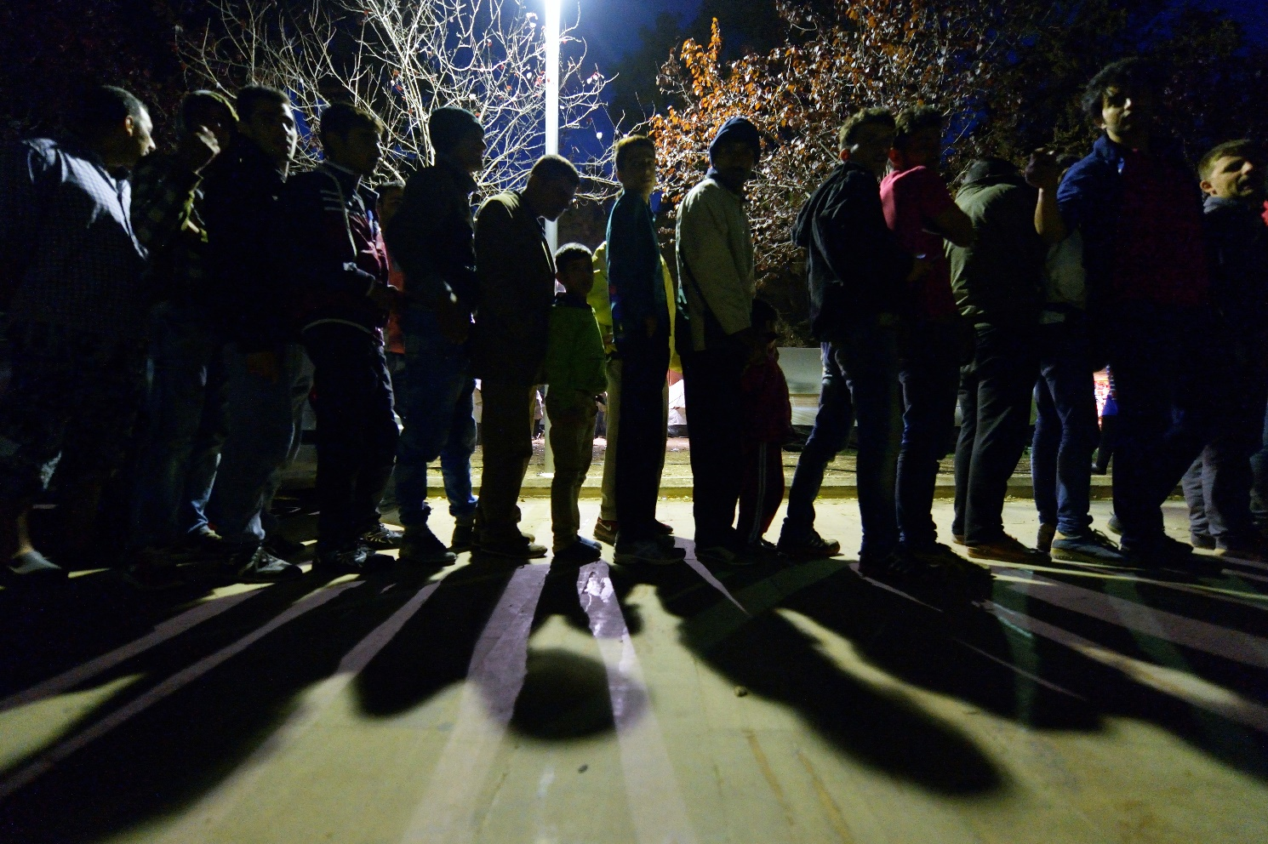
Different roles
As members of families
As those following men who fled before
Fleeing when men are attacked As first /only one to test the water/ to ensure family survival
Different scenarios: on move, in camp, in urban setting
Notes:
3

Slide 4
Challenges and risks
Even more precarious access to rights, discrimination
Gender based violence on the way (smuggling ) and at reception
Health issues (e.g. around childbirth, diseases)
Trafficking in particular women and children
Children recruited into military and warfaring groups
Little say in planning of their environment (e.g. Camp setup)
Often excluded from decision making about own fate
Access to education and livelyhood
Often year-long stay in camp situations
Notes:
4

Slide 5
Policy aspects
UNHCR age, gender and diversity policy: full equality, participatory approach
EU reception conditions directive: Special attention:
Keep family unity
Gender specific concerns in housing to be respected
Take measures against gender based violence
Children:
- Access to schooling
Guardianship
Seperate reception facilities
Take into considerations vulnerability
Framework for durable solutions (full local integration, voluntary return or resettlement)
Notes:
5

Slide 6
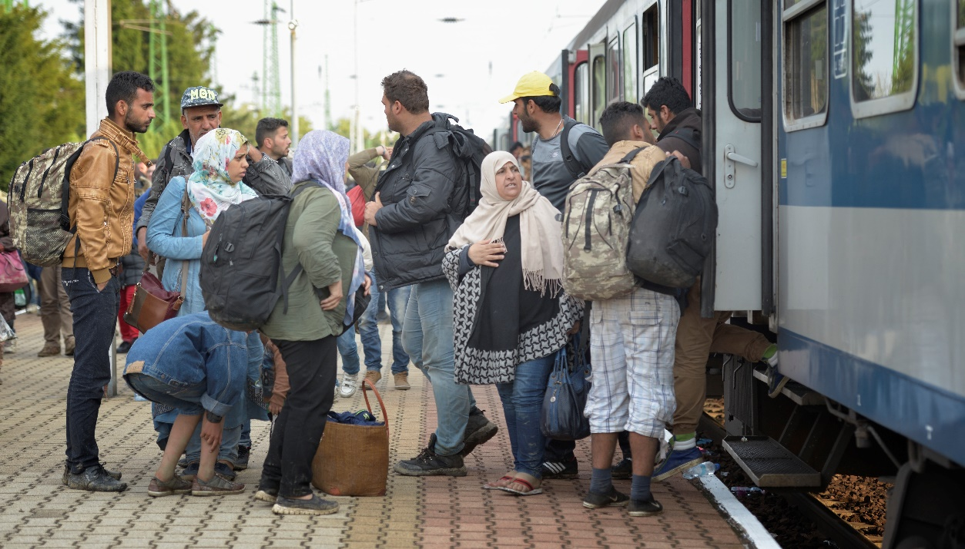
Practical aspects
Safe way of sheltering e.g. In camps
Best Interest of the Child determination at intake at refugee situation
Participatory assesment of risk
Enrolment of children (boys AND girls) in schools
Linking up with national child protection systems
Empowerment programmes
Creation of livelihoods to counter survival sex
Gender sensitive distribution of food and non food items
Protection as cross-cutting issue
Looking at changing family relations
Notes:
6

Slide 7
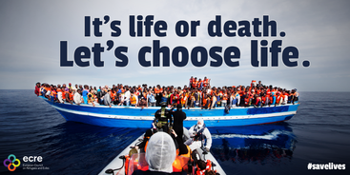
Long term solution: Safe Passage
Access to Europe
Resettlement – emergency and urgency, with UNHCR
Legal entry for labour migrants
Humanitarian visa – principle and limits
Lifting of visa requirements in crisis situation
Reduce smuggling and trafficking
Increase security
Solidarity in Europe
Recognition of protection status
Distribution of recognised refugees more fairly in Europe, possibly also of asylum applicants, considering as priority the desires and personal situation of the persons
Notes:
7

Slide 8
CCME
Thank you for your attention!
Churches’ Commission for Migrants in Europe
Rue Joseph II 174 B-1000 Brussels
www.ccme.eu

