Slide 1
Christof Sauer: Populism, Religious Freedom, and Theological Challenges
Giessen School of Theology, Germany
ETF Leuven, Belgium
Stellenbosch University, South Africa
University of South Africa
International Institute for Religious Freedom

Slide 2
Outline
Populism: Terminology and definitions
Populism: Background
Populists hijacking religion
Christian populism
Religious freedom and populism
Theological challenges

Slide 3
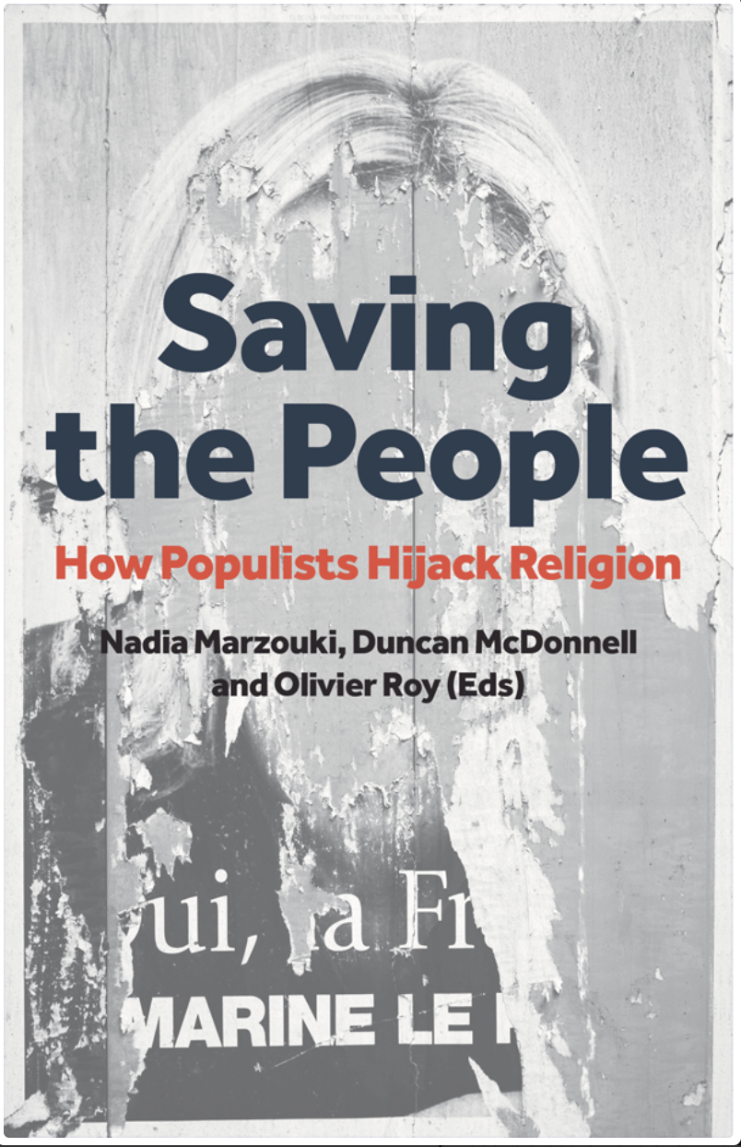
Populism: Definitions
Daniele Albertazzi and Duncan McDonnell
“a thin-centered ideology which pits a virtuous and homogeneous people against a set of elites and dangerous ‘others’ who are together depicted as depriving (or attempting to deprive) the sovereign people of their rights, values, prosperity, identity and voice.”

Slide 4
Populism: Terminology
A loaded term: used to denigrate others
An unprecise term: right wing and left wing
Signifies a broad range of phenomena in different contexts
Alternative terms:
Exclusivist populism: describes the people in an exclusivist way; claims to be the exclusive voice of the whole people
Nativist ideologies: put the indigenous above all others

Slide 5
Populism: Distinctions
Style of politics
(trying to get the favor of the masses)
Type of political party
(narrowly defined: four elements simultaneously combined, and exclusivist reference to the people)
Tim Spier, Professor of Political Science, Siegen, Germany

Slide 6
Populist party: Scholarly Definition (Tim Spier)
People suggested as a unity; denying opposing interests in society
Identity politics: creating identity through an imaginary community; community by exclusion via hostile stereotypes (against elites and minorities)
Leader: Charismatic figure using a standard arsenal of means for gaining attentions,
Organisation: self-description as movement not party; often very hierarchical decision processes

Slide 7
Populist party: Scholarly Definition (Tim Spier)
Combination
“thin centered ideology” + any other ideology
e.g. Characteristics of right wing populism:
Radical nationalism
Strong xenophobia
Authoritarianism
Possible other elements

Slide 8
Populism in action
In government
Party in opposition
Hungary: Fidesz
Poland: Law and Justice
USA: Trumpism
Mainly in former soviet block countries (Halik)
Germany: AfD
Defunct party
Movement
UK: Brexit

Slide 9
Populism: Analysis of Background (Zulehner)
Problems
Societal changes lead to new complexity (Unübersichtlichkeit)
Require increased coping skills
Growing gap between challenges and corresponding competences
Resolution
Borrowing identity
Following charismatic leaders
Offering simplistic solutions for complex problems

Slide 10
Populism: Analysis of Background (Zulehner)
Diagnosis:
Europe is united in a culture of fear since 2008 (Heinz Bude)
Two ways of responding to fears of people
Politics of fear: multiplies fears
Politics of confidence: reduces/overcomes fear

Slide 11
Problems Triggering Populism (Walter Lesch)
Irritation by failure of political elite and crisis of political institutions
Evolution of parallel societies and identitarian communities
Paralysis by excesses of violence, hatred, racism, authoritarianism
Difficulties in dealing with the plurality of cultures, religions, lifestyles …

Slide 12
Attitudes to religion: global picture (Olav Fykse Tveit)
Syncretism: Mixing religions
Freedom from religion: promoting societies and life orientation free of religion
Promoting exclusive identity,
by
Politicizing religion
Nationalizing religion
Using religion as basis for violence

Slide 13
Religion and Populism: Distinctions
Populists not using religion
(but national tradition, liberalism, secularism)
Populists hijacking religion
Religious populists

Slide 14
Populists hijacking Christianity
Drawing on Christian language, imagery and (superficially) Christian concerns.
Varied according to context
Appeal to Europe’s Christian heritage, Christian roots, values, principles, people, identity.

Slide 15
Populists hijacking Christianity
Consider Christianity not as a faith but as an identity
Use of Christianity is alsmost always exclusionary
Favor material and geographic manifestations of the faith over and above personal, spiritual content
The cross is largely emptied of its content. Becomes a comfortable symbol of national cultural identity.

Slide 16
Christian populists
E.g. Hungary
Say, the do not want to grant asylum to Muslim refugees
(In fact don‘t want any refugees)
Say, they only want to accept Christians
(In fact accept very few Christians and send some back)

Slide 17
Religious Freedom and populism
Hostility to minorities
Dividing religious freedom
Tendency to control religion

Slide 18
Theological issues in responding to populism
Identity
Church – State relations
Role of public theology
Strengthening values of democratic discourse
Truth
Human dignity
Service

Slide 19
Questions for discussion
Nationalism vs healthy patriotism
Truth: practices of opinion shaping by lies
Which societal challenges do your recognize in your context?
Red line: Where must churches draw a red line in engaging with populist politicians in the dispute on political issues.

Slide 20
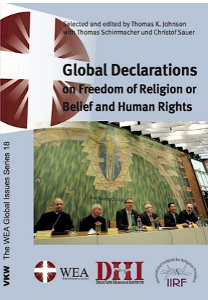
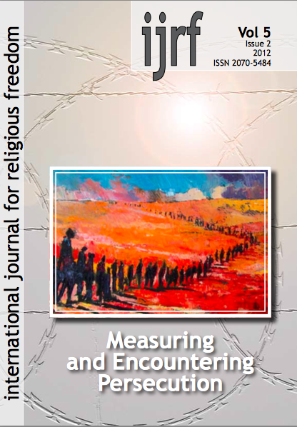
Free @ www.iirf.eu

Slide 21
Bibliography
Browne, Matt, Dalibor Rohac, and Carolyn Kenney: Europe’s Populist Challenge: Origins, Supporters, and Responses. Center for American Progress/ American Enterprise Institute for Public Policy Research. May 2018, 24 pp. www.americanprogress.org
CEC, Public Issues Committee Statements, 5. June 2018 (section on populism)
Cremer, Tobias: Defenders of the faith: why right wing populists are embracing religion. 30 May 2018. New Statesman.
Halik, Tomas: Statement ... im Pressegespräch zum Studientag ”Verständnisgrundlagen des Dialogs mit den Kirchen in Mittel- und Osteuropa”, Pressemitteilung der Deutschen Bischofskonferenz. 21.02.2018
Hoelzl, Michael: Die normative Kraft des Kontrafaktischen: Populistische Positionen zwischen Ideal und Lüge. In: Walter Lesch (ed.): Christentum und Populismus. Freiburg: Herder, 2017, 187-199.
Lesch, Walter: Perspektiven der Auseinandersetzung mit dem Populism in Religion, Politik, und Gesellschaft. In: Walter Lesch (ed.): Christentum und Populismus. Freiburg: Herder, 2017, 200-208.
Marzouki, Naida and Duncan McDonnell and Olivier Roy (eds.): Saving the people. How populists hijack religion. Hurst 2016
Reclaiming Jesus: A confession of faith in a time of crisis. USA. ReclaimingJesus.org.
Rising Populism Threatens International Religious Freedom. www.sharedjustice.org 2017.
Spencer, Nick: The rise of Christian populism. 6 October 2017. First published in: The Bible in Transmission. www.biblesociety.org.uk
Spier, Thomas: Was versteht man unter „Populismus“? Bundeszentrale für Politische Bildung, 25.9.2014.
Thielmann, Wolfgang (ed.): Alternative für Christen? Die AfD und ihr gespaltenes Verhältnis zur Religion. Neukirchener Verlag 2017.
Tveit, Olav Fykse: Accountability in global leadership. Speech at World Economic Forum, -Davos, January 2017. www.WCC-COE.org
Weidinger, Bernhard: Equal before God, and God Alone: Cultural Fundamentalism, (Anti-) Egalitarianism, and Christian Rhetoric in Nativist Discourse from Austria and the United States. Journal of Austrian-American History, Vol. 1, No. 1 (2017), 40-68.
Woelki, Kardinal Rainer Maria: Entschieden für Menschenwürde und Menschenrechte: Zur kirchlichen Haltung gegen Rechtspopulismus. In: AfD, Pegida und Co.: Angriff auf die Religion? Edited by Stefan Orth and Volker Resing, Freiburg: Herder 2017, 9-35.
Zulehner, Paul M.: Zum Rechtspopulismus in Europa: Gründe und Gegenstrategien. In: AfD, Pegida und Co.: Angriff auf die Religion? Edited by Stefan Orth and Volker Resing, Freiburg: Herder 2017, 181-190.

Slide 22
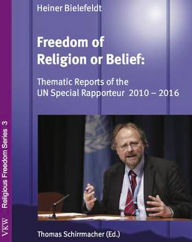
Heiner Bielefeldt: Freedom of Religions of Belief,
Bonn 2017.
(UN Special Rapporteur for Freedom or religion or belief)
Online: www.iirf.eu

